Slide 1

Indirect Costs and How to Use Them
VASBO Conference
May 16, 2023
Bill Bowen
York County School Division
David Rubenstein
South Panola School District, MS

Slide 2
What are indirect costs?
Indirect costs are LEAs, general management costs. General management costs consist of administrative activates necessary for the general operation of the LEAs, such as accounting, budgeting, payroll preparation, personnel services, purchasing and centralized data processing.
2 CFR 200.414

Slide 3
What are direct costs?
Direct costs are costs that provide measurable, direct benefits to particular programs.

Slide 4
What is an indirect cost rate?
Indirect cost rate is the percentage of an LEAs indirect costs to its direct costs and is a standardized method of charging individual federal programs for their share of indirect costs.

Slide 5

Indirect cost

Slide 6
Types of indirect cost rates?
Restricted Rate
Unrestricted Rate

Slide 7
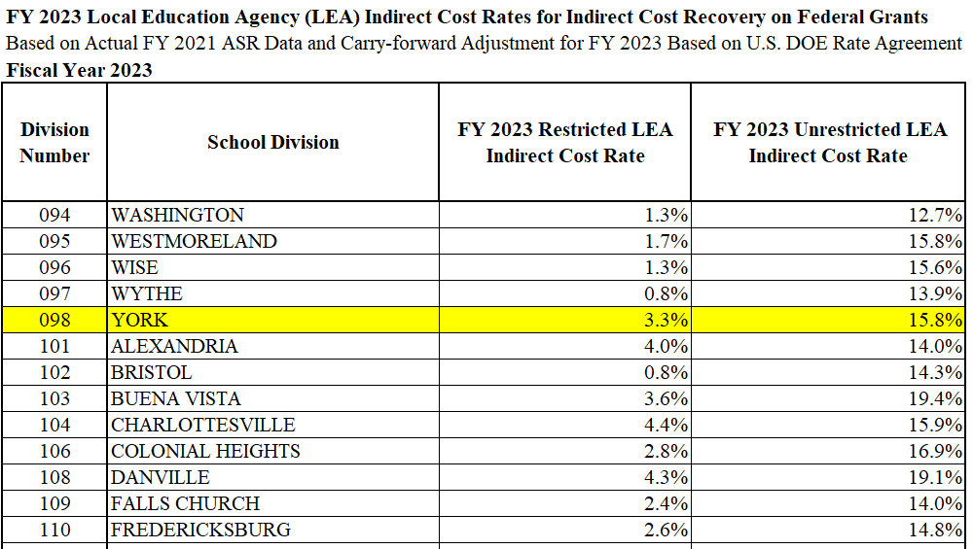
Restricted and Unrestricted Rates in VA
https://www.doe.virginia.gov/data-policy-funding/school-finance/budget-grants-management

Slide 8
Restricted indirect cost rate
Restricted rates apply to grants that are made under federal programs with “supplement but not supplant” requirements. Federal funds are for support in addition to state and local funding. Such amounts are intended to supplement, but not replace, local funds.
34 CFR 76.563

Slide 9
Grants with restricted indirect cost rate
Title I
Title II
Title IV
Title V
IDEA
IDEA, Preschool

Slide 10
Unrestricted indirect cost rate
Unrestricted rates apply to grants not subject to the “supplement but not supplant”.

Slide 11
Grants with unrestricted indirect cost rate
Food Service
ESSER I
ESSER II
ARP ESSER

Slide 12
Differences between restricted and unrestricted indirect cost rate
Indirect costs – the unallowed portion of executive administrative services, governing body of the grantee, divisional administration limited to one component, and operation of the CEO, direct reports and the immediate offices, as well as the direct portion of operation and space maintenance costs related to these functions, are classified as an indirect cost when calculating an unrestricted rate.
34 CFR 76.565; 34 CFR 76.567

Slide 13
How to determine your indirect cost rates?
The VDOE applies to the USDOE on behalf of school divisions
Information comes from the Annual School Report
Fiscal year 2024 indirect cost rates are based on expenditures from fiscal year 2022

Slide 14
Excluded costs
Property
Facilities acquisition and construction (except district-level management)
Food service – Food, donated commodities, production supplies, and equipment
Subawards in excess of $25,000
Debt
Judgments, fines and penalties

Slide 15
Unallowed Costs
Board of education
Executive administrative services

Slide 16
Indirect Costs
Business administrative services
Support services - central

Slide 17
Direct Costs
All other expenditures

Slide 18
Virginia School Divisions
Indirect Cost Rates for FY 2024
https://www.doe.virginia.gov/data-policy-funding/school-finance/budget-grants-management

Slide 19
Applying the Indirect Cost Rates

Slide 20
Restricted Indirect Cost Rate
Example
  Fixed grant amount $200,000
  Unallowable expense $ 5,000
  Restricted rate 3.00%

Slide 21
Restricted Indirect Cost Rate
Calculation
  Fixed grant amount $200,000
  Less: Unallowable expense $ 5,000
  New avail for direct & indirect $195,000
  Divide $195,000 by 1.03 (100% of direct cost plus 3% indirect cost) = $189,320.39 (amount of direct cost)

Slide 22
Restricted Indirect Cost Rate (continue)
  Subtract the direct cost $189,320.39 from the net avail for direct and indirect $195,000 = $5,679.61 indirect cost
  Check: $189,320.39 * 3.00% = $5,679.61 indirect cost

Slide 23
Restricted Indirect Cost Rate (continue)
Project budget
  Direct costs $189,320.39
  Indirect cost $ 5,679.61
  Unallowable expense $ 5,000.00
  Grant $200,000.00

Slide 24
Unallowable Expense
Property
Facilities acquisition and construction (except district-level management)
Food service – Food, donated commodities, production supplies, and equipment
Vendor contract in excess of $25,000
Debt
Judgments, fines and penalties

Slide 25
Unrestricted Indirect Cost Rate
Example
  Fixed grant amount $500,000
  Unallowable expense $175,000
  Restricted rate 15.00%

Slide 26
Unrestricted Indirect Cost Rate
Calculation
  Fixed grant amount $500,000
  Less: Unallowable expense $175,000
  Allowable Expenditures $325,000

Slide 27
Unrestricted Indirect Cost Rate (continue)
  Allowable Expenditures $325,000.00
  Multiply unrestricted rate 15%
  Indirect Cost $48,750.00

Slide 28
What rate to use for a Grant?
Use the current year indirect cost rate for the expenditures.

Slide 29
Multiple Year Grant
Restricted Indirect Cost Rate
 | FY 2021 | FY 2022 | FY 2023 | Total
Expenditures | 750,000.00 | 837,695.08 | 1,741,005.00 | 3,328,700.08
Unallowable | 50,000.00 | 154,874.00 | 385,215.25 | 590,089.25
Eligible | 700,000.00 | 682,821.08 | 1,355,789.75 | 2,738,610.83
IC Rate | 3.50% | 3.16% | 4.01%
Indirect Cost | 23,671.50 | 20,916.19 | 52,271.10 | 96,858.79

Slide 30
Journal Entry
  Debit – Grant indirect cost expenditure
  Credit – Grant cash
  Debit – General operating fund cash
  Credit – General operating fund indirect cost revenue

Slide 31
Questions
Bill Bowen
Chief Financial Officer
York County School Division
wbowen@ycsd.york.va.us
David Rubenstein
Director of Finance & Business Operations
South Panola School District, Mississippi
drubenstein@spanola.net

