Slide 1
2022 Virginia Association of School Business Officials (VASBO)
Individual With Disabilities Act IDEA Fiscal Requirements
Tracie Coleman, Director
Office of Special
Education Finance and Budget
Special Education and Student Services
May 18, 2022

Slide 2












OFFICE OF SPECIAL EDUCATION
FINANCE AND BUDGET (FAB)
Tracie Coleman, Director
Cynithia Reid
Paul Raskopf
Angela Phenicie
Devin
Larson
Jo Ann Burkholder
Terry Eckhout
Samantha Tansey
Shalonda Lewis
Denise Lawus

Slide 3
Objective: Review constructs necessary for managing Special
Education State, Federal and Local funds
Gain an Understanding of:
  The state and federal funding resources, regulations, and funding cycles
  The federal funding formula used to determine IDEA allocation and the approved IDEA application /Mandatory Annual Plan necessary to receive funding
  The IDEA Fiscal Data Reporting requirements
      Maintenance of Effort - MOE (Eligibility and Compliance)
      Excess Cost
      Proportionate Set-Aside (Equity Services)
      Comprehensive Coordinated Early Intervening Services (CCEIS) or Coordinated Early Intervening Services (CEIS)
  Allowable use of IDEA funds and required VDOE/USED pre-approval for certain expenditures

Slide 4
Presentation Sections
Section One | Funding
Section Two | IDEA Part B Funds
Section Three | LEA Annual Plan Application, Managing and Using Funds
Section Four | IDEA Fiscal Data Reporting Requirements

Slide 5

SECTION ONE – FUNDING
Funding Sources
Local/State Budget Cycle
State Budget Process

Slide 6
Funding Sources
Local
State
Federal
Special Funds
  (food Service, capital outlay, private grants, fees, etc.,)

Slide 7
Local and State Budget Cycle
  October/November
        Local Schools Routinely Start Budget Discussions
December, 1st Year of Biennial
        State Biennial Projections (mid-December)
  January – March/April
          Public Meetings and Public Hearings
  April/May
            Local Governments Appropriate Funds

Slide 8
State Budget Process
Virginia has a biennial budget cycle (i.e., two fiscal years)
Biennial budget is developed by the Governor and submitted to the General Assembly (GA) in December of odd years
Final Budget must be approved by the GA
Budget can be amended by the Governor and/or the GA during the subsequent two years
The Standards of Quality (SOQ) funding model is updated during each biennial budget in a process called “rebenchmarking"
http://doe.virginia.gov/school_finance/budget/calc_tools/2020-22/calc-2022-veto-apr20.xlsm

Slide 9

SECTION TWO – IDEA PART B FUNDS
  IDEA PART B Federal Funds
  IDEA PART B Federal Regulatory Overview
  IDEA PART B Federal Funding: A Few Facts
  IDEA PART B Allocation Timeline
  IDEA PART B Allocation Amounts

Slide 10
IDEA Part B Federal Regulatory Overview
Federal Reference Guide
    34 CFR* Parts 300 and 301; Assistance to States for the Education of Children with Disabilities and Preschool Grants for Children with Disabilities
Federal Funding Types
    IDEA Part B, 611 Flow-through Funds**
    IDEA Part B, 619 Preschool Funds
* “CFR” means Code of Federal Regulations – it is the codification of the general and permanent rules published in the Federal Register by the executive departments and agencies of the Federal Government
** “Flow-through” means federal funds received from USED to VDOE to school divisions. VDOE is the fiscal steward of these funds and is held responsible/monitored by USED. VDOE approves LEA IDEA plan applications, distribution of allocations, approves allowable expenditures and requests school division reimbursement amounts from USED as directed by federal IDEA regulations and the Federal Uniform Guidance rules and requirements for grants management, etc.

Slide 11
IDEA Federal Funding: A Few Facts
Federal funds are available both for preschool (619) and school-age (611) special education programs
The amounts received by each school division are determined by a formula that considers historical federal funding, total school enrollment, and poverty level
School divisions must apply annually for any federal funds
School divisions cannot commingle federal special education funds with other funds
Upon approval from VDOE, the school division may spend the money and then is reimbursed for approved expenditures

Slide 12
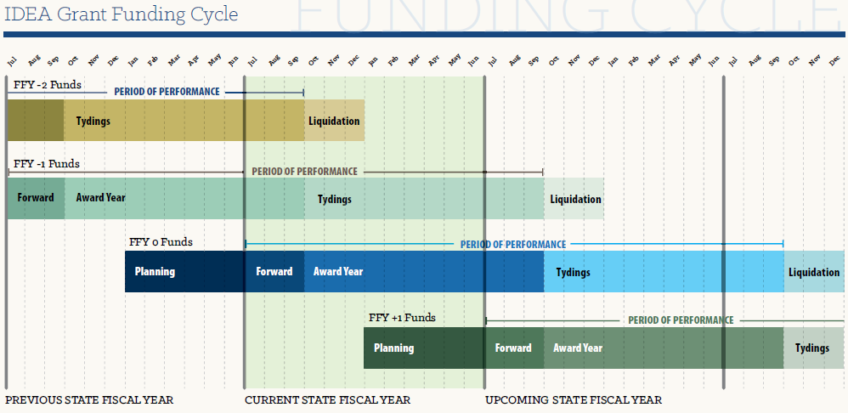
I
SEA Part B Allocation Award Cycle:
Annually LEAs receive new allocations that must be encumbered by September 30th of the next year of an award period
* “FFY” means Federal Fiscal Year – October 1 – September 30
10/2019-9/2021
10/2020-9/2022
10/2021-9/2023
10/2022-9/2024
Virginia’s fiscal year is July – June – this slide shows the relationship for planning between the state and federal fiscal periods
Notes:
An Approved Annual Application Allows LEAs to Receive IDEA Funding
.

Slide 13
IDEA Part B Award Timeline
Federal Fiscal Year ( FFY2020, FFY2021, FFY2022*)
  October 1 through September 30
Availability of Funds,
  27 Months to Commit, ex., July 1, 2021 – September 30, 2023
  Final Reimbursements Due November 15th
2021 - Current Award Year and Amounts
    611 Funds = $312,492,610 and 619 Funds = $9,498,374
    One-Time Only Funds - American Rescue Plan (ARP) – Add on-funds
    611 ARP Funds = $67,799,708 and 619 ARP Funds = 4,931,537
Notes:
Make sure dollar amounts and year is correct

Slide 14
IDEA Part B Allocation of
611 AND 619 Funds (FFY2021)
611 = $312,492,610
  (H027A210107, CFDA# 87.027)
619 = $9,498,374
  (H173A210112, CFDA # 87.173)
Flow-through
  $275,916,518
State Set-Aside
  $30,309,299
Administration
  $6,266,722
Flow-through
  $6,995,312
State Set-Aside
  $2,503,062
Administration
  $501,544 (max)
Notes:
This is to be replaced with slide #29

Slide 15
Allocation of 611and 619 Funds –
Including ARP
Funding Category | 611= $312,492.610 (H027A210107, CFDA# 87.027) | 611 (ARP) = $ 67,799,708 |  | 619 = $9,4498,374 (H173A210112,CFDA #87.173) | 619 (ARP) = $ 4,931,537
Flow-Through | $275,916,518 | $ 67,799,708 |  | $ 6,995,312 | $ 4,926,875
State Set-Aside | $ 30,309,299 | $ 00 |  | $ 2,503,062 | $ 4,662
Administ-ration | $ 6,266,722 | $ 00 |  | $ 501,544 | $ 00
Total | $379,943,121 |  |  | $14,429,911
Notes:
Found information for this on
S:\SESS\FINANCE\BudgetDocs– Award Comparison – FFY20va FFY21 w-ARP-rev07-14.21

Slide 16
Example: Recap of LEA Funding Formula
Description | Amount
Total Allocation | $275,916,518
Base Allocation – subtract from total | $79,717,764
Subtotal | $196,198,754
Census Allocation (85% of Total Allocation minus Base) | $166,768,941
Poverty Allocation (15% of Total Allocation minus Base) | $29,429,813

Slide 17

SECTION THREE – IDEA ANNUAL PLAN APPLICATION, MANAGING AND USING FUNDS
Annual Plan
Managing IDEA Funds
Resources

Slide 18
ANNUAL PLAN APPLICATION
IDEA Application Excel Workbook
IDEA Annual Plan Application Required Components
Key Planning Points for Completing the Application
IDEA Annual Plan Excel Workbook and Tabs

Slide 19
Annual Plan Application
The Special Education Annual Plan/Part B Flow-Through Application serves as the formal agreement between a local school board and the Virginia Department of Education (VDOE) for implementing federal and state laws and regulations governing special education services
Accordingly, the disbursement of state and federal funds appropriated for the education of children with disabilities is contingent upon the approval of this plan and each of its components
Thus, the Annual Plan application submitted by a school division is a request to become eligible to receive IDEA Part B funds, and if found eligible, agrees to comply with all legal assurances and regulations governing this funding

Slide 20
Annual Plan Application
Required Components
The Superintendent's Certification (completed electrically)
Policy Statements
Statement of Assurances
Maintenance of Effort (MOE) Requirements
Proportionate Set-Aside (PSA) (parentally placed private school children)
Comprehensive Coordinated Early Intervening Services (CCEIA) or Coordinated Early Intervening Services (CEIS) (up to 15%)
The Report on the Implementation of Last Year’s Plan
The Application for Use of Federal Funds for Sections 611 and 619

Slide 21
Key Planning Points
  Read and discuss the Application requirements (may want to refer to previous applications).
  Review Superintendent’s Memo, and be aware that the Application is normally due to the Virginia Department of Education (VDOE) in mid-May.
  Meet with key personnel in the offices of finance, instruction, and the superintendent (recommend doing early in the school division’s budget development cycle).
  Gain access to
      Single Sign-on for Web Systems-SSWS (initiated locally) and
      Online Management of Education Grant Awards-OMEGA (omega.support@doe.virginia.gov)

Slide 22
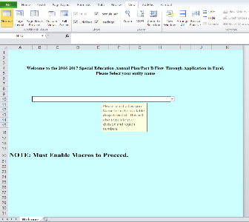
Annual Plan Application Excel Workbook
An approved Annual Plan application allows the LEA to be eligible to receive federal special education funds
The workbook is uploaded to VDOE for review
DUNS numbers were added to the 2016-2017 Annual Plan Application

Slide 23
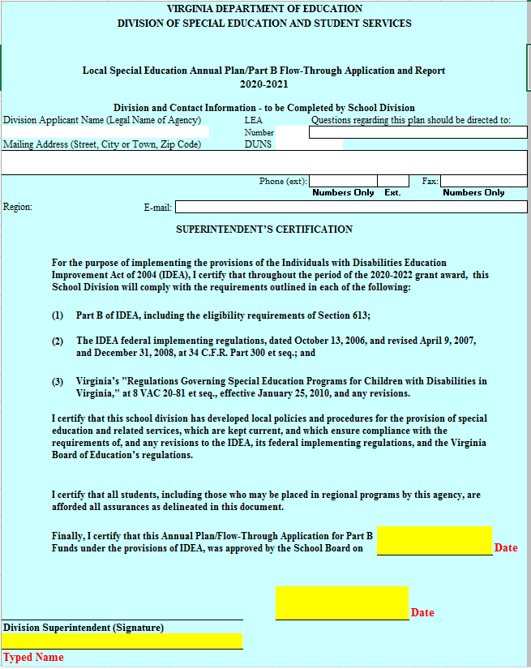
Excel Plan/Application:
Workbook Tabs
Welcome
LEA Instructions
Cover & Certifications
LEA Assurances & Certifications
LEA Local & Regional Jails (Not applicable for SOPs)
Implementation Narrative
MOE Eligibility
CEIS & PSA (Not applicable for SOPs)
Section 611
Section 619

Slide 24
Prior to Submission
Each school division shall
  Review the Application with its local special education advisory committee
  Submit the Application to the local school board for approval
    SOPs are required to submit their Application to the State Special Education Advisory Committee
    The VSDB is required to submit its Application to its board for approval and then to the State Special Education Advisory Committee
Superintendent must complete the electronic signature (Maintain Copy for Audit Purposes)
The Application must be completed and submitted electronically

Slide 25
What‘s Next?
Once the Application is completed, submitted through OMEGA and approved, the budget is loaded in OMEGA, then reimbursement request can be made. The budget will open for use in OMEGA approximately the first week of July. However, the application must be approved before funds are made available to divisions.
Spend Funds in Accordance with Approved Application
  Submit Application Amendments, if there are major changes to how funds are being used
  Submit Budget Amendments, if necessary for category spending changes
Submit Timely Reimbursement Requests (monthly or quarterly)
Maintain Time & Effort Reports and other Supporting Documentation

Slide 26

Managing and Using Funds
LEA Responsibilities
Use of Funds
Things to Remember
SPED Office of Finance and Budget (FAB) Fiscal Information Link and Resources

Slide 27
LEA Responsibilities
Procurement mechanisms conform to Federal and State laws and standards
LEAs must document time and effort in accordance with the Uniform Guidance (formerly OMB Circular A-87) for employees funded from federal grant sources. https://www.ecfr.gov/cgi-bin/text-idx?SID=6214841a79953f26c5c230d72d6b70a1&tpl=/ecfrbrowse/Title02/2cfr200_main_02.tpl
LEAs must maintain financial and programmatic records as required by Federal and State law
General Rule – Sole Use of property purchased with Part B funds
LEAs must maintain a physical inventory of property purchased with Part B funds (IPads, computers, etc.)

Slide 28
Use of Funds
Generally, grant recipients already know what is reimbursable since awards are issued only after applications are received, reviewed and approved
Applicants are informed prior to issuance of an award, of any proposed expenditures determined to be inappropriate, improper or otherwise not approvable
IDEA funds must only be used to pay for the excess costs of providing special education and related services to children with disabilities. To determine if a cost is allowable, the VDOE follows the Uniform Grant Guidance (UGG) at 2 CFR §§ 200.403 - 405. Costs must be necessary, reasonable, allocable, and adequately documented

Slide 29
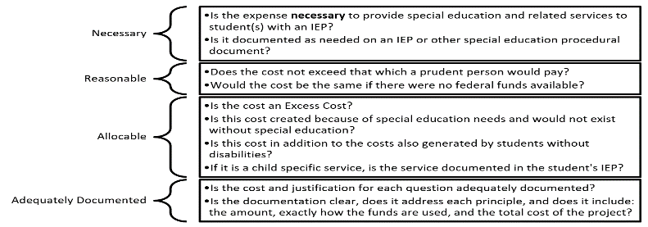
Allowable Cost Test

Slide 30
Use of Funds (continued)
Out-of-state and out-of-country travel must be approved by the Virginia Department of Education in advance
Travel expenses (in-state and out-of-state) charged to federal grant awards may not exceed the maximum amounts permitted by Virginia state government travel regulations http://www.doe.virginia.gov/boe/regulations/travel_regs/travel_regulations.pdf
Equipment items must be approved in advance by the Virginia Department of Education. Equipment is defined as any item costing $5,000.00 or more

Slide 31
Fiscal Data Submission Chart At A Glance
Fiscal Data | Data collection window opens | When is it due | Is this data used in developing the Annual Plan Application | Is there additional information needed after the Annual Plan Application is approved
IDEA Application/Annual Plan | January – Upload Application | May | The annual plan includes sections of the majority of the data reports below | Maybe, changes may be made through a budget amendment and an email to the FAB Office
Excess Cost | April | May | It is submitted at the same time as the annual plan application | No, must be submitted and approved to receive funding.
MOE Compliance | December | January | Yes, the data is used to develop the budget to meet MOE eligibility | No, but monitoring of expenditures is required
MOE Eligibility | January | May | Yes, the budget must meet or exceed the compliance amount submitted in January | No, but collaboration on SPED budgeting is necessary
Proportionate Set-Aside | October | November | Yes, the data is used to develop the budget | Yes – to determine if budget changes are needed
CEIS | None | May – Budget is submitted in Annual Application | Yes, if the division voluntarily elects to use up to 15% of the allocation | Yes – A specific plan
Comprehen-sive CEIS | Data calculation is completed by SEPI | October - SEPI provides information to LEAs | Yes – 15% of allocation must be budgeted for CCEIS | Yes – A specific plan is developed for the use of the 15% and submitted to

Slide 32

SECTION FOUR – IDEA FISCAL DATA REPORTING REQUIREMENTS
  Maintenance of Effort - MOE (Eligibility and Compliance)
  Excess Cost
  Proportionate Set-Aside/Equitable Services
  Comprehensive Coordinated Early Intervening Services (CCEIS) or Coordinated Early Intervening Services (CEIS)

Slide 33
Maintenance of Effort: Why Is It Required and What Does It Mean?
MOE is required to ensure that LEAs do not replace state/local dollars with federal funds.
MOE means that, in each year for the education of children with disabilities, an LEA:
  Budgets state and local dollars for at least as much as it expended in the most recent year it met MOE. This component of the MOE is referred to as the “Eligibility Standard”
  Expends at least as much as it expended in the most recent year it met MOE. This component of the MOE is referred to as the “Compliance Standard”
Reference: Virginia Department of Education, IDEA Maintenance of Effort Guidance Document, page 1-2
Notes:
The term Maintenance of Effort, often shortened to MOE, refers to the requirements placed upon many federally funded grant programs, that a recipient demonstrate the level of local funding for a particular program remain constant from year-to-year.
The local MOE requirement obligates any LEA receiving IDEA Part B funds to budget and spend at least the same amount of local – or state and local – funds for the education of children with disabilities on a year-to-year basis.
The intent behind the MOE requirement is to help ensure that the SEA and LEAs are expending at least a certain level of non-federal funds for the education of students with disabilities. The required MOE levels for budgeting and spending are referred to, respectively, as the “eligibility standard” and the “compliant standard.”
Failure to meet MOE requirements may result in the LEA losing eligibility to receive federal funding, or a reduction in the amount the LEA would receive, or a repayment of funds.

Slide 34
Four Methods for Calculating LEA MOE
Total amount of local funds
Total amount of state and local funds
Per capita amount of local funds
Per capita amount of state and local funds
Reference: Virginia Department of Education, IDEA Maintenance of Effort Guidance Document, page 1-2
Notes:
Both the eligibility and compliance standard regulations refer to four sources for LEA MOE. These sources are really four ways to calculate/test the LEA MOE methods for determining if the eligibility and compliance standards were met.
There are only two sources of funds for LEA MOE — local and state — and four methods that LEAs may use to meet the LEA MOE standards. The methods are: the total amount of local funds, the total amount of combined state and local funds, the per capita amount of local funds, and the per capita amount of combined state and local funds. Per capita refers to the amount per child identified for special education under Part B of I-D-E-A. The total number of these children comes from the official child count of children with disabilities. This child count occurs in December; LEAs submit to the VDOE for submission to OSEP each February.
For per capita methods, you divide the total amount of funds, whether local only or combined state and local, that was budgeted or expended, for the education of children with disabilities, depending on whether you are calculating eligibility or compliance, by the official child count that was submitted to the VDOE, for the same state fiscal year for which you are calculating LEA MOE.
An LEA is allowed to use any of these four methods each state fiscal year.

Slide 35
What is
What is
MOE Eligibility Standard
Determines whether an LEA is “eligible” to receive the IDEA Part B Allocations
LEA must budget amounts same as or greater than prior closed year expenditures
Completed in the IDEA Annual Plan/Application due in May
MOE Compliance Standard
Determines whether an LEA is in “compliance” by the expenditure of state and local dollars
LEA expenditures is a two-year comparison
Expenditures are based on the State Fiscal Year
Completed in the MOE data Report due in January
Four methods of calculation tests are used to determine if the LEA met the Standards
Notes:
LEA MOE Regulation 34 CFR §300.203(a)(1)
Eligibility standard. (1) For purposes of establishing the LEA’s eligibility for an award for a fiscal year, the SEA must determine that the LEA budgets, for the education of children with disabilities, at least the same amount, from at least one of the four methods of calculation, as the LEA spent for that purpose from the same source for the most recent (state) fiscal year for which information is available – i.e., using verified or audited data.
LEA MOE Regulation 34 CFR §300.203(b)
Compliance standard. (1) Except as provided in 34 CFR §§300.204 and 300.205, funds provided to an LEA under Part B of the Act must not be used to reduce the level of expenditures for the education of children with disabilities made by the LEA from local funds below the level of those expenditures for the preceding fiscal year.
Generally, this requirement states that an L-E-A must expend at least as much in a state fiscal year as it expended in the preceding fiscal year – equal to or more than what was budgeted in the annual plan.

Slide 36
The Eligibility Standard
LEA MOE Regulation
34 CFR §300.203(a)(1) (
Eligibility standard. (1) For purposes of establishing the LEA’s eligibility for an award for a fiscal year, the SEA must determine that the LEA budgets, for the education of children with disabilities, at least the same amount, from at least one of the FOUR sources, as the LEA spent for that purpose from the same source for the most recent fiscal year for which information is available.
Notes:
Let’s talk first about the eligibility standard.

Slide 37
KNOWLEDGE CHECK
Pick one response for the following:
To make sure I’m eligible for my IDEA allocation, I have to budget at least as much as I…
intend to spend next year.
spent for the same purpose from the same source last year.
spent for the same purpose from the same source in the most recent year for which I have information available.
spent for the same purpose from the same source in the most recent year for which I have information available and met MOE.
Notes:
Let’s see how well you understand this regulation by checking your knowledge with a short quiz. To make sure you are eligible for your subgrant, you have to budget at least as much as you…. Which one of the four sentence completion choices is best? Take a minute to review the choices and then we’ll see how you did. [Presenter’s Note: Allow time for audience to read and think a minute about the choices before proceeding.]
It’s not number 1, because the division needs to budget at least as much as it intends to spend next year; however, the eligibility standard for LEA MOE has additional requirements about spending in previous years.
It’s not number 2 — For eligibility, data for the year immediately before the budget year — last year — is not final and verified, so it cannot be used as comparison data.
It’s not number 3 —It’s true that you must compare to the most recent year for which you have information available, but if you did not meet M-O-E in that year, you must go back further.
So number 4 is correct and is: Spent for the same purpose from the same source in the most recent year for which I have information available and met MOE. We’ll hear more about this a little bit later.

Slide 38
KNOWLEDGE CHECK - Answer #1
To make sure I’m eligible for my IDEA allocation, I have to budget at least as much as I…
    Incorrect 1) intend to spend next year.
It’s not number 1, because the division needs to budget at least as much as it intends to spend next year; however, the eligibility standard for LEA MOE has additional requirements about spending in previous years.

Slide 39
KNOWLEDGE CHECK - Answer #2
To make sure I’m eligible for my IDEA allocation, I have to budget at least as much as I…
Incorrect 2) spent for the same purpose from the same
source last year.
It’s not number 2 — For eligibility, data for the year immediately before the budget year — last year — is not final and verified, so it cannot be used as comparison data.

Slide 40
KNOWLEDGE CHECK - Answer #3
To make sure I’m eligible for my IDEA allocation, I have to budget at least as much as I…
Incorrect 3) spent for the same purpose from the
        same source in the most recent year for which I have information available.
It’s not number 3 - It’s true that you must compare to the most recent year for which you have information available, but if you did not meet MOE in that year, you must go back further.

Slide 41
KNOWLEDGE CHECK - Answer #4
To make sure I’m eligible for my IDEA allocation, I have to budget at least as much as I…
CORRECT 4) spent for the same purpose from the
        same source in the most recent year for which I have information available and met MOE.

Slide 42
Eligibility (Budget) Standard:
Two Scenarios
A.
An LEA expended $1,000,000 and met LEA MOE in SFY 2021. In SFY 2023, it budgets $900,000.
B.
An LEA expended $900,000 and met LEA MOE in SFY 2021. In SFY 2023, it budgets $1,000,000.
Notes:
Here are two basic examples of how the eligibility standard plays out. In these examples, an LEA’s level of effort is being calculated under the eligibility standard for state fiscal year 2020. Take a moment to review these examples individually.
The main point of these examples is to give you a foundational understanding of the eligibility standard. Let me ask you, does the LEA meet the eligibility standard in both examples, one of the examples, or neither example?
The Answer is the LEA meets the eligibility standard in example B, because the LEA budgeted more ($1,000,000 in 2023) than it expended in the most recent year for which it had audited data ($900,000 in 2021).] Okay, in example A, the LEA did not meet the MOE eligibility requirement for an SFY 2023 grant award because it budgeted less for SFY 2023 than it expended in SFY 2021.
Also, the state fiscal years in the example may stand out to you. Let’s talk through that. When applying for IDEA Part B funds for SFY 2023, an LEA needs to compare its budget to the last year it has verified expenditure numbers that demonstrated it met LEA MOE. For most LEAs, the most recent year with verified data would be SFY 2021. If an LEA met LEA MOE in SFY 2021, it would need to budget for SFY 2023 at least what it spent in SFY 2021 to meet the eligibility standard.
Then, you can see how SFY 2022 would be an intervening year between SFY 2021 and SFY 2023. The concept of intervening years may be relevant when applying exceptions and adjustments. We’ll revisit this topic, and work through examples applying it, once we’ve reviewed the exceptions and adjustment themselves.

Slide 43
Eligibility (Budget) Standard:
Two Scenarios
The Answer is the LEA meets the eligibility standard in example B, because the LEA budgeted more ($1,000,000 in 2023) than it expended in the most recent year for which it had audited data ($900,000 in 2021).
In example A, the LEA did not meet the MOE eligibility requirement for an SFY 2023 grant award because it budgeted less for SFY 2023 than it expended in SFY 2021.
Notes:
Here are two basic examples of how the eligibility standard plays out. In these examples, an LEA’s level of effort is being calculated under the eligibility standard for state fiscal year 2020. Take a moment to review these examples individually.
The main point of these examples is to give you a foundational understanding of the eligibility standard. Let me ask you, does the LEA meet the eligibility standard in both examples, one of the examples, or neither example?
The Answer is the LEA meets the eligibility standard in example B, because the LEA budgeted more ($1,000,000 in 2023) than it expended in the most recent year for which it had audited data ($900,000 in 2021).] Okay, in example A, the LEA did not meet the MOE eligibility requirement for an SFY 2023 grant award because it budgeted less for SFY 2023 than it expended in SFY 2021.
Also, the state fiscal years in the example may stand out to you. Let’s talk through that. When applying for IDEA Part B funds for SFY 2023, an LEA needs to compare its budget to the last year it has verified expenditure numbers that demonstrated it met LEA MOE. For most LEAs, the most recent year with verified data would be SFY 2021. If an LEA met LEA MOE in SFY 2021, it would need to budget for SFY 2023 at least what it spent in SFY 2021 to meet the eligibility standard.
Then, you can see how SFY 2022 would be an intervening year between SFY 2021 and SFY 2023. The concept of intervening years may be relevant when applying exceptions and adjustments. We’ll revisit this topic, and work through examples applying it, once we’ve reviewed the exceptions and adjustment themselves.

Slide 44
The Compliance Standard
LEA MOE Regulation
34 CFR §300.203(b)
Compliance standard. (1) Except as provided in 34 CFR §§300.204 and 300.205, funds provided to an LEA under Part B of the Act must not be used to reduce the level of expenditures for the education of children with disabilities made by the LEA from local funds below the level of those expenditures for the preceding fiscal year.
Notes:
[NO CUSTOMIZATION: SEE PRESENTER’S NOTE IN “GUIDE TO SLIDES”]
The regulation at 34 C-F-R Section 300 point 2-0-3-b is the compliance standard.
Generally, this requirement states that an L-E-A must expend at least as much in a state fiscal year as it expended in the preceding fiscal year. That’s a short way of saying it, but it can be complicated, so let’s break down a few key terms.
Quote — except as provided in 34 C-F-R Sections 300 point 2-0-4 and 300 point 2-0-5 — end quote, is a reference to the regulations governing exceptions and the adjustment to L-E-A M-O-E. It essentially means that those exceptions and the adjustment apply to the compliance standard. As with the eligibility standard, we’ll look at the exceptions and adjustment provisions in more detail later.
Expenditures means that the compliance standard is about spending, not budgeting.
Quote — below the level of those expenditures for the preceding fiscal year — end quote … refers to the preceding state fiscal year.
Before we move on to a compliance example, take a minute to reflect and write down any questions you may have about the general concept or regulatory language of the compliance standard.

Slide 45
MOE Compliance Standard
Collaboration
Local or state or local and state funds spent
Accurately Categorized Expenditures
Examples of Allowable Expenditures
Non-allowable Expenditures
Accurate Reporting - Annual School Report (ASR)

Slide 46
MOE COMPLIANCE
“Did the school division spend enough state or local or both to be in MOE Compliance?”

Slide 47
Compliance (Expenditures) Standard:
Two Scenarios
A.
The LEA expended $900,000 and met LEA MOE in SFY 2021. In SFY 2022, it expended $950,000.
B.
The LEA expended $900,000 and met LEA MOE in SFY 2021. In SFY 2022, it expended $850,000.
Notes:
Here are two examples of how the compliance standard applies to state fiscal year 2022. Take a moment to review them and we’ll discuss these examples together next.
Okay. In which example did the LEA meet the compliance standard?
The Answer is A - because the LEA expended more ($950,000 in 2022) than it expended in the preceding year ($900,000 in 2021).]
Why didn’t the LEA meet the compliance standard in example B? The is Answer Because the LEA expended less ($850,000 in 2022) than it expended in the preceding year ($900,000 in 2021).

Slide 48
Compliance (Expenditures) Standard:
Two Scenarios
The Answer is A - the LEA expended more ($950,000 in 2022) than it expended in the preceding year ($900,000 in 2021).
LEA did not meet the compliance standard in example B. The LEA expended less ($850,000 in 2022) than it expended in the preceding year ($900,000 in 2021).
Notes:
Here are two examples of how the compliance standard applies to state fiscal year 2022. Take a moment to review them and we’ll discuss these examples together next.
Okay. In which example did the LEA meet the compliance standard?
The Answer is A - because the LEA expended more ($950,000 in 2022) than it expended in the preceding year ($900,000 in 2021).]
Why didn’t the LEA meet the compliance standard in example B? The is Answer Because the LEA expended less ($850,000 in 2022) than it expended in the preceding year ($900,000 in 2021).

Slide 49
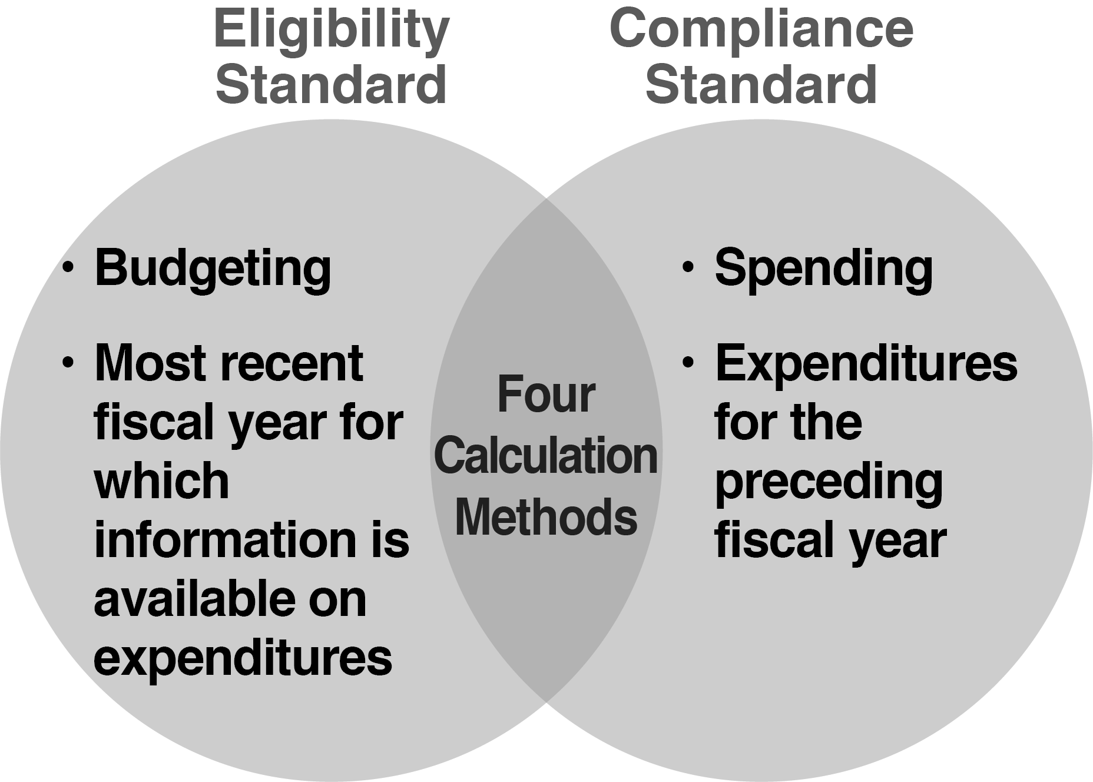
Check Your Understanding
Notes:
Remember that the eligibility standard is about budgeting while the compliance standard is about spending — expenditures. And that for eligibility, you start by looking at the most recent prior state fiscal year for which information on expenditures is available, and for compliance, you start with the preceding state fiscal year. In both cases, you need to go back to the most recent year in which LLEA MOE compliance was met.
Finally, for both standards, there are four methods of calculating LEA MOE: local only total funds, state and local total funds, local only funds per capita, and state and local funds per capita.
And that, in its shortest form, is LEA MOE So now we reviewed, let’s look specifically at the “Compliance Standard and data submission.”

Slide 50
Key MOE Take Aways for Today!
Importance of Collaboration
Accurately Capture and Report Expenditures
Maintain Documentation
Use Allowable Exceptions if Needed

Slide 51

Collaboration
Finance and Special ED Offices
“Collaboration is necessary to accurately categorize expenditures which may reduce the need to use allowable exceptions”
This Photo by Unknown Author is licensed under CC BY-SA

Slide 52
The Importance of Collaboration
Share information to categorize expenditures
Obtain accurate data for analyzing expenditures for reporting and planning
Meet MOE Compliance Standard
Avoid non-compliance status and sending funds to USED

Slide 53
Collaboration is Necessary for
Documenting Processes
Document, maintain and review annually the division’s process for MOE data collection and submission
Is the process documented?
Categorizing Expenses and Maintaining Documentation
Ensure all backup sources for expenditures are categorized and maintained
Separating State and Local Funds
Separate State and local funds used for all expenditures (FEDERAL FUNDS ARE EXCLUDED)
Monitoring and Audit Purposes
Audit and monitoring visits will require proof of expenditures and when allowable exceptions are taken

Slide 54
Accurately Categorize Expenditures
Only cost out local and state dollars – not federal
Expenditures must be reported separately by state and local funds
Only use expenditures that are above and beyond the cost of providing regular education programs
Reference: Virginia Department of Education, IDEA Maintenance of Effort Guidance Document, page 1-2

Slide 55
Accurately Categorize Expenditures
Do not use costs associated with capital outlay or regular education and services – e.g., cost for charges related to American with Disabilities Act
Only report costs for students that the division is “legally responsible” for educating vs students from another division that are being served
The Schedule A of the Annual School Report Financial Section document is used as a basis for categorizing MOE expenditures
Reference: Virginia Department of Education, IDEA Maintenance of Effort Guidance Document, page 1- 2

Slide 56
Accurately Categorize Expenditures
Each entry must represent actual expenditures and must be consistent with Federal and State definitions of special education and related services
Expenditures for instruction, related services supports must be for the sole benefit of provisions needed for the education of student’s with disabilities such as those in a Student’s Individual Education Plan (IEP) or for the cost involved in the eligibility determination process
Reference: Virginia Department of Education, IDEA Maintenance of Effort Guidance Document, pages 1- 2

Slide 57
Examples of Allowable
Local and State Expenditures
  Salaries/benefits (full and prorated) or contracted services
    Special Education Teachers
    Aides for Special Education Students
    Related Services and Providers – speech pathologist, audiologist, psychologist, physical, occupational and recreational therapist, school social workers, medical services for diagnostic/evaluation purposes, school health services, and parent counseling and training
Reference: Virginia Department of Education, IDEA Maintenance of Effort Guidance Document, pages 1- 2

Slide 58
Examples of Allowable
Local and State Expenditures
  Expenses related to instruction and services in jails
  Expenses related to homebound or home-based instruction and services
  Special Transportation
  Certain equipment/construction specifically for student with disabilities as noted in the IEP
  Tuition paid to another division
Reference: Virginia Department of Education, IDEA Maintenance of Effort Guidance Document, page 1- 2

Slide 59
Allowable Local and State Expenditures
Simplified Example
Expenditure | Local Funds |  | State Funds
Special Ed Teacher | 50% of Salary/Benefits | $40,000 | 50% of Salary/Benefits | $40,000
Aide | 100% of Salary/Benefits | $45,000
Speech Pathologist Contracted |  |  | 100% | $80,000
Driver for one Student – in IEP | 100% of Salary/Benefits | $10,000
Mileage for Homebound Instructors |  | $5,000
Totals |  | $100,000 |  | $120,000
Notes:
How does your school division’s accounting system track expenditures for the education of children with disabilities?
Some accounting systems may not disaggregate expenditures by state and local funds. This could limit the ability of school divisions to use the local-only options for calculating their MOE.

Slide 60
Non-Allowable Expenditures
Tuition received from another division
General Education Teachers/Principals/Administrators Salaries/Benefits (unless detailed time and effort documentation is maintained)
General capital outlay
General transportation cost including vehicle maintenance and gas
Comprehensive (Children) Services Act (CSA) local match
Costs that apply to all students
Reference: Virginia Department of Education, IDEA Maintenance of Effort Guidance Document, page 1- 2

Slide 61
Sample – SPED Expenses
Accurate and Consistent Reporting Are Critical
(Annual School Financial Report)

Slide 62
MOE Data Submission
IDEAMOE Application
Data Entry
Application of the Four Methods of Calculation
Subsequent Years Rules
Pass or Fail Calculations and Results

Slide 63
Next Step: IDEAMOE Application
Enter the data into the VDOE IDEA Maintence of Effort (IDEAMOE) web-based application.
It is accessed through the Single Sign-On Web portal.
Once data is entered the IDEAMOE will complete some calculations and pre-populate cells with data for school divisions.
The IDEAMOE allows the school division and VDOE to track and view, present and past, data submissions/reports.
Please review the VDOE MOE Application User’s Manual for specific details.

Slide 64
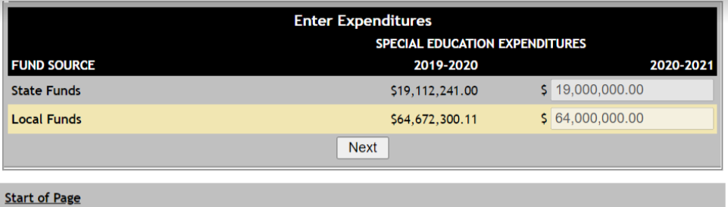
Input Expenditures into the IDEAMOE Application
Reference: Virginia Department of Education, IDEA Maintenance of Effort Application User’s Manual, page 5, Figure 6

Slide 65
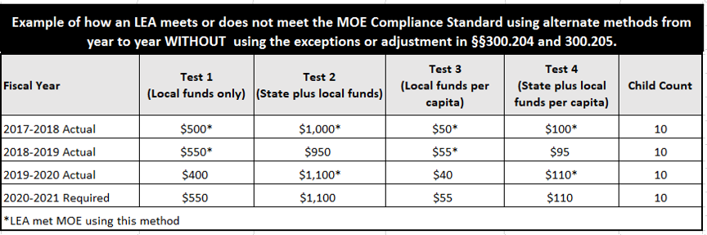
Example: Application of the Four Tests and the Subsequent Years Rule
Reference: Virginia Department of Education, IDEA Maintenance of Effort Guidance Document, pages 3-4

Slide 66
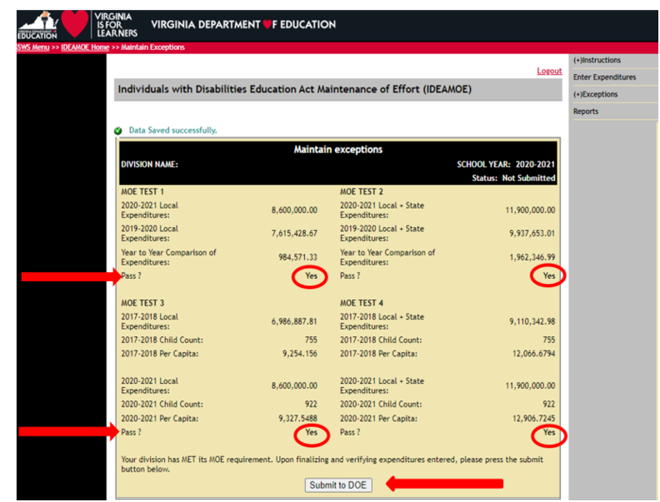
Passed All Four Tests
Reference: Virginia Department of Education, IDEA Maintenance of Effort Application User’s Manual, page 7

Slide 67
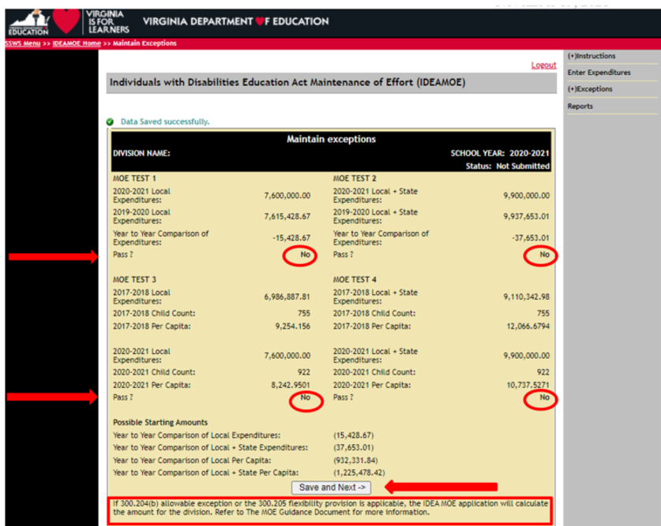
Uh Oh...Did Not Make Compliance
HELP!
Reference: Virginia Department of Education, IDEA Maintenance of Effort Application User’s Manual, page 17

Slide 68
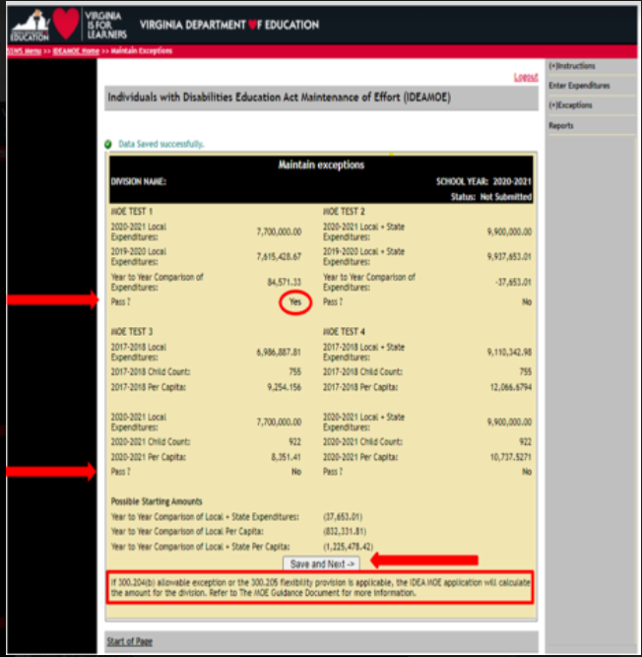
Uh Oh...We only met one of the test, now what?

Slide 69
MOE Exceptions
How Exceptions can Help to Meet Compliance
Personnel/Contracted Services Exceptions and Examples
Enrollment Decrease Exception
Costly Student Exceptions and Examples
Costly Expenses and Examples
Adjustments and Example

Slide 70
If MOE Is Not Met, There Are
“Exceptions” That May Help
Exceptions are allowable costs that decreased in the current year from the actual expenditures for that year.
It is permissible to take multiple exceptions in one year, as long as each exception applies in that year.
An LEA may apply these exceptions to reduce its required MOE level and meet the compliance standard using any of the four methods.
Reference: Virginia Department of Education, IDEA Maintenance of Effort Guidance Document, page 4
Notes:
Once calculated the amount of the decreased expenditures may allow the school division to meet one of the four methods of tests and meet the compliance standard.
The five categories of allowable exceptions are:
Personnel
A decrease in enrollment
Costly students
Decrease in costly expense
Adjustment to local fiscal effort

Slide 71
Personnel/Contracted Services Exceptions
§300.204(a) “…The voluntary departure, by retirement or otherwise, or departure for just cause of special education or related services personnel (e.g., special education teachers, speech pathologists, paraprofessionals or related services providers assigned to work with children with disabilities).”
Reference: Virginia Department of Education, IDEA Maintenance of Effort Guidance Document, pages 4-5
Notes:
Exception (a) is when special education or related services staff leave. It is important to note that it must be voluntary — someone retires or resigns — or for just cause, such as when an employee is terminated for misconduct. It does not refer to a reduction in force or downsizing.
In its Letter to Lovato, OSEP determined that the voluntary termination of a services contract also falls under this provision.

Slide 72
Personnel Exception Examples
A veteran special education teacher retired and is replaced by a less-experienced special education teacher.
The school division expended $150,000 in salary and benefits on the veteran teacher last school year and will expend $90,000 on the new hire in the current school year.
The school division can reduce its required level of effort by $60,000 ($150,000 – $90,000) in the current school year.
Notes:
In this school division, a veteran teacher retired at the end of the last school year, and the division hires a less-experienced teacher for the current school year.
The veteran cost 150,000 dollars. The new hire only costs 90,000 dollars.
You can only reduce your required level of effort by the difference, which is 60,000 dollars.
The cost for each teacher includes salary and benefits combined. If the division had not replaced the veteran teacher, it could have reduced its MOE by the full 150,000 dollars.
It is important to note that the LEA is still obligated to ensure, in the event the teacher was not replaced, that it continued to provide a free appropriate public education, or FAPE, to the children in its jurisdiction.
In the current school year, you can reduce the required level of effort — for both the local only total and state and local total methods — by 60,000 dollars.

Slide 73
A Decrease in Enrollment Exception
§300.204(b) “…A decrease in the enrollment of children with disabilities.”
If the current year December 1 Special Education Child Count total is less than the previous year’s December 1 count total, the per capita cost of local expenditures or local plus state expenditures may be multiplied by the decrease in the enrollment to produce a dollar amount that may be an allowable exception under this section.
Reference: Virginia Department of Education, IDEA Maintenance of Effort Guidance Document, pages 4- 5
Notes:
Exception (b) occurs when there is a decrease in the enrollment of children with disabilities.

Slide 74
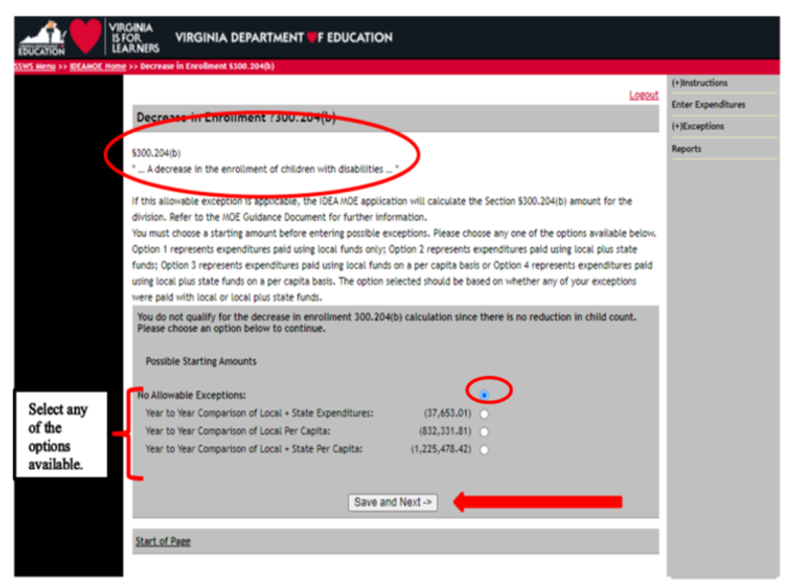
A Decrease in Enrollment Exception
If this exception is applicable to a division, the IDEAMOE web application will calculate the exception for the division.
Reference: Virginia Department of Education, IDEA Maintenance of Effort Application User’s Manual, page 21, Figure 18.1

Slide 75
Costly Students
§300.204(c) “…The termination of the obligation of the agency, consistent with this part, to provide a program of special education to a particular child with a disability that is an exceptionally costly program, as determined to be two to three times more than the average per pupil cost, because the child….”
Has left the jurisdiction of the agency;
Reference: Virginia Department of Education, IDEA Maintenance of Effort Guidance Document, page 5-6
Notes:
An school division's required level of effort may be reduced when the school division stops providing an exceptionally costly program of special education to an individual child with a disability. The school division can reduce its level of effort the following state fiscal year. This exception can only be taken if the child has left the school division’s jurisdiction, if the child has aged out of the school division’s responsibility to provide FAPE, or if the child no longer needs that program of special education.
In particular, the last bullet point requires some discussion. It doesn’t necessarily mean the child no longer needs any special education. The child may continue to need special education services but may no longer need the program of services that meets the state’s definition of an exceptionally costly program. In such a case, the school division may need to talk with the FAB contacts about how much its level of effort might be reduced.

Slide 76
Costly Students
Has reached the age at which the obligation of the agency to provide FAPE to the child has terminated;
or
  No longer needs the program of special education.
An exceptionally costly program means an individual program for an individual child that is at least two to three times more than the average cost for providing special education and related services in a school division.
Reference: Virginia Department of Education, IDEA Maintenance of Effort Guidance Document, page 5-6

Slide 77
Simplistic Example of
Costly Program Services
2019-20 | 2020-21 | Amount of Exception for Decreased Spending in FY 2020
Student receives special services that include a one-to-one contracted interpreter that cost $50,000.00, paid for with local/state special education funds. | Student left school and moved across the country. The educational interpreter is no longer need. | $50,000.00

Slide 78
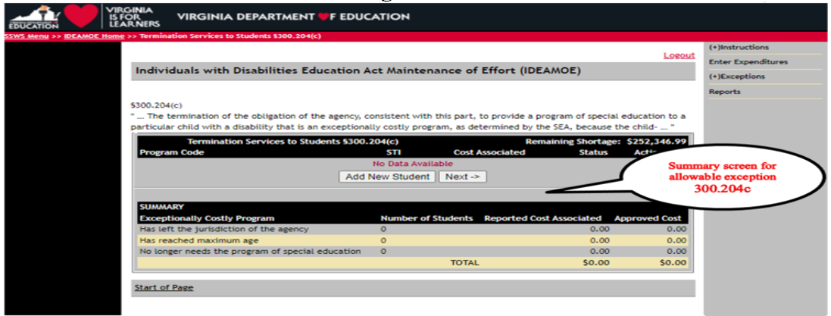
Costly Students
Any possible exception generated by this section will be considered on an individual, case by case basis, using the information submitted through the IDEAMOE application, and reviewed by VDOE prior to approval.
Reference: Virginia Department of Education, IDEA Maintenance of Effort Application User’s Manual, page 26, Figure 23

Slide 79
Decrease in Costly Expense
§300.204(d) “…The termination of costly expenditures for long-term purchases, such as the acquisition of equipment or the construction of school facilities.”
Allowable exceptions under this section may include costs for construction projects that have ended or for equipment previously purchased for which there is no need for an additional purchase.
Reference: Virginia Department of Education, IDEA Maintenance of Effort Guidance Document, page 6

Slide 80
Decrease in Costly Expense
Construction costs related to special education would generally be prorated based on the percentage of special education related costs as a percentage of the cost of the project.
These possible exceptions would be considered on an individual, case-by-case basis.
Reference: Virginia Department of Education, IDEA Maintenance of Effort Guidance Document, page 6

Slide 81
Exception – Construction Example
The school division expends funds for a two-year construction contract to retrofit and renovate a building for special education purposes.
The LEA can reduce its level of effort by $100,000 in Year three.
Year | Cost ($)
Year 1 | 70,000
Year 2 | 100,000
Year 3 | N/A
Notes:
In this example of a long-term expenditure, the school division is renovating a building for special education purposes, over two state fiscal years. The two-year construction contract includes adding elevators and ramps to an old 4-story building, along with accessible bathrooms on each floor, and special equipment such as accessible chemistry/biology workstations, sinks, and so forth. The contract is 170,000 dollars to be spread over two state fiscal years.
The school division expends, and includes in its MOE calculation, 70,000 dollars in the first state fiscal year of the contract. The work is completed in the second year for the remaining 100,000 dollars. Because the school division was expending funds against that contract during the second state fiscal year, the 100,000 dollars is included in the MOE calculation in the second year.
The contract ends in the second year. Now we are calculating MOE for the current S-F-Y, Year Three. In this S-F-Y — the state fiscal year following the termination — the school division can reduce its level of effort by 100,000 dollars, the amount actually expended in Year Two.
In this example, the 100,000-dollar amount can be deducted from the required level of effort for both the local total and the state and local total methods in the current fiscal year.

Slide 82
Adjustment to Local Fiscal Effort
Adjustment to local fiscal effort in certain fiscal years: 34 CFR §300.205
“…for any fiscal year for which the allocation received by an LEA under §300.705 exceeds the amount the LEA received for the previous fiscal year, the LEA may reduce the level of expenditures otherwise required by §300.203(a) by not more than 50 percent of the amount of that excess….”
Reference: Virginia Department of Education, IDEA Maintenance of Effort Guidance Document, page 6
Notes:
The provisions of these regulations refer to the funds the school division receives under 34 C-F-R Section 300 point 7-0-5, which are section 611 funds provided for children with disabilities ages 3 through 21. So, in calculating the increase in funds from one year to the next, funds received under section 619 for children with disabilities ages 3 through 5 are not included.
When a school division receives an increase in its section 6-11 allocation, then it can calculate 50 percent of that increase. Based on that amount, a school division can reduce its expenditures out of local, or state and local funds, by up to that amount for MOE. As always, there are rules and parameters for taking advantage of this provision in the regulations, and we will talk about those next.

Slide 83
Adjustment to
Local Fiscal Effort
In any fiscal year that a school division/SOP IDEA allocation exceeds the amount the school division/SOP received for the previous fiscal year, under certain circumstances:
  the LEA may reduce the level of local, or State and local, expenditures otherwise required to meet MOE by up to 50 percent of the amount of the excess
  as long as the LEA uses the freed up local funds for activities that could be supported under Every Student Succeeds Act of 2015 (ESSA) ESEA¹ ²
¹section 613(a)(2)(C) of IDEA
²https://www2.ed.gov/policy/speced/leg/arp/arp-idea-fact-sheet.pdf

Slide 84
Adjustment to Local Fiscal Effort
  the LEA will need to provide evidence/demonstrate how these funds were spent
  The funds must supplement and not supplant the activity costs in the year of the reduction
  Divisions that voluntarily take up to 15% for Coordinated Early Intervening Services (CEIS) may take that amount as an exception under this provision. Funds expended for voluntary CEIS reduce the maximum amount that may be reduced.
Reference: Virginia Department of Education, IDEA Maintenance of Effort Guidance Document, page 6

Slide 85
Adjustment Example
Adjustment Calculation | Dollar amount
FFY 2017 Section 611 Allocation | 800,000
FFY 2018 Section 611 Allocation | 900,000
Difference ($900,000 – $800,000) | 100,000
50% of the increase ($100,000 x 50%) | 50,000
The LEA can reduce its level of effort up to $50,000 in FFY 2018 (SFY 2019) as if all other conditions are met in that year.
Notes:
For the purpose of this example, we are going to assume that this L-E-A meets requirements as determined by the S-E-A, has not been identified with significant disproportionality, has not had action taken against it by the S-E-A under section 616 of the I-D-E-A, and has not been determined unable to establish and maintain programs of FAPE.
That said, the L-E-A received an allocation under section 6-11 in F-F-Y 2017 of 800,000 dollars. It received an allocation under section 6-11 in F-F-Y 2018 of 900,000 dollars.
The increase was 100,000 dollars… and 50 percent of that increase was 50,000 dollars.
Therefore, the L-E-A could have reduced its level of effort up to 50,000 dollars in S-F-Y 2019. Note the wording here: could have reduced its level of effort up to 50,000 dollars. This means that the L-E-A did not have to reduce its level of effort at all — or could have reduced it by, say, 10,000 dollars. Or 25,000 dollars. Any amount up to 50,000 dollars.
Here is another important note: The federal funds an L-E-A receives in F-F-Y 2018 are available for obligation and expenditure for two fiscal years. However, the L-E-A must take the available adjustment in the first year that the funds are available, which would be state fiscal year 2019 in this example.
But remember — the L-E-A is required to use any amount by which it reduced its level of effort for other purposes allowable under E-S-S-A — and must document that it did so.

Slide 86
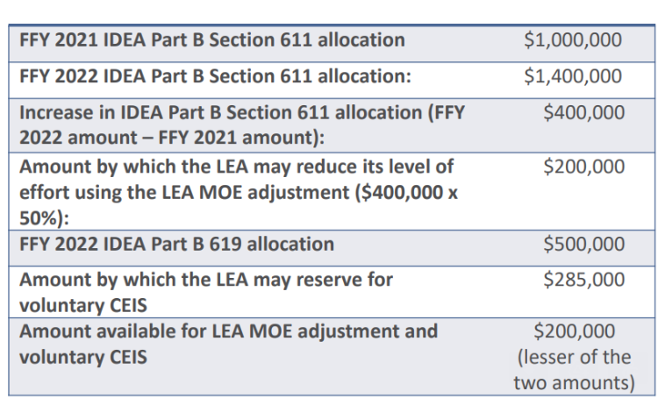
CEIS Adjustment Example
The LEA can reduce its level of effort up to $50,000 in FFY 2018 (SFY 2019) as if all other conditions are met in that year.
Notes:
For the purpose of this example, we are going to assume that this L-E-A meets requirements as determined by the S-E-A, has not been identified with significant disproportionality, has not had action taken against it by the S-E-A under section 616 of the I-D-E-A, and has not been determined unable to establish and maintain programs of FAPE.
That said, the L-E-A received an allocation under section 6-11 in F-F-Y 2017 of 800,000 dollars. It received an allocation under section 6-11 in F-F-Y 2018 of 900,000 dollars.
The increase was 100,000 dollars… and 50 percent of that increase was 50,000 dollars.
Therefore, the L-E-A could have reduced its level of effort up to 50,000 dollars in S-F-Y 2019. Note the wording here: could have reduced its level of effort up to 50,000 dollars. This means that the L-E-A did not have to reduce its level of effort at all — or could have reduced it by, say, 10,000 dollars. Or 25,000 dollars. Any amount up to 50,000 dollars.
Here is another important note: The federal funds an L-E-A receives in F-F-Y 2018 are available for obligation and expenditure for two fiscal years. However, the L-E-A must take the available adjustment in the first year that the funds are available, which would be state fiscal year 2019 in this example.
But remember — the L-E-A is required to use any amount by which it reduced its level of effort for other purposes allowable under E-S-S-A — and must document that it did so.

Slide 87
Conditions Forbidding LEAs From Using the MOE Adjustment Option
An LEA may not take this reduction if the SEA determines the LEA is unable to establish and maintain programs of FAPE, or the SEA has taken action against the LEA under section 616 of IDEA¹
An SEA must prohibit an LEA from taking the MOE reduction if the LEA’s Local Determination is Needs Assistance, Needs Intervention, or Needs Substantial Intervention¹
An LEA that is required to budget 15% under CCEIS due to significant disproportionality will not be able to take advantage of the MOE adjustment option¹
¹https://www2.ed.gov/policy/speced/leg/arp/arp-idea-fact-sheet.pdf

Slide 88
MOE Non-Compliance
What Happens in Non-Compliance
Verification

Slide 89
Applied the Exceptions But the Division is Still In Non-Compliance, What’s Next?
VDOE must repay federal government the amount by which the school division failed to maintain effort (34 CFR §300.203(d)).
VDOE will require the school division to repay the state.
Payback must be made from nonfederal funds
A school division will not receive an IDEA subgrant if it does not budget at least as much as expended in the most recent year it met MOE –i.e., the amount that was paid back does not reduce how much must be budgeted to meet the eligibility standard.
Reference: Virginia Department of Education, IDEA Maintenance of Effort Guidance Document, page 6

Slide 90
MOE Summary
Use the Resources
Collaborate
Categorize local and state expenditure
The IDEA MOE APP will pre-populate and calculate much of the information if entered correctly
Strive to pass all four of the test methods but at least one
Use exceptions if needed
Plan to ensure the division budgets and expends enough local and state dollars to maintain eligibility and compliance
Verification Process – make sure you understand

Slide 91
MOE is Not Excess Cost
There are more differences between the MOE and the Excess Cost than similarities. The primary similarity is that both are required by Federal Regulations to ensure sufficient funding for special education programs
The Excess Cost calculation includes the divisions most recent MOE data submission. However, for the Excess Cost calculation the MOE data has to be categorized by Elementary (K-7) and Secondary (8-12) grade levels
Federal Requirement
MOE
Excess Cost
Reference: Key Differences between IDEA Local Education Agency Maintenance of Effort and Excess Cost Requirements, Center for IDEA Fiscal Reporting, WestEd
Notes:
The excess cost requirement stipulates the minimum amounts an LEA must spend on average per pupil on students with disabilities, as the LEA spends on average per pupil for enrolled students at both the elementary and secondary school levels (must be computed separately).
IDEA regulations require each LEA to compute the average expenditures per elementary or secondary school
Kindergarten through grade 7 is considered “elementary”
Grade 8 through grade 12 is considered “secondary.”

Slide 92
MOE and Excess Cost Basic Comparison
 | MOE | Excess Cost
Spending on | Special Education Students only | Special Education students compared to non-Special Education Students
Spending by | School Division | Grade range
Expenditures | Compared to prior year | Compared in same year
https://ed.sc.gov/districts-schools/special-education-services/fiscal-and-grants-management-fgm/lea-maintenance-of-effort-moe-information/idea-lea-moe-vs-excess-cost-equirements/#:~:text=IDEA%20Part%20B%20funds%20can,costs%20of%20special%20education%20and
Notes:
Excess Cost compares spending on special education students to non-special education students whereas MOE is only looking at spending on special education students.
Excess cost looks at spending on certain grade ranges (elementary and secondary) whereas MOE is looking at school division level spending.
Finally, excess cost looks at current year expenditures whereas MOE is comparing expenditures for this year to last year (or most recent year the division met MOE?)
To sum it up
Excess Cost is to ensure that for the current fiscal year that the IDEA funds are used to supplement state/local funds
MOE is looking to ensure that the general funds spending remains the same or higher than the previous year

Slide 93
What is Excess Costs?
Except as otherwise provided, amounts provided to an LEA under Part B of the Act may be used only to pay the excess costs of providing special education and related services to children with disabilities.
Excess costs are those costs for the education of an elementary school or secondary school student with a disability that are in excess of the average annual per student expenditure in an LEA during the preceding school year for an elementary school or secondary school student, as may be appropriate.
An LEA must spend at least the average annual per student expenditure on the education of an elementary school or secondary school child with a disability before funds under Part B of the Act are used to pay the excess costs of providing special education and related services.

Slide 94
Excess Cost Federal Regulations
§300.16 Excess Costs
Excess costs means those costs that are in excess of the average annual per-student expenditure in an LEA during the preceding school year for an elementary school (K-7) or secondary school (8-12) student, as may be appropriate, and that must be computed after deducting specified amounts
§300.202(b)
The excess cost requirement prevents an LEA from using funds provided under Part B to pay for all of the costs directly attributable to the education of a child with a disability

Slide 95
Excess Cost Simply Stated
The excess cost requirement stipulates that LEAs spend the same average per pupil amount for all students, including students with disabilities
    The expenditures must be categorized separately for elementary (K-7) and secondary school (8-12) levels as defined by the State of Virginia
LEA must spend funds to cover all the basic costs it would provide if these students didn’t have disabilities, “before” expending Federal IDEA Part B funds
Notes:
The excess cost requirement stipulates the minimum amounts an LEA must spend on average per pupil on students with disabilities, as the LEA spends on average per pupil for enrolled students at both the elementary and secondary school levels (must be computed separately).
IDEA regulations require each LEA to compute the average expenditures per elementary or secondary school
Kindergarten through grade 7 is considered “elementary”
Grade 8 through grade 12 is considered “secondary.”

Slide 96
Four Components
There are four components in determining excess costs
  Calculate for the total expenditures
  Subtract certain expenditures
  Compute for the average annual per pupil amount
  Determine the minimum amount of funds to spend for students with disabilities

Slide 97
State Monitoring and Federal Documentation
The methodology used by each school division may be unique based on the organizational structures and assignments within each division
The methodology used by the LEA for calculating the costs that are not distinctly identified as elementary (K-7) or secondary (8-12) school expenditures should be documented
All information that details methodology and/or process must be retained by the LEA for monitoring and audit purposes

Slide 98

Total Expenditure Reflection Question
Does your school division
separate costs for
central administration operations and/or
district programs
between elementary (K-7)
and
secondary (8-12)?
This is a good time to collaborate with the school divisions Special Education Office to discuss requirements and actual expenditures for the previous school year

Slide 99
Distinct and Separate Cost
In some cases it is difficult to determine distinct and separate costs associated with elementary (K-7) or secondary (8-12) school students. It is recommended that those costs be allocated in accordance with work assignments and not based upon student enrollment.
Examples and possible allocation methodologies include:
  Pupil Transportation, apply costs based on student routes
  Custodial Staff, apply costs based on building assignments
  Central Office Instructional Support Staff, apply costs based on building or grade assignments
  Central Office Fiscal Staff, apply costs based on personnel count assignments within the district

Slide 100
Distinct and Separate Cost - Example
 | Elementary (K-7) | Secondary (8-12)
Marching Band |  | X
Technical Education |  | X
K-7 Instructional/Support Staff | X
PALs Reading Program | X
Pupil Transportation/Bus Drivers - same route - combined grades K 12 students | X | X
Custodial Staff - works at 2 or more K-12 building | X | X
Central Office Instructional Support Staff | X | X
Central Office Fiscal Staff | X | X

Slide 101
Collect Data
LEA should not exclude any K-12 costs from the excess costs calculation
DATA | Elementary (K-7) | Secondary (8-12)
Total Expenditures
Total Capital Outlay and Debt Services
IDEA Part B Allocation
Funds under ESEA* (Elementary and Secondary Education Act),Title I, Part A allocation
Funds under ESEA, Title III, Parts A and B
State and Local Funds for children with Disabilities (Equals IDEAMOE Application)
State and local funds for programs under ESEA Title I, Part A, and Title III Parts A and B.
.
* Also referenced as Every Student Succeed Act (ESSA) in current Title I Federal regulations

Slide 102
DETERMINING COSTS FOR MIXED GRADES
The method used must be reasonable, defensible and used consistently from year to year
Once a method is determined, document it as a written procedure
Methods to consider when teachers are instructing both elementary (k-7) and secondary (8-12)
  Teacher’s costs based on number of students served in each level
  Teacher’s costs based on number of classes taught at each level
  Teacher’s costs based on number of hours spent per level
This should include the teachers base salary, benefits and don’t forget to count teacher planning hours when using methods 2 and 3.

Slide 103
Teacher’s costs based on number of students served in each level
Division Data
Teacher salary/benefits = $90,000.
6th grade = 30 students
7th grade = 20 students
Total elementary = 50 students
8-9 grades = 10 students
Total secondary = 10 students
Total = 60 students
Calculation
$90,000./60 total students = $1,500. per student
50 elementary students x $1,500. each = $75,000.
10 secondary students x $1,500. each = $15,000.
Results:
Elementary level Cost = $75,000.
Secondary level Cost = $15,000.

Slide 104
  Teacher’s costs based on number of classes taught at each level
Division Data
Teacher salary/benefits = $90,000.
  6th grade = 2 classes
  7th grade = 1 class
Total elementary = 3 classes
  8-9 grades = 1 class
Total secondary = 1 class
    Total = 4 classes
Calculation
$90,000./4 classes = 22,500 per class
3 elementary classes at $22,500. each = $67,500.
1 secondary class x $22,500.
each = $22,500.
Results:
Elementary Cost = $67,500.
Secondary Cost = $22,500.

Slide 105
  Teacher’s costs based on number of hours spent per level
Division Data
Teacher salary/benefits = $90,000.
Works – 8 hours a day
  Spends 5 hours per day at Elementary
  Spends 3 hours per day at Secondary
Calculation
Teacher works a total of 1,440 hours per year (36 weeks at 40 hours per week) $90,000 /1440 hrs = $62.50 per hour
Spends 5 hours per day at the elementary school: $62.50 x 5 hours per day = $312.50 x 5 days per week = $1,562.50 x 36 weeks = $56,250.
Spends 3 hours a day at the secondary school: 62.50 x 3 hours per day = $187.50 x 5 days per week = 937.50 x 36 weeks = $33,750.
Results:
Elementary Cost = $56,250.
Secondary Cost = $33,750.
      $90,000.

Slide 106
Excess Cost Summary
Use the Resources
Document the process used for calculations (policies and procedures)
Collaborate
Categorize elementary (K-7) and secondary (8-12) expenditures
Identify expenditures and separate distinct costs for elementary and secondary categories
The Speced-Excess Cost Application opens usually in March. Review the Superintendent’s Memo for the exact date
Make sure the Superintendent completes the Verification Process before the collection window closes

Slide 107
Proportionate Set-Aside (PSA)
IDEA Equity Services
34 CFR §300.130
To meet the requirements of IDEA, every year each LEA must expend a proportionate share of federal IDEA Part B funds on equitable services for parentally placed private school children with disabilities which includes students who are home schooled
Notes:
Each year school divisions must set aside a calculated share of their IDEA Part B 611 and 619 federal allocation to provide equitable services for students with disabilities who are placed in private schools by their parents or who are being home schooled. This includes qualified religious, elementary and secondary, and home schools located in the division’s jurisdiction.
In Virginia home-schooled is synonymous with “Home Instruction” as noted in the Administrative Code of Virginia. However the Code of Virginia mandates certain criteria that parents must meet in order for the home-school to qualify. For the purposes of this presentation the term “parentally placed private school children” includes “home-schooled stu
dents.
34 CFR §300.130
** VA Administrative Code 8VAC20-81.10 Definitions.
***§ 22.1-254.1 of the Code of Virginia

Slide 108
Formula for Determining The PSA Equity Service Set-Aside Amount*
The formula for determining the proportionate share of the LEA's IDEA Part B 611 & 619 allocation is based on
1) The total number of eligible (not on the number served)parentally placed children with disabilities aged 3 through 21 attending private schools located
in the district
2) In relation to the total number of eligible public and
private school children with disabilities aged 3
through 21 in the LEA's jurisdiction
*Appendix B to Part 300 – Proportionate Share Calculations - IDEA
Notes:
The parentally placed private school children that a school divisions must count in their PSA calculation include:
All children who attend a private school and have been evaluated and found eligible for special education and related services but are not receiving services and
those children found eligible and are receiving services through a developed services plan
Each LEA must determine the total number of private school children with disabilities who are enrolled by their parents in private elementary schools and secondary schools located in the school division
and the total number of children with disabilities enrolled in the public and private schools located in the jurisdiction of the school division.
Remember that students with disabilities attending a private school in the school division’s catchment area are to be counted by this school division regardless of where the child may reside.
Remember that the child data is submitted in December and the school has verified the count. If you need information please contact Karen Plunkett.

Slide 109
Proportionate Share Calculation for Parentally-Placed Private School Children with Disabilities for a School Division (slide 1 of 3)
*Appendix B to Part 300 – Proportionate Share Calculations - IDEA
Number of eligible children with disabilities in the public school division | 300
Number of parentally-placed eligible children with disabilities in private elementary and secondary schools located in the school division | 20
Total number of eligible children | 320
Federal Flow-Through IDEA Part B 611 & 619 Funds to a school division = Total Allocation | $ 152,500.00
Notes:
So now that we’ve reviewed the timeline for spending the PSA funds, let’s walk through how the PSA is calculated.
This is where the efforts of the child find and the count of children eligible to receive special education and related services is used.
The number of eligible students with disabilities in the public schools is added to the number of eligible students with disabilities in the private schools to get the total number of eligible children.
The total of the two figures is the number used to determine the individual student portion of set-aside funds.
The division’s total allocation for Part B 611 and 619 funds is one hundred and fifty-two thousand and five hundred dollars.

Slide 110
Proportionate Share Calculation for Parentally-Placed Private School Children with Disabilities for a School Division (slide 2 of 3)
Calculating Proportionate Share
*Appendix B to Part 300 – Proportionate Share Calculations - IDEA
Total IDEA Part B 611 & 619 Allocation to a school division | $ 152,500.
Divided by the total number of eligible children | 320.
Average allocation per eligible child | $ 476.5625
Multiplied by the number of parentally-placed children with disabilities | 20
Total amount to be expended for parentally-placed children with disabilities | $ 9,531.25
Notes:
The total allocation is divided by the total number of eligible students (private and public) which comes to approximately $476.56 per student. That amount is multiplied by the number of eligible parentally-placed children with disabilities to get the PSA.

Slide 111
Proportionate Share Calculation for Parentally-Placed Private School Children with Disabilities for a School Division (slide 3 of 3)
Total Allocation of IDEA Part B 611 & 619 | $ 152,500.00
(minus) Proportion Set-Aside | $ 9,531.25
Total Award Available to School Division* | $ 142,968.75
*Appendix B to Part 300 – Proportionate Share calculations - IDEA
Notes:
The PSA amount of $9,531.25 is subtracted from the total allocation which lowers the available funds to the public school division. The school division must maintain a separate accounting of the PSA expenditures and ensure documentation is retained for audit or monitoring purposes.

Slide 112
Timeline Rule for Spending
PSA/Equity Service Funds
Example - 27 months to expend an IDEA award
 | Year 1 - July 1 - June 30 | Year 2 – July 1 - June 30 | Final 3 Months- July, August, September
 | Award Year | Carry-over Year | Must be obligated by September 30
Proporationate Set Aside Total | $ 9,531.25
Spent | $ 8,000.00
Remaining | $ 1,531.25 | $ 1,531.25
Spent |  | $ 1,000.00
Remaining |  | $ 531.25 | $ 531.25*
*All Unexpended funds may be used by the LEA for public schools items that are allowed under Federal Idea Part B regulations
Notes:
Explain example
Basically, an IDEA allocation is for 27 months and
If a school division does not spend all of the PSA funds in the first year of an IDEA Part B allocation then the remaining funds for special education and related services to children with disabilities placed by their parents in private schools must be carried –over for one additional year.
If the school division does not expend the entire PSA share of Part B funds by the end of the carry-over period then the school division may use the unexpended funds to pay for other allowable Part B expenditures for their public schools.

Slide 113
How to Access the PSA Application (Speed-PSA): Use the Proportionate Set-Aside Guidance Document*
1) Sign into SSWS (Page 4, Figures 2 & 3)
2) Click on Special Education Proportionate Set-
Aside (Speed-PSA) Application (Page 5, Figure 4)
3) A window will come up that indicates the date the
submission window will close (Page 5, Figure 5)
Worksheet
Reports
*Proportionate Set-Aside Guidance Document, Virginia Department of Education, Individuals with Disabilities Education Act (IDEA)
Notes:
The 2021-22 Proportionate Set-Aside Guidance Document on the Office of Special Education Grants and Budget Web page is the place to start. There is also a link to this guide in the Supt’s. Memo #298-21 dated October 22, 2021 on PSA submission.
The guide will provide a very clear process for submitting the verified report and approval by the School Division Superintendent.
As you can see on the slide in order to access the PSA worksheet and reports you must first sign into SSWS. Then click on the Special Education Proportionate Set-Aside Application. A window will pop up that indicates when the submission window will close. On the right side of that page you will be able to click on “Worksheet” or “Reports”. The Worksheet allows you to view the current data and “Reports” allows you to view past PSA verified submissions.

Slide 114
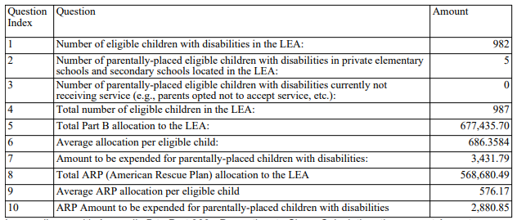
Example of Proportionate Set-Aside (Speced-PSA)
Web-based Calculation Report
Notes:
This is a screen shot of a submitted approved PSA report.
Don’t forget that the report is not submitted to VDOE until the Superintendent or Designee approves or disapproves and clicks the submit button. If the report is approved then the submission is completed and the collection window will close. If the report is not approved then the collection window is re-opened and resubmission is required. An explanation is required for disapproved submissions. Once again VDOE will need to be contacted to open the collection window.

Slide 115
PSA/Equity Services
Non-Allowed
and
Allowed Expenditures
Notes:
This next section discusses what not to do with PSA funds and what is allowable.

Slide 116
Non–Allowable Use of PSA Funds
Funds are never given directly to the private school
  The School division must manage funds and maintain accurate records of expenditures.
  Cannot be used to benefit the needs of the private school or general needs of students enrolled in the private school (34 CFR §300.141)
Supplement, not supplant
    State and local funds may supplement but in no case supplant the proportionate amount --i.e., cannot use state and local funds in lieu of IDEA funds
Notes:
Can the school division give the proportionate share of funds to the private school to provide equitable services? No. The control of funds used to provide special education services and the control of materials, equipment, and property purchased with those funds is the sole responsibility of the public school division.
The school division may not use these funds to finance the existing level of instruction in a private school or to otherwise benefit the private school.
The LEA use of these funds can only be used to meet the special education and related services needs of parentally-placed private school children with disabilities,
but not for meeting—
The needs of a private school; or
(2) The general needs of the students enrolled in the private school.
Supplement, not supplant. State and local funds may supplement and in no case supplant the proportionate amount of Federal funds required to be expended for parentally-placed private school children with disabilities.
In other words:
The PSA set-aside calculated amount of the school division’s total IDEA allocation must be spent first and if there are additional cost for private school placed eligible student then local and state dollars can be used but public schools are not required to spend additional local or state dollars.

Slide 117
Child Find Non-allowable Expenses
Child Find Process Expenses are not an allowable charge.
This includes the cost for:
Screening expenses to determine if a referral for an evaluation is indicated
Evaluation expenses
Staff salaries and benefits
Supplies and materials
Notes:
When identified these children may be provided various screenings, such as hearing, vision and scoliosis, speech, voice, language, fine and gross motor functions, and screenings for instructional purposes to determine if a referral for an evaluation for special education and related services is indicated.
However, the cost of carrying out the child find requirements, including student screenings or evaluation costs, may not be considered in determining if the school division has met its financial set aside obligation under the PSA regulation (34 CFR 300.133). In other words the child-find process may not be funded with PSA funds.

Slide 118
Non-Allowable Use of PSA funds
Child Find Costs (34 CFR § 300.131 (d))
    Administrative costs of child find and evaluation
    Child find program (--e.g. staff, salaries, supplies, travel)
    Evaluations expenses
Cannot be used to create separate classes (34 CFR § 300.143)
Funds must not benefit a private school (34 CFR § 300.141)
  Repairs of private school facilities
  Minor remodeling of private school facilities
  Construction of private school facilities
Notes:
The school division as stated earlier may not use the PSA set-aside amount to carry out the child find requirements, including cost for administration, personnel, and screenings or evaluations.
§300.143 Separate classes prohibited.
A school division may not use funds available under section 611 or 619 of the Act for classes that are organized separately on the basis of school enrollment or religion of the children if—'
(a) The classes are at the same site; and
(b) The classes include children enrolled in public schools and children enrolled in private schools.
Funds must not benefit a private school (34 CFR § 300.141)
Repairs of private school facilities
Minor remodeling of private school facilities
Construction of private school facilities

Slide 119
Only Allowable Expenditures are included in Service Plans for Eligible Students
A service plan must be developed and implemented for each private school child with a disability, whose parents accept services.
The Service Plan must include
  A description of the specific services provided by the school division and,
  Where the services will be provided and transportation details, if needed
The allowable direct and indirect services in the Service Plan must be allowable PSA expenditures.
Notes:
Every parentally-placed private school child with a disability who has been designated to receive services must have a service plan. The plan must describe the specific special education services that the school division will provide and where the services will be provided.
A service plan is not the same as an Individual Education Plan or an IEP that eligible students attending a public school are entitled to receive. The school division, however, to the extent appropriate, must develop, review, and revise service plans consistent with a timeline similar to an IEP process.
The service development plan and monitoring process includes, but is not limited to, inviting private school representatives and parents to the meetings to develop, monitor and change service plans. This includes participation of parents who reside in another state and the child attends a non-public school in the school division’s jurisdiction.
However, IDEA does not require that a parent provide written consent to a service plan. Parents may refuse services proposed in a service plan. However, the school division must continue to count the child as a private placed student eligible but not receiving services.
A service plan should reflect only the allowable services the school division will provide to a parentally placed private school child with a disability who is eligible to receive services.

Slide 120
Allowable Cost for Services*
  Direct Services
  Indirect Services
*34 CFR §§ 300.137-300.144
Notes:
In the following slides we will review allowable expenses for direct and indirect services. However, it is important to note again that these federal funds are never given directly to private schools. For all direct and indirect services the school divisions must remain in control, track the expenditures from the PSA amount, and select the PSA tab in the Online Management Education Grant Act system “OMEGA” when requesting reimbursement from VDOE for these funds.

Slide 121
Allowable Use of PSA Funds
Direct services
  Must benefit only eligible students who are privately enrolled (34 CFR § 300.141)
  Use of Personnel (34 CFR § 300.142)
    Can make public school personnel available in facilities other than public facilities
      Can pay a private school employee to provide services, if qualified, outside of his or her regular hours of duty and only if under public supervision and control
Notes:
The provision of equitable services must be only for those students found eligible in the private school. The services identified in the service plan may be provided by employees of a public school division or through an individual, association, agency, organization, or other entity contracted by the public school division. However, parentally-placed private school children with disabilities may receive a different amount of services than children with disabilities in public schools.
School divisions may use IDEA federal funds to facilitate a private school student’s access to services in a number of ways. School divisions may provide services on site at the private school, at a public or neutral site convenient to the private school, or provide services on public school grounds, and may contract for the provision of services at an appropriate site, ensuring that transportation is provided for the students. Often, private schools welcome the opportunity to facilitate students’ access to services at their site.
Use of personnel.
A school division may use funds available to make public school personnel available to provide services for parentally-placed private school children with disabilities if those services are not normally provided by the private school.
A school division may pay for the services of an employee of a private school to provide services if—
The employee performs the services outside of his or her regular hours of duty; and
The employee performs the services under the public school division’s supervision and control.

Slide 122
Allowable Use of PSA Funds
Indirect services
  Equipment and materials to support students (34 CFR § 300.144)
  Training for private school teachers and other private school personnel related to special education
  Location of services and transportation (34 CFR § 300.139)
Notes:
Equipment and Materials
The school division must control and administer PSA funds to provide special education and related services. This includes the oversight of all materials, equipment, and property purchased with those funds including, but not limited to, ownership of and rights to such materials, equipment, and property.
Equipment and supplies may be placed in a private school for a period of time only to service eligible individual students and only if the equipment and supplies can be removed without remodeling the private school facility. The school division must remove such equipment and supplies when no longer serving those students or if the equipment and supplies are being used in an unauthorized manner.
School divisions may not use funds for any repairs, minor remodeling, or construction of private school facilities.
If equipment and/or materials are needed for accommodation then the school division may purchase the items for use by the private school. However, the items remain the property of the school division and when the equipment is no longer needed then it should be returned to the school division.
A record of the equipment purchased and loaned to the private school must be maintained by the school division and acknowledged in a signed document by the private school.
Training
The school division may arrange/provide trainings to the private school teacher and/or personnel and they may be invited to attend school division trainings.
Location of services and transportation.
Service Delivery (Including On-site) Services may be provided on the premises of private schools, including religious, elementary and secondary schools, to the extent consistent with state and federal laws. This may be less costly in terms of transportation, and may be more appropriate for some children. Providing on-site services could help eliminate the need to transport children to and from services. Services may also be provided at an alternate location in a manner deemed appropriate by the school division.
If it is necessary for a parentally placed child to benefit from or participate in the services provided under the service plan, he or she must be provided with transportation from the school or the home to a site other than the private school; and from the service site to the private school, or to the child’s home, depending on the timing of the services. The cost of this transportation may be included in calculating whether the LEA has met the expenditure requirements of the proportionate share.
School divisions are not required to provide transportation from the child’s home to the private school.

Slide 123
PSA/Equity Services
Reimbursement Request Process
Notes:
We’ll now discuss Tips and Rules for getting PSA reimbursements from VDOE.

Slide 124
PSA Reimbursement Tips and Rules
Be sure to collaborate with the Special Education Office.
PSA reimbursement funds must be tracked separately by the school division.
Do not spend more than the Federal PSA set-aside amount for parentally placed private school children.
These set-aside funds must be used for the purpose of PSA.
Unspent funds in year one must be carried over for twelve additional months.
Notes:
PSA funds must be tracked separately by the school division to ensure they meet the required allotted funding for PSA.
Remember that the amount submitted in the Annual Plan is only an estimate…the actual amount the school division should set-aside (reserve) is in this PSA calculation.
Do not spend more than the Federal PSA set-aside amount for parentally placed private school children...but additional local and state funds may be spent on parentally placed private school students, however school divisions are not required to do so.
These set-aside funds must be used for the purpose of PSA. With one exception if all the funds have not been used during years one and two of the allocation then the remainder may be used for public schools.

Slide 125
PSA Reimbursement Tips and Rules
In the OMEGA system when requesting reimbursement for spent PSA funds the drop-down button for “PSA”, located in the program area field, must be selected.
PSA funds are reserved under object code 0000 until ready to submit reimbursements.
The reimbursement will be denied if not submitted correctly.
Must monitor to make sure the Federal IDEA funds are not closed without the PSA funds being spent.
Be mindful that there are two PSA allocations: Regular IDEA Part B 611 and 619 and ARP
Notes:
When requesting reimbursements, use the drop down button in OMEGA to identify Proportionate Set-Aside (PSA) related expenditures.
Be sure to remember the carry-over provision of twelve months. If after the twelve months there are funds left in the PSA that was not spent by the private schools then it should be used by the public school division.
Be sure not to close out funds without making sure the PSA funds are spent.

Slide 126
Coordinated Early Intervening Services (CEIS) Comprehensive Coordinated Early Intervening Services (CCEIS)
34 CFR §300.226 Coordinated Early intervening services
34 CFR §300.646 Disproportionality …Comprehensive Coordinated Early Intervening Services…
States and LEAs should have procedures in place to ensure that the use of funds is in accordance with these requirements.
Notes:
Each year school divisions must set aside a calculated share of their IDEA Part B 611 and 619 federal allocation to provide equitable services for students with disabilities who are placed in private schools by their parents or who are being home schooled. This includes qualified religious, elementary and secondary, and home schools located in the division’s jurisdiction.
In Virginia home-schooled is synonymous with “Home Instruction” as noted in the Administrative Code of Virginia. However the Code of Virginia mandates certain criteria that parents must meet in order for the home-school to qualify. For the purposes of this presentation the term “parentally placed private school children” includes “home-schooled stu
dents.
34 CFR §300.130
** VA Administrative Code 8VAC20-81.10 Definitions.
***§ 22.1-254.1 of the Code of Virginia

Slide 127
What are Coordinated Early Intervening Services (CEIS) and
Comprehensive CEIS (CCEIS) in Brief
Voluntary - CEIS | Mandatory – Comprehensive CEIS
A School division may use up to 15% of IDEA Part B allocation For general education activities to provide early interventions to prevent/overcome the need for special education or related services Are used for Kindergarten through grade 12 students | A School division must use exactly 15% of IDEA Part B allocation That have a high risk-ratio of significant disproportionality based on race/ethnicity occurring among students with disabilities, impairments, placement, and discipline. These funds are used primarily, but not exclusively, to provide prevention/interventions services for students identified as needing special education or related services Are used for Age 3 through grade 12 students
The CEIS/CCEIS supplemental funds are in addition to, and are not to replace or supplant services that students would otherwise receive
Notes:
In December 2016, the Office of Special Education Programs (OSEP) finalized new regulations on significant disproportionality (34 CFR §300.646). These regulations enforce the use of Individuals with Disabilities Education Act (IDEA) funds for mandatory Comprehensive Coordinated Early Intervening Services (CCEIS), which local education agencies (LEAs) provide upon identification of significant disproportionality, and distinguish use of funds for CCEIS from the use of IDEA funds for voluntary Coordinated Early Intervening Services (CEIS). The following chart outlines the differences between CCEIS and CEIS on key elements

Slide 128
Detailed Comparison of CEIS/CCEIS* (1 of 3)
Element | Coordinated Early Intervening Services | Comprehensive Coordinated Early Intervening Services
Abbreviation | CEIS | CCEIS
Regulation | 34 CFR §300.226 | 34 CFR §300.646
Type | Voluntary – LEAs can choose to use a portion of their IDEA Part B funds for services to a defined group of at risk students. | Mandatory – LEAs identified as having significant disproportionality in identification, placement, and/or disciplinary removals must use IDEA Part B funds for CCEIS.
Funds | Up to 15 percent of IDEA Part B funds (611 and 619) | Exactly 15 percent of IDEA Part B funds (611 and 619)
*A Comparison of Mandatory Comprehensive Coordinated Early Intervening Services (CCEIS) and Voluntary Coordinated Early Intervening Services (CEIS) https://ideadata.org/
Notes:
https://ideadata.org/

Slide 129
Detailed Comparison of CEIS/CCEIS (2 of 3)
Voluntary - CEIS | Mandatory – Comprehensive CEIS
A School division may use up to 15% of IDEA Part B allocation For general education activities to provide early interventions to prevent/overcome the need for special education or related services Are used for Kindergarten through grade 12 students | A School division must use exactly 15% of IDEA Part B allocation That have a high risk-ratio of significant disproportionality based on race/ethnicity occurring among students with disabilities, impairments, placement, and discipline. These funds are used primarily, but not exclusively, to provide prevention/interventions services for students identified as needing special education or related services Are used for Age 3 through grade 12 students
Element | Coordinated Early Intervening Services | Comprehensive Coordinated Early Intervening Services
Grade level/ages services | Kindergarten through grade 12 | Age 3 through grade 12
Groups served | Only children who are not currently identified as needing special education or related services. | Children who are not currently identified as needing special education or related services but who need additional academic and behavioral support to succeed in a general education environment. Children currently identified as needing special education or related services (funds can be used primarily, but not exclusively, for this group).

Slide 130
Detailed Comparison of CEIS/CCEIS (3 of 3)
Element | Coordinated Early Intervening Services | Comprehensive Coordinated Early Intervening Services
Abbreviation | CEIS | CCEIS
Regulation | 34 CFR §300.226 | 34 CFR §300.646
Type | Voluntary – LEAs can choose to use a portion of their IDEA Part B funds for services to a defined group of atrisk students. | Mandatory – LEAs identified as having significant disproportionality in identification, placement, and/or disciplinary removals must use IDEA Part B funds for CCEIS.
Element | Coordinated Early Intervening Services | Comprehensive Coordinated Early Intervening Services
Permitted activities | Professional development for teachers and other school staff to enable such personnel to deliver scientifically based academic and behavioral interventions, including scientifically based literacy instruction and, where appropriate, instruction on the use of adaptive and instructional software. Educational and behavioral evaluations, services, and supports, including scientifically based literacy instruction. | Professional development and educational and behavioral evaluations, services, and supports. The activities must address factors and policy, practice, or procedure contributing to significant disproportionality.

Slide 131
“Significant Disproportionality”
20 U.S.C. 1418(d) requires states to:
Determine if significant disproportionality based on race/ethnicity is occurring with respect to the:
  Identification of children as children with disabilities, including identification as children with particular impairments;
  Placement of children in particular educational settings; and
  Incidence, duration, and type of disciplinary actions, including suspensions and expulsions.
Notes:
Jeff

Slide 132
What is Significant Disproportionality
Significant Disproportionality is the term used to identify school divisions mandated to implement CCEIS
Federal Regulations mandate that SEAs “must require an LEA with significant disproportionality to utilize 15% of the LEA’s total amount of IDEA Part B funds for CCEIS…”
Notes:
Jeff - Although the calculations are not the same, more often than not they are early warning signs of possible Significant Disproportionality to come.

Slide 133
Calculating CCEIS – 15% of Part B
Total Part B Allocation
611 - School Age Allocation | $ 665,295.00
619 - Preschool Allocation | $ 35,020.00
Total Part B Allocation | $ 700,315.00
Reserved for CCEIS @ 15% | $ 105,047.25

Slide 134
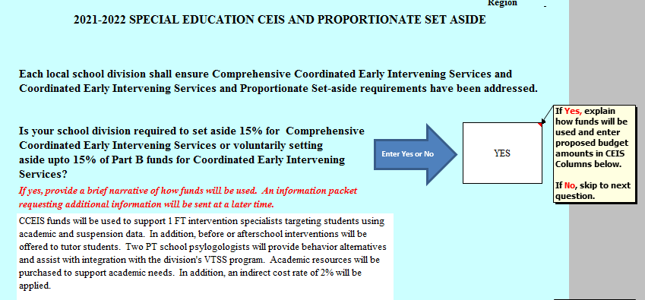
CCEIS/CEIS Included in the Annual Plan
Initial training includes a review of preliminary information that must be included in the School Division’s IDEA Part B Annual Plan Application if they are required, or will voluntarily use, funds for CCEIS/CEIS.
EXAMPLE:
Note: The budget & narrative information provided in the annual plan is preliminary & will change.

Slide 135
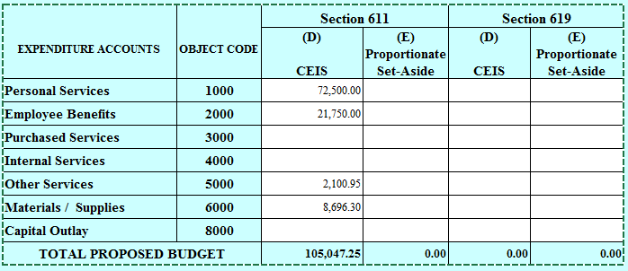
CEIS/CCEIS included in the Annual Plan
EXAMPLE:

Slide 136
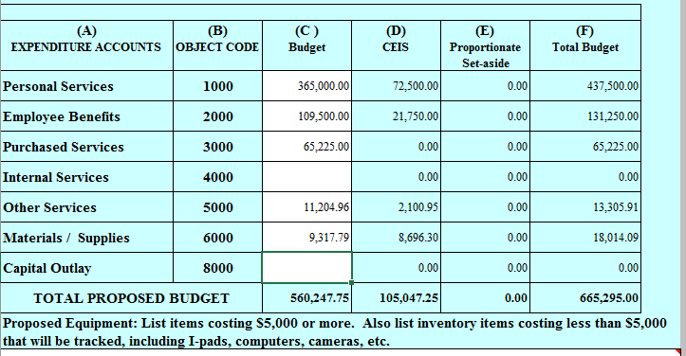
CEIS/CCEIS – Pre-Populated Amounts
EXAMPLE:
Note: Information is pre-populated for CCEIS/CEIS

Slide 137
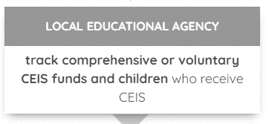
Fiscal Reporting Requirements
Voluntary CEIS | Required CCEIS
Report amount reserved | Report amount reserved
State ensures that this amount is no more than 15% of IDEA 611 and 619 funds | State ensures that this amount is exactly 15% of IDEA 611 and 619 funds
State ensures that the expenses are allowable | State ensures that the expenses are allowable and address the factors for significant disproportionality
Notes:
72-76

Slide 138
Tracking LEA CCEIS/CEIS Funds
Office of Finance and Budget (FAB)
      CCEIS/CEIS budget is maintained separately from other IDEA Part B allocations. School divisions request reimbursement from the CCEIS/CEIS budget for expenditures as noted in their approved plan.
      FAB reimbursement specialists are responsible for reviewing and approving or denying the request.
      In the due diligence of reviewing, monitoring, and approving these funds, the reimbursement specialist conducts several activities.
Notes:
CCEIS/CEIS school divisions are encouraged to contact the Office of the SEA Level Team at anytime for assistance. Each office provides a monitoring function.
Office of Finance and Budget – CCEIS/CEIS budget is maintained separately from other IDEA Part B allocations. School divisions request reimbursement from the CCEIS/CEIS budget for expenditures as noted in their approved plan. The FAB reimbursement specialist is responsible for reviewing and approving or denying the request. In the due diligence of review and monitoring of the funds the reimbursement specialist:
Compares the approved plan with the reimbursement request
Ensure the reimbursement request is allowable, reasonable and necessary
Denies the request pending additional information
Discusses the request with the school division
Approves the reimbursement request
Keeps school division informed of budget amounts
Consults with SEA team members on financial concerns and/or progress

Slide 139
Office of Finance and Budget C/CEIS Activities
FAB
Compares reimbursement request with approved plan
Ensures allowable reasonable and necessary
Approves request
Consults with SEA Team
Denies pending additional info
Consults with divisions
Informs Division of budget amounts
Notes:
Compares the approved plan with the reimbursement request
Ensure the reimbursement request is allowable, reasonable and necessary
Denies the request pending additional information
Discusses the request with the school division
Approves the reimbursement request
Keeps school division informed of budget amounts
Consults with SEA team members on financial concerns and/or progress

Slide 140
SPED-FAB Fiscal Information Link
Virginia Department of Education’s website under Special Education and Grants and Funding Section
http://www.doe.virginia.gov/special_ed/grants_funding/index.shtml

Slide 141
Virginia and Federal Resources
State Resources
Office of Special Education Finance and Budget webpage
  IDEA Annual Application/Plan Guidance and YouTube training session
  Excess Cost Calculation Requirements Guidance and YouTube training session
  Maintenance of Effort Guidance and YouTube training session
  Proportionate Share (Set-Aside) Guidance Document and YouTube training session
  Time and Effort Reporting Guidance Document
  VDOE Fiscal Monitoring Protocol
Federal Resources
The American Rescue Plan Act of 2021 (Public Law 117-2) was signed into law on March 11, 2021
*U.S. DEPARTMENT OF EDUCATION FACT SHEET Section 2014 of the American Rescue Plan Act of 2021 and the Individuals with Disabilities Education Act
See Cost Principles for federal grants set out at 2 CFR Part 200 Subpart E of the “Uniform Administrative Requirements, Cost Principles and Audit Requirements for Federal Awards.”
Federal IDEA Regulations –CFR 300 and 301

Slide 142
MOE Regulations and Resources
VDOE – Special Education Finance Budget Web Page
OSEP’s Letter to Michael Lovato for Voluntary Departure of Contractor/Service Provider (PDF)
USED Office of Special Education Programs MOE Compliance under IDEA Part B (PDF) – April 4, 2014
USED Final LEA MOE Regulations and Guidance (PDF) – August 17, 2015
Procedures for Monitoring Local Education Agencies Individual with Disabilities Education Act (IDEA) Federal Maintenance of Effort Requirement

Slide 143
PSA Regulations and Resources
FEDERAL
  Children with Disabilities Enrolled by Their Parents in Private Schools 34 CFR Sections 300.129 through 300.144
  Sec. 300.131 Child find for parentally-placed private school children with disabilities
  Questions and Answers on Serving Children with Disabilities Placed by Their Parents in Private Schools
  The Individuals with Disabilities Education Act: Provisions Related to Children With Disabilities Enrolled by Their Parents in Private Schools (Click on PDF for a downloadable booklet)
The American Rescue Plan Act of 2021 (Public Law 117-2) was signed into law on March 11, 2021
*U.S. DEPARTMENT OF EDUCATION FACT SHEET Section 2014 of the American Rescue Plan Act of 2021 and the Individuals with Disabilities Education Act
VIRGINIA
  Regulations Governing Special Education Programs for Children with Disabilities in Virginia

Slide 144

Questions & Answers

Slide 145
For Additional Information,
please contact the
Office of Special Education Finance and Budget at:
Sped-finance@doe.Virginia.gov

Slide 146
Thank You!
The Office of Special Education
Finance and Budget
Tracie Coleman, Director
Shalonda Lewis
Samantha Tansey
Cynithia Reid
Angela Phenicie
Devin Larson
Denise Lawus
Paul Raskopf
Teresa “Terry” Eckhout
Jo Ann Burkholder

