Slide 1
VDOE OMEGA Support Team
804-371-0993 – OMEGA.Support@DOE.Virginia.gov
Allison May – *OMEGA Support Specialist (804) 371-0993*
Rhonn James – Associate Director of Finance (804) 786-3235

Slide 2
VDOE OMEGA Training 2019
Table of Contents
OMEGA Introduction
Access to OMEGA
  OP-1 Form (Updated)
Application Processing
  Original Application
  Revisions
  Amendments
Budget (Object Code) Transfers
Reimbursement Requests

Slide 3
What is OMEGA?
Online Management of Education Grant Awards (OMEGA)
The Online Management of Education Grant Awards (OMEGA) is an automated grant reimbursement and application system designed and administered by the Virginia Department of Education. It is used to process grant expenditure reimbursements, budget transfers and application requests. OMEGA is accessed via the Department’s secure internet portal, the Single Sign-on for Web Systems (SSWS). [https://p1pe.doe.virginia.gov/ssws/login.page.do]

Slide 4
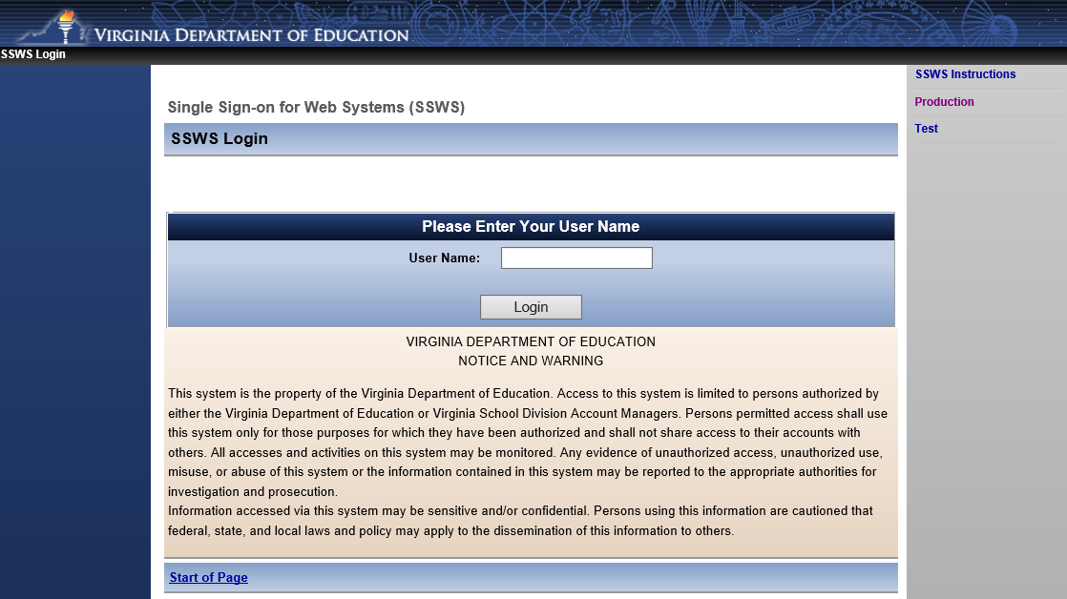
OMEGA Login Page

Slide 5

Access to OMEGA
OP-1 FORM (Levels 1 - 4)
OP-VDOE (Levels 5 – 7)
Forms can be found on the VDOE website
http://www.doe.virginia.gov/school_finance/budget/grants_acct_reporting/omega/index.shtml

Slide 6
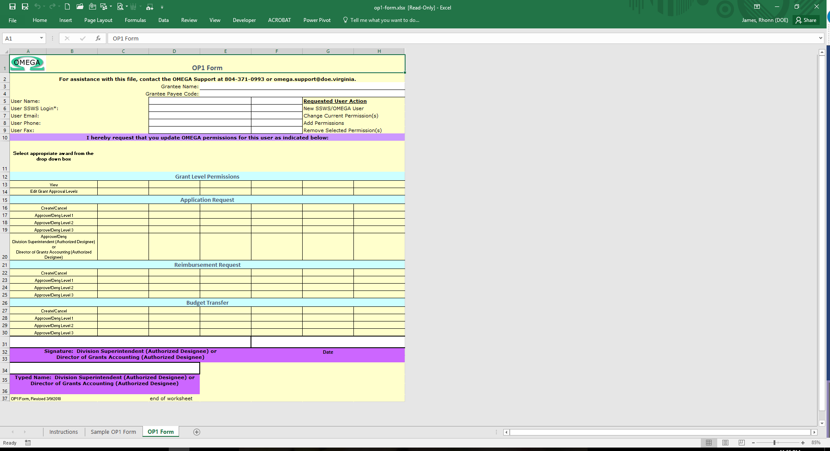
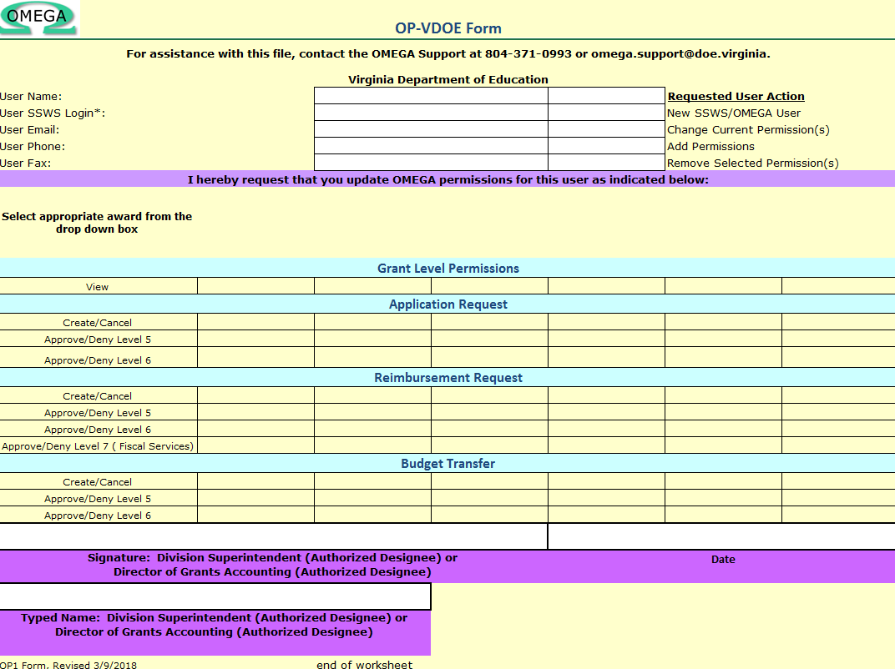
OP-1 & OP-VDOE Forms

Slide 7
Things to remember when completing an OP Form
Use the most up to date OP form
  Latest revised: 7/11/2019
Successive credentials are not allowed
  Level 0 create/ submit cannot also be a level 1 approver, etc...
OP form must be signed
  Superintendent or Supt’s designee must sign and date
Please submit OP form to OMEGA Support
  (Generally completed in 24 hours)
  OMEGA.SUPPORT@DOE.VIRGINIA.GOV
    ☺ Allison May will be more than happy to help you ☺

Slide 8

Submitting an Application
The application process allows school divisions to transmit grant award information electronically to the Department of Education while ensuring appropriate levels of review.
  The process provides one central repository for award documentation and allows immediate access to users.
Grantees may choose to submit an application for one award (non-consolidated) or an application for multiple awards (consolidated).
  More than one application per year can be submitted by a grantee and the applications can be a combination of consolidated and non-consolidated.
  *Duplicate requests for the same award for the same year will not be processed.*

Slide 9
☺ Fun Facts ☺ – Well maybe not so fun ☹
At least two people at the school division level are required to be involved in the automated process of submitting and approving an application.
One of those individuals, the Application Originator, performs the download of the completed application(s) Excel spreadsheet and submits the application for approval. (The application spreadsheet is prepared on a local computer.)
After the application has been downloaded, saved and submitted by the originator, the division superintendent or a superintendent’s designee, on record at DOE as having signature authority for the superintendent, must approve the application in OMEGA.

Slide 10

Submitting an Application
On the OMEGA home page, the application Originator selects Submit an Application.

Slide 11
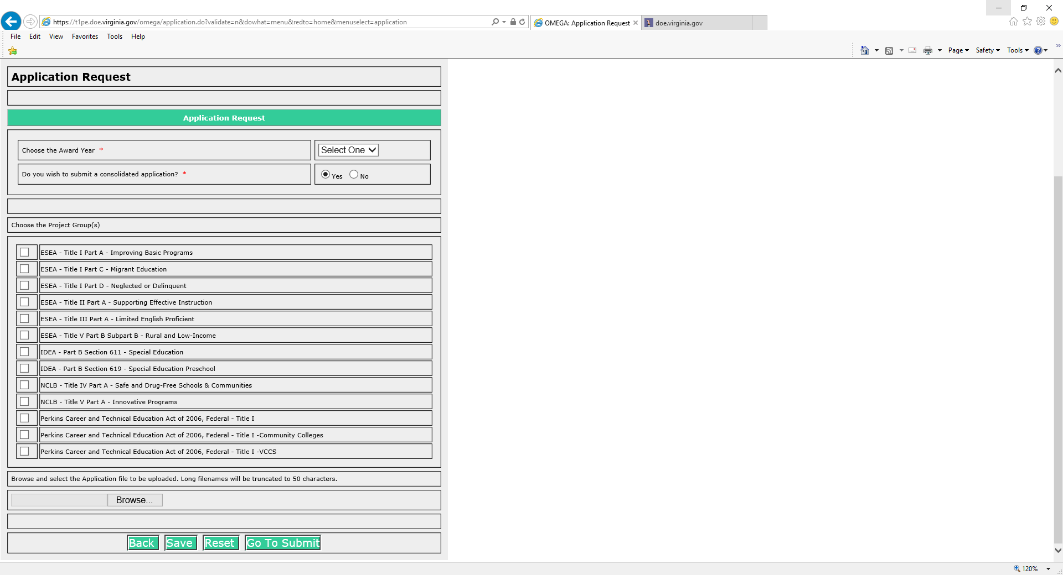
Select:
Year
Type of Application: Consolidated or Non-Consolidated (Yes or No)
Project Group
Indicate the award(s) for which funding is being requested by checking the appropriate box(es).
Then click on Browse.
Find and select (double click the file name or click the file name once and “Open” once) the Excel spreadsheet that contains the application information.

Slide 12
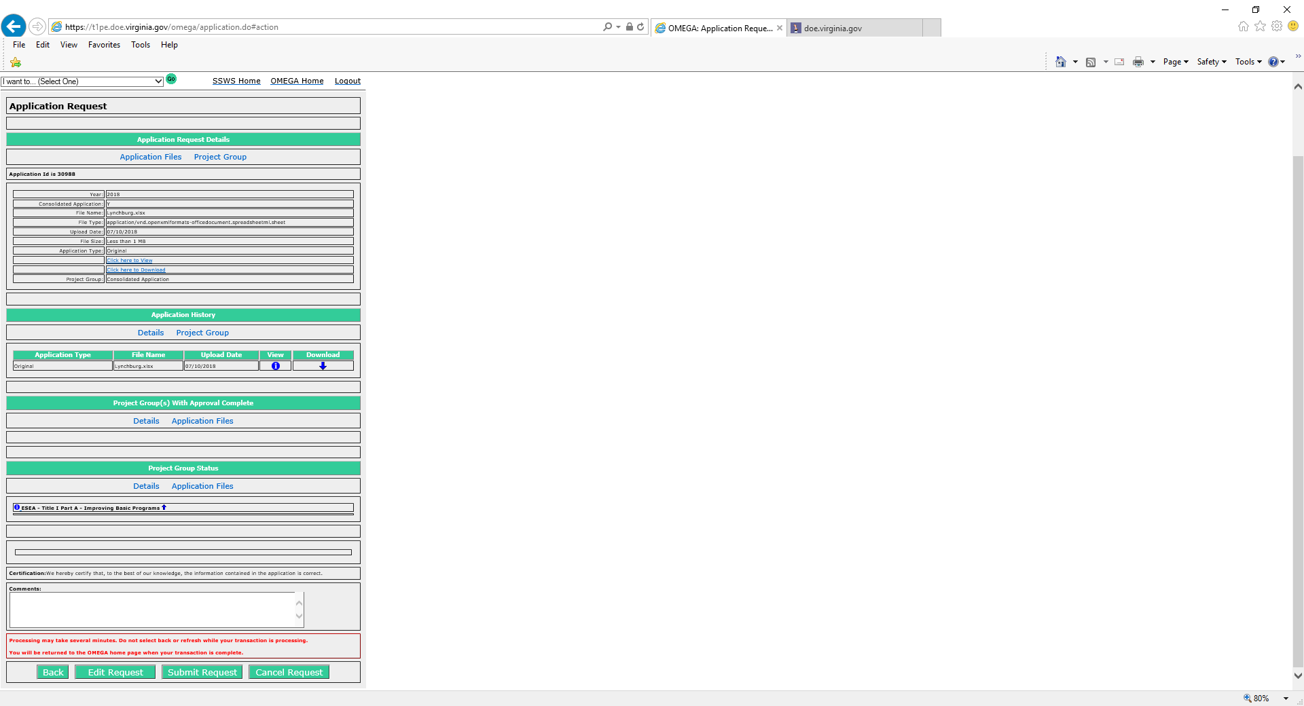

Application is staged and ready for an action
Back
Edit Request
Submit the request (Moves to the next Level)
Cancel the request
OMEGA is old and Cranky – Please be patient after clicking the submit button to avoid “Duplicate Submissions”
When contacting OMEGA Support – We always ask for the Application ID Number
Notes:
When submitting the request please be patient

Slide 13
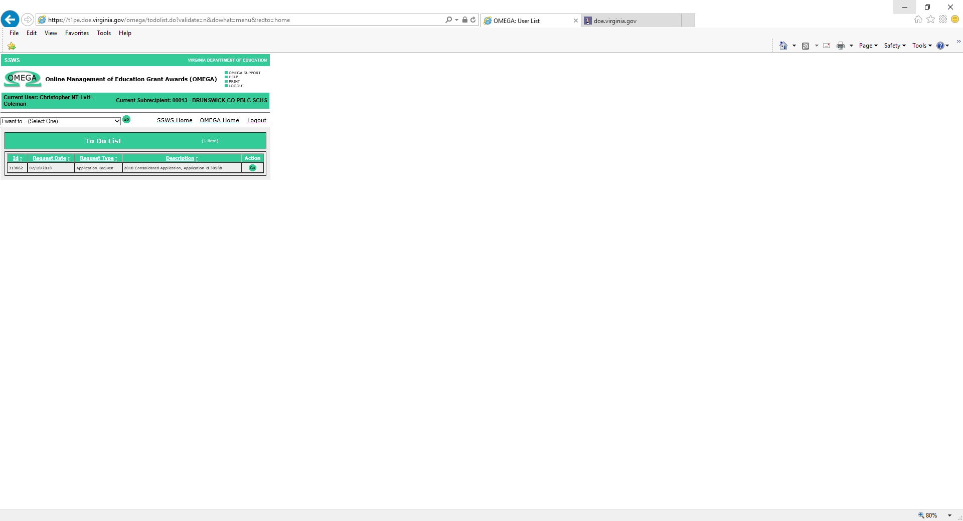
The Application is then routed in the “To Do List” of the next person up-line in the approval queue for that award
To Do List
Take Action:
Select “GO”
Application will open up to 3 Action buttons (review the attached application – Excel Format)
Back
Approve
Deny

Slide 14

Once the Application is approved… Well where did it go ???
Normal flow of the application is to move on to the next person(s) “To Do List” Up-Line
    This could be at the LEA or SEA levels
  Approval QUEUE may not be set up properly and the application could be hung up
  Other technical issues may be at fault – Contact OMEGA SUPPORT
    ☺ Allison May will be more than happy to help you ☺

Slide 15
Revising a Denied Application
A submitted application can be denied at any LEA or SEA Review Level as it moves through the Approval Queue.
Correction of a denial can be done only by an originator and only when the application is available in an originator’s To-Do list.
If a non-consolidated (only one award) application is denied, the application immediately returns to the Originator’s To-Do List.
If an award in a consolidated (multiple awards) application is denied, the application won’t return to the originator until all awards within the application have a status of either “Denied” or “Approval Completed”.

Slide 16
Revising a Denied Application
Because denials require the reviewer to add a comment as to why the award was denied, an Originator can access the application from the To-Do list as shown below.....

Slide 17
Revising a Denied Application
Access the status queue to determine what needs to be revised:
Open the status queue

Slide 18
Revising a Denied Application
Revisions are made by going into EXCEL, accessing the spreadsheet that contains the award information, making required changes, and saving the revised spreadsheet
Go back to Omega, access the application from the To-Do list by clicking the Go button .....

Slide 19
Revising a Denied Application
Select Edit Request:

Slide 20
Revising a Denied Application
Check the box(s) in the “Choose the Project Group(s)” for the award(s) that are revised
Click on “Browse”
Click-to-select the spreadsheet that contains the revised information
Click on “Open”

Slide 21
Revising a Denied Application

Slide 22

Application Revision is staged and ready for an action
Back
Save
Reset
Go to Submit
*Remember* OMEGA is old and Cranky – Please be patient after clicking the submit button to avoid “Duplicate Submissions”
Notes:
When submitting the request please be patient

Slide 23
The following screen allows comments. A brief description of revisions should be entered.
Select
In a few moments the originator is returned to the Omega Home screen. That indicates the revised application is successfully submitted and has simultaneously moved off of the originator’s To-Do list and onto the To-Do list of the first reviewer in the queue.

Slide 24
Submitting an Amended Application
The steps for processing an Amended Application is just the same as processing a Revised Application above: (From the Dropdown – Select “Submit an Application Amendment”)
However….
An application amendment may only be processed after an Application Request has the status of Approval Completed (Through level 6).
In a consolidated (multiple awards) application, all individual awards must have the status of Approval Completed.
In a non-consolidated application (one award) the one award must have the status of Approval Completed.

Slide 25
Budget (Object Code) Transfers
Change My Object Code Budget
Also known as “Budget Transfer” Change My Object Code Budget is the mechanism used to move funds within an award from object line to object line. Transfers do not increase nor decrease the funds available or affect the award’s remaining balance.
From the OMEGA home page select Change my object code budget.

Slide 26
Budget (Object Code) Transfers
Select

Slide 27
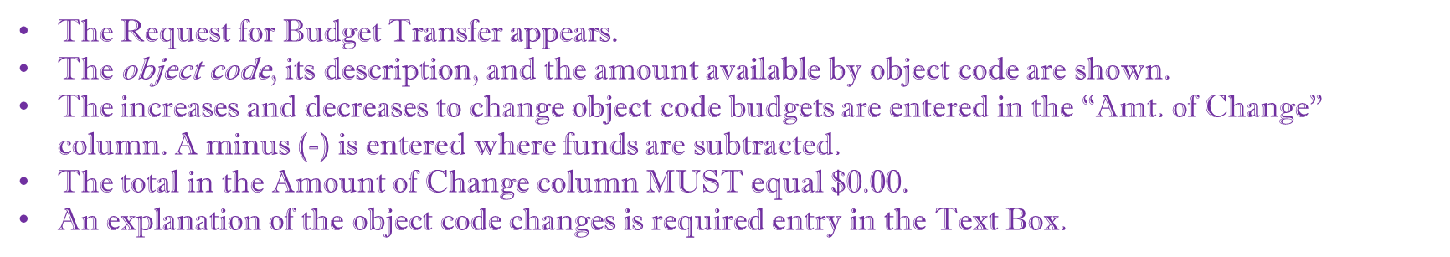
Budget (Object Code) Transfers

Slide 28
Budget (Object Code) Transfers
The next example is after changes were entered.
Note that the “Amt of Change” column total is zero and the required justification has been entered.
Other than the decimal point and minus sign, no special characters are entered i.e., ($ + ,).
There are three options:
The Back button returns the user to the home screen without saving the request.
Save saves the request, adds it to the user’s To-Do list and Omega assigns a unique request ID number.
Reset changes all amounts entered into the Amt of Change column back to zero.
Notes:
Notice the sum total is still Zero.

Slide 29
Budget (Object Code) Transfers
After saving the data, confirmation appears at the top of the page and a request ID is assigned.

Slide 30
Budget (Object Code) Transfers
Clicking on allows another review of the data and another chance to edit.

Slide 31
Budget (Object Code) Transfers
After successfully saving
  The Status Queue indicates the request is Created and shows a tracking number
  Status change date
  Individual that changed the status
  level at which the change was made.
There are four options:
  Back returns the user to the Omega Home page.
  Edit Request allow further changes to be made.
  Submit Request begins the processing and puts the request into the approval queue.
  Cancel Request will remove the request from the To-Do list.
  *Once cancelled, the request cannot be further processed. Cancellation requires a justification.*

Slide 32
Reimbursement Requests
Creating and Submitting a Reimbursement Request
Requirements for Reimbursement Requests:
  All reimbursement requests require the following information:
    Expenditure Start Date - the date of the first expenditure on the request.
    Expenditure End Date - the date of the last expenditure on the request.
    Object Code - code established by the Department to classify expenditures.
    Sector - identifies whether the cost is associated with a public or private school.
    Program Area - additional classifications established by the Department for expenditures.
    Payment Amount.
In addition to the list above, reimbursement requests including Object Codes 3000-8000 also require the following information:
    Vendor Name (100 characters max.),
    Description of the Expenditure (240 characters max),
    Check/Voucher Number (10 characters max), and
    Payment Date – date payment record was established (date processed in the accounting system or the date the check was cut).

Slide 33
CREATING A REIMBURSEMENT REQUEST
Step 1: Select “Create/Submit a reimbursement” from the I want to…list on the OMEGA Home Page or from the I want to… Drop-down Box.

Slide 34
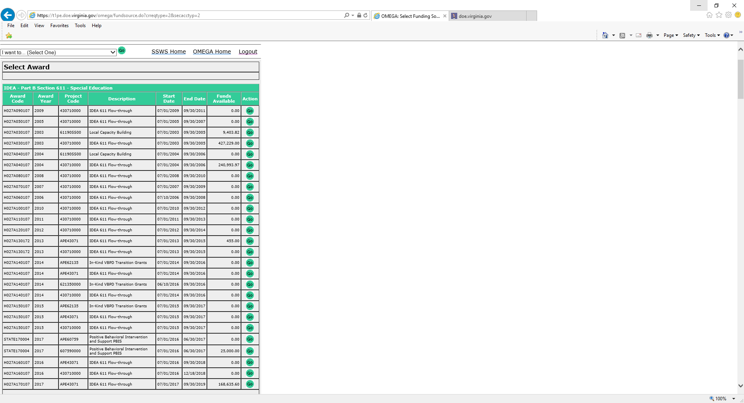
CREATING A REIMBURSEMENT REQUEST
Choosing the Create/Submit a reimbursement function will access the Select Award page so that the user can select a funding source. This will become the default award.
Select an Award using the button
Note: If, upon selection of the award, the user then tries to Create/Submit a Reimbursement but is denied access, review the user’s OP1 form to ensure that the appropriate permissions have been established. If the OP1 form shows permission is granted for this award, the user should contact OMEGA Support at the Department.

Slide 35
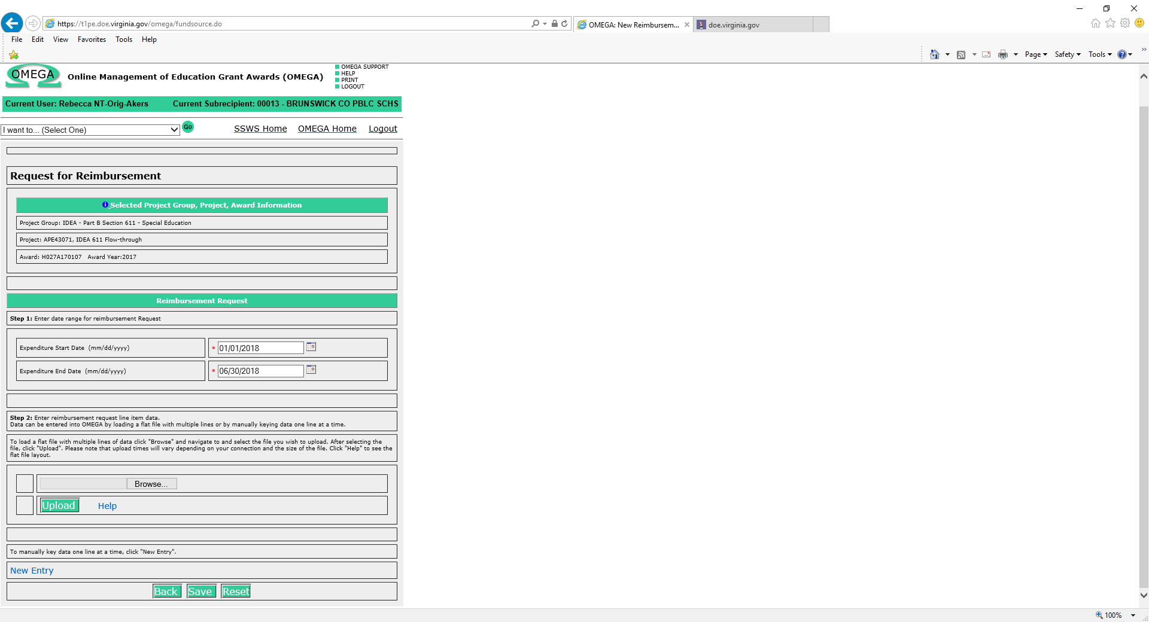
CREATING A REIMBURSEMENT REQUEST
Select an Expenditure Start Date
  Expenditure Start Date: the date of the first expenditure on the reimbursement request
Select an Expenditure End Date
  Expenditure End Date: the date of the final expenditure on the request.
Enter the expenditure data. (Expenditure data can be entered manually or uploaded from Excel into OMEGA.)
For Manual Entry:
  Select the New Entry link near the bottom of the request for reimbursement form.
For Electronic Data Entry:
  Use the Browse button to locate the file and upload into OMEGA. For details about this feature see Appendix B Uploading Data for Reimbursements.

Slide 36
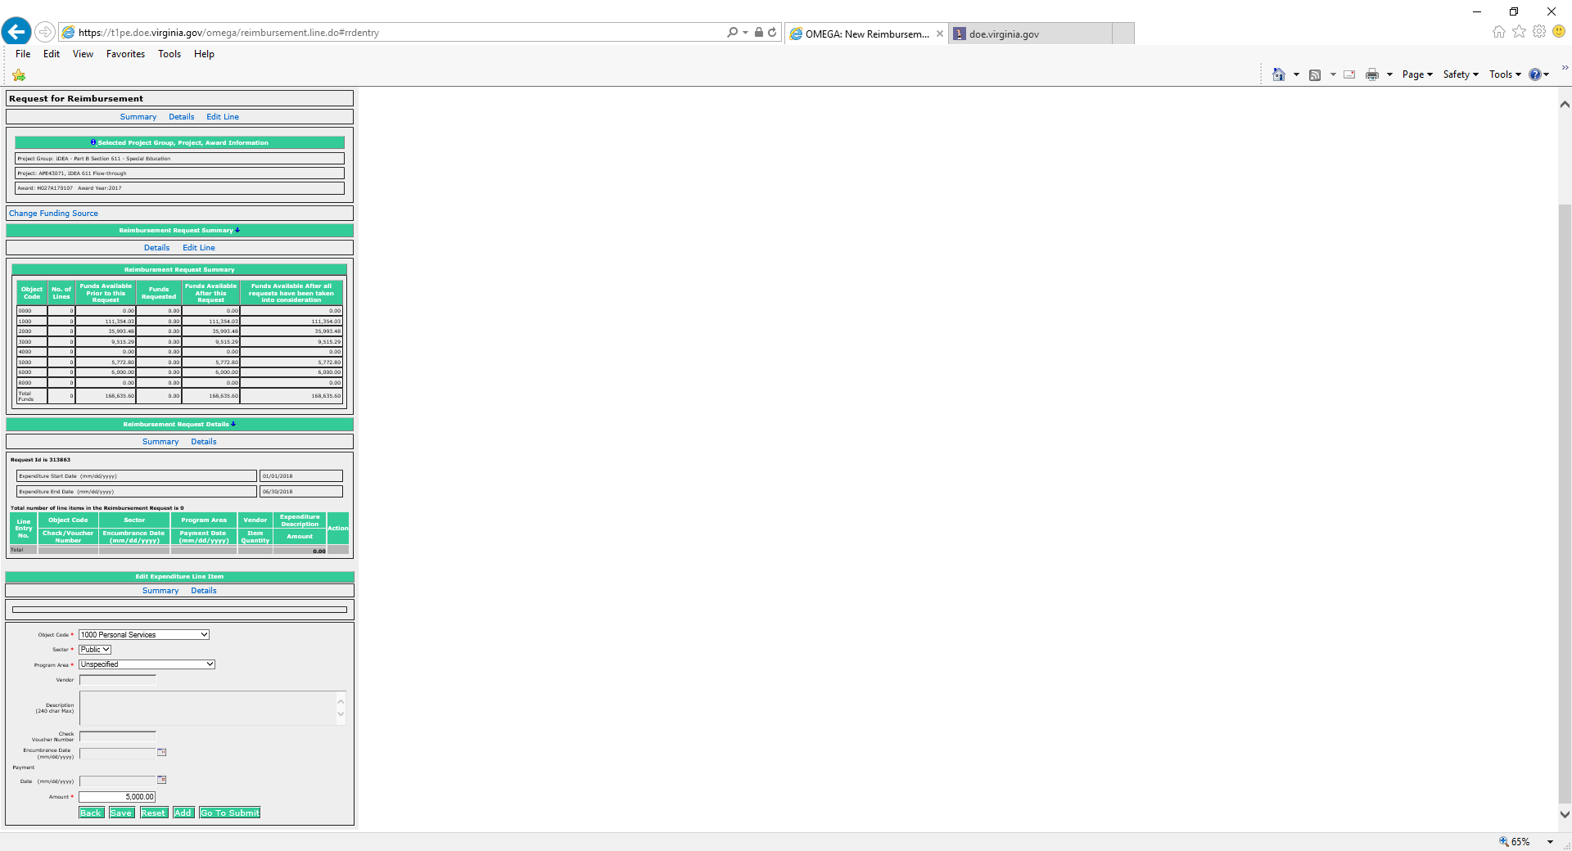
CREATING A REIMBURSEMENT REQUEST
Entering Expenditure Data Manually:
Upon selection of New Entry, a Reimbursement Request appears, containing 4 sections.
  Selected Project Group, Project, Award Information
    This section displays the selected award and related information. Change Funding Source is located here so that you can change the award from this page if necessary.
  Reimbursement Request Summary
    This section includes columns for:
      Object Code (code used to identify type of expenditure)
      No. of Lines – the value changes as detail lines are added
      Funds Available Prior to this Request (the current balance by object code). (Note that a budget transfer in process will temporarily decrease this amount. Funds are subtracted from donating object lines upon submission of the transfer request. Recipient object lines won’t change until all levels in the queue have been approved and the status is “Transfer Completed”)
      Funds Requested (amounts will appear as detail lines are added)
      Funds Available After this Request
      Funds Available After all requests have been taken into consideration (balances after all pending expenditures and budget transfer requests are included).
  Reimbursement Request Details
    This section includes:
      Request ID – a tracking number automatically assigned by OMEGA
      Expenditure Start and End Dates
      Details of each line in the request appear as lines are added
  Edit Expenditure Line Item
    This section includes the fields that are required for reimbursement. Required fields are denoted by an asterisk (*).

Slide 37
*New Policy – Object Code 1000 & 2000*
For object codes 1000 (Personnel Cost) and 2000 (Fringe Benefits) a Description is now required in the following format:
Payroll Range or Payroll Cycle Dates
GL Posting Date
Pay Date

Slide 38
*New Policy – Object Code 1000 & 2000*
Encumbrance date is an optional field
Expenditure Date is a required field and should be aligned with the Pay Date
A template is available to upload OMEGA Reimbursement transactions.
Contact Allison @ OMEGA Support for details.

Slide 39
CREATING A REIMBURSEMENT REQUEST
Action Buttons
Returns the user to the previous page .
Saves the information in OMEGA in a created status, but does not submit the request for approval. The request is saved and can be edited and/or submitted at a later date. The first time the request is saved, Omega assigns a unique ID number to the request and adds the request to the originator’s To-Do list.
Clears the information previously entered for this line item.
Opens a blank detail line to add another line item to the request.
Opens a “locked” version of the request so that the user can review it before submission. The user has options to add a comment, go back to the previous page, edit, submit,, or cancel the request. See below:

Slide 40
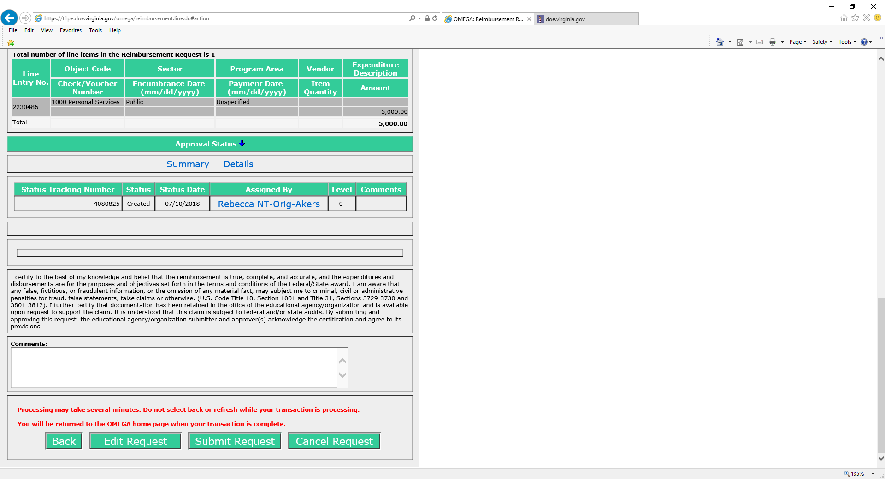
CREATING A REIMBURSEMENT REQUEST
Edit a Reimbursement Request
To edit a request, select the Action button from the bottom of the request. This will allow editing. The Reimbursement Request Details will show each line item in the request and provide an Action column on the right for each line.
Choose to change information in the selected line.
Choose to copy the line item and add it to the request.
Choose to delete the line item from the request.
Select to save the edited request in the created state.
Its always a good idea to Save after editing.
Select “GO TO SUBMIT” to proceed with submission of the request for approval

Slide 41
CREATING A REIMBURSEMENT REQUEST
NOTE: Once a request is submitted, the Originator cannot edit it. If editing is required after submission, any reviewer in the queue can deny it . A denied request will return to the To-Do list of the Originator and the originator can then edit it.
When the submission has been processed, the originator will be returned to their Omega Home screen and the request will have moved from the originator’s To-Do list to their Pending list. The request will also be on the To-Do list of the first reviewer in the queue and on the Coming Soon list of all subsequent reviewers listed in the queue. As each reviewer processes the request, it will be deleted from that reviewer’s To-Do list and will be added to their Pending list. When the request reaches its final status of Approval Completed after the last reviewer in the queue, the request will disappear from all Pending lists.
An approval level may have more than one reviewer. All individuals at a level have equal access and authority. When a status changes at a level, it changes for all individuals in the queue at that level. A division can require multiple approvals at any level. Due to separation of duties concerns, any one individual should not have permissions at more than one level for any one award.

Slide 42

When in Doubt…
Contact OMEGA SUPPORT 804-371-0993
OMEGA.SUPPORT@DOE.VIRGINIA.GOV
Any General Questions??? (Please save specific issues for OMEGA Support)

Slide 43



Connect with VDOE
Twitter: @VDOE_News
Facebook: @VDOENews
#VAis4Learners #EdEquityVA

Slide 44
Contact Information
Rhonn.James@doe.virginia.gov
www.doe.virginia.gov
Twitter: @VDOE_News
Facebook: @VDOENews
#VAis4Learners #EdEquityVA

