Slide 1
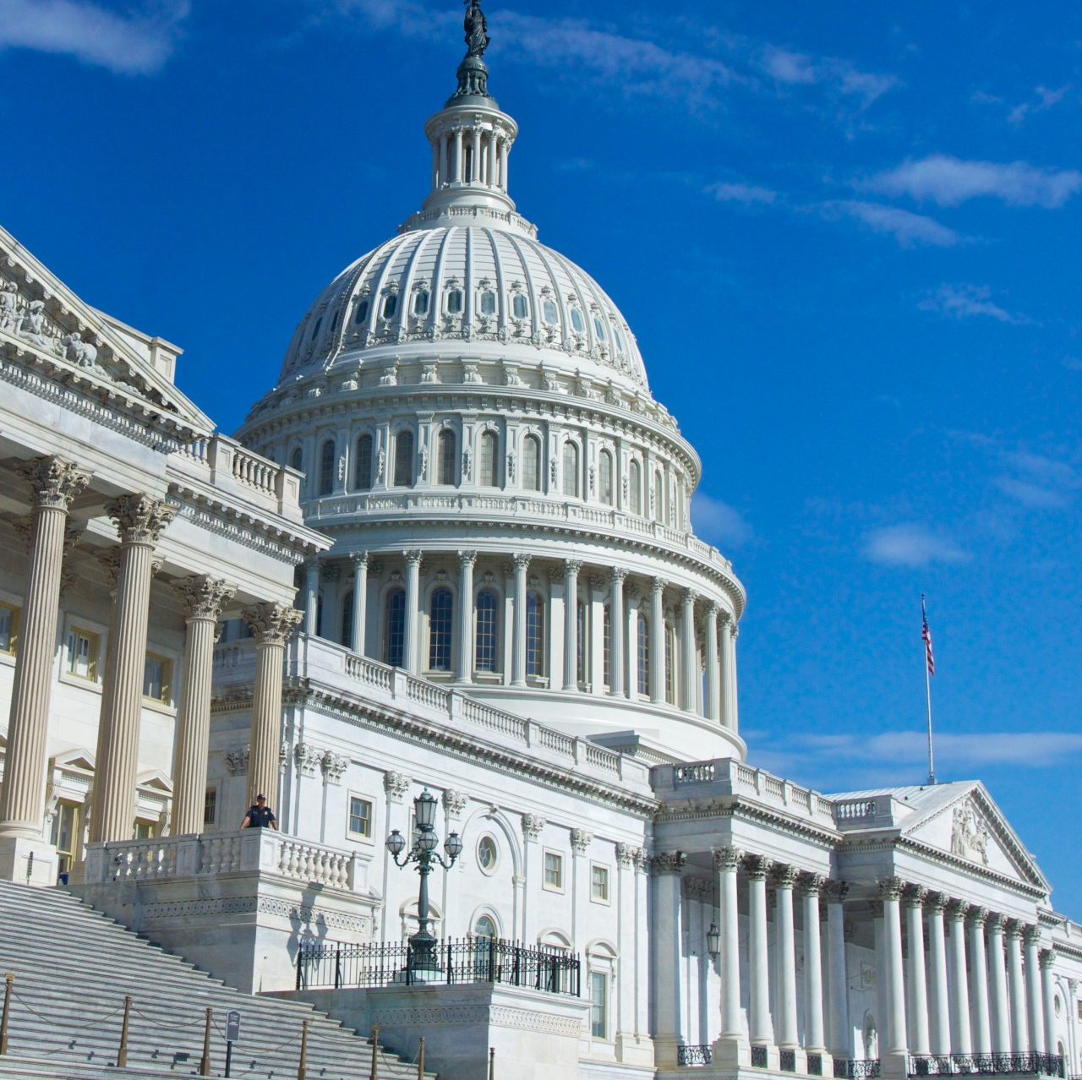
AASA Advocacy Update
Noelle Ellerson Ng
January 2023

Slide 2
Agenda
The Federal Context
Policy action in ‘23
FY23 funding
ARP
Mental Health grants
Other agency updates
SCOTUS

Slide 3
Context matters
2 More years of Biden left- how fast can they move? What will they do next?
Student loan forgiveness has been a legal debacle
Scrutiny over how they work with parents, involvement with NSBA
Civil rights groups getting frustrated by lack of progress
Environment groups increasingly frustrated
Democrats still control the Senate, but how will Sinema cooperate on key issues?
GOP takeover of the House…
That speaker vote

Slide 4
GOP Agenda in the House
Parents Bill of Rights
NSBA-DOJ collusion to investigate parents
“Unscientific justifications for school closures, mask mandates in school, and COVID vaccine mandates for young children”
“Department of Education attempt to erase scientific definitions of gender/harm of proposed Title IX regulation”
Educational Choice for Children Act ($10b/year for TTC vouchers)
Notes:
The Commitment to America

Slide 5
Leadership Shifts
New HELP Committee Chair/Ranking Members
Bernie Sanders
(D-VT)
Bill Cassidy (R-LA)
Unclear who will lead House Ed & Labor Cmte
Virginia Foxx or someone else?
Bobby Scott will remain the lead D.
New Senate Approps Leads
Patty Murray (Chair, WA)
Susan Collins (RM, Maine)
Same House Approps Leads
Kay Granger (R, TX)
Rosa DeLauro (D, CT)
New House Speaker and Minority Leader
McCarthy and Jeffries
Notes:
NEXT SLIDE

Slide 6
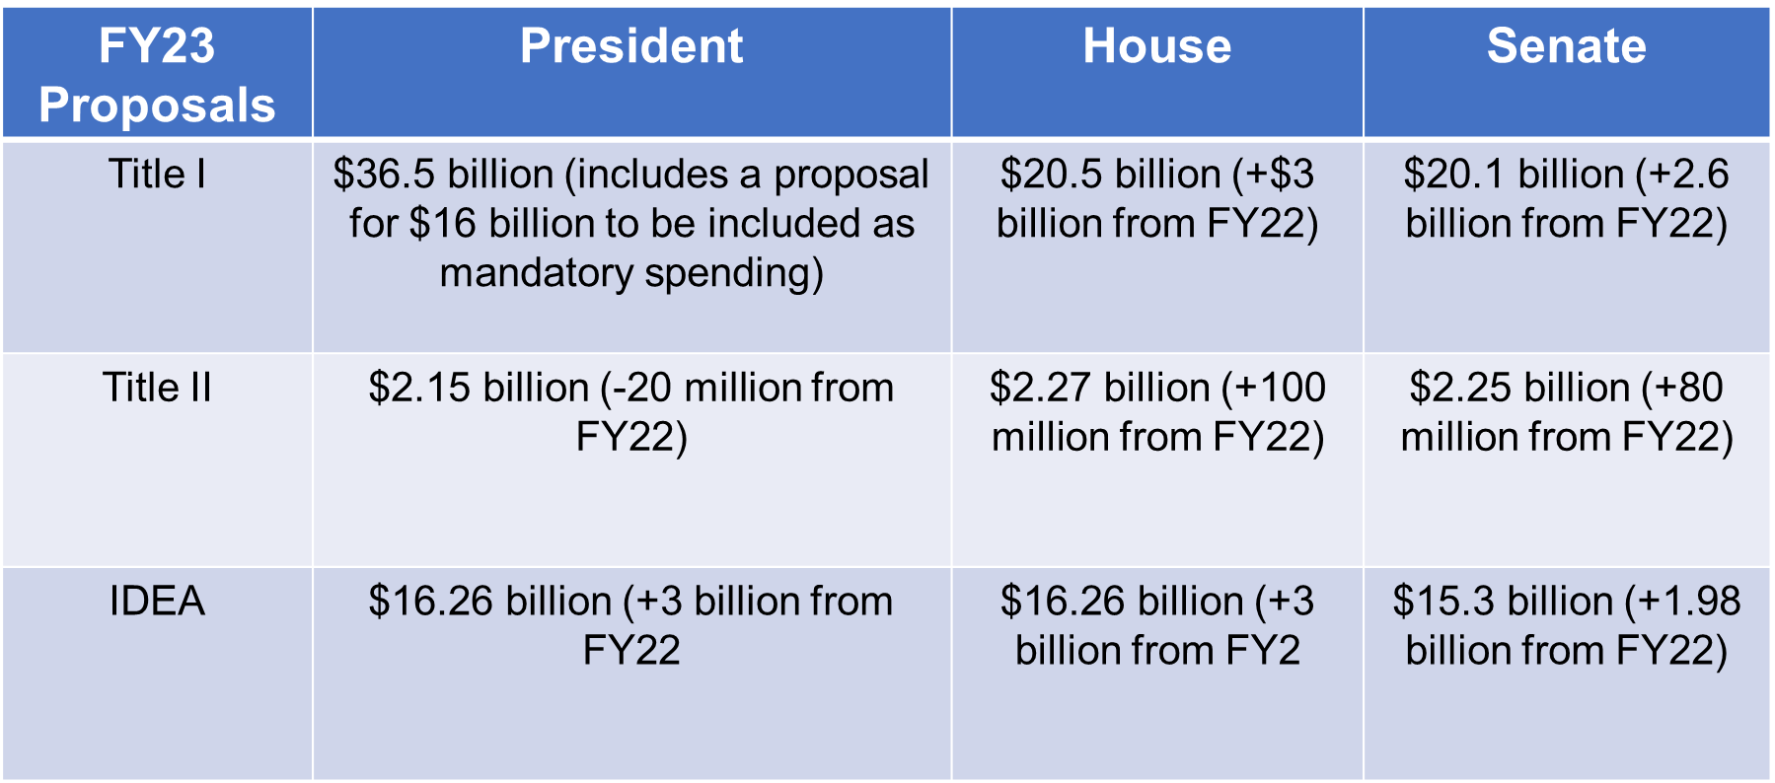
FY23 Appropriations Process
The bill provides a big increase for ED, but less than the even larger increase the President requested.

Slide 7
FY23 OMNIBUS
$1.7 t spending bill passed in late December. Includes 10% boost for military spending. Includes emergency funding for Ukraine.
USED funded at $79.6 b (+$3.2 b)
For K12: $45 b (+$2.4 b over FY22)
Title I $18.4 b (+$2.4 b)
IDEA $15.5 b (+$934 m)
Title IV $1.3 b (+$100 m)
REAP $215 m (+$20 m)

Slide 8
FY23 OMNIBUS
Does NOT include KOSA or COPPA (child/student privacy provisions)
Does NOT include extended funding for Emergency Connectivity Fund
Does NOT reauthorize or extend DC vouchers, but does level fund and allow new students to enter
Does NOT include funding for student debt relief
DOES include funding increase for Early Edu
CCDBG to $8.02 b / Headstart to $11.99 b)
School Nutrition: extends summer EBT; includes $30 m for school equipment

Slide 9
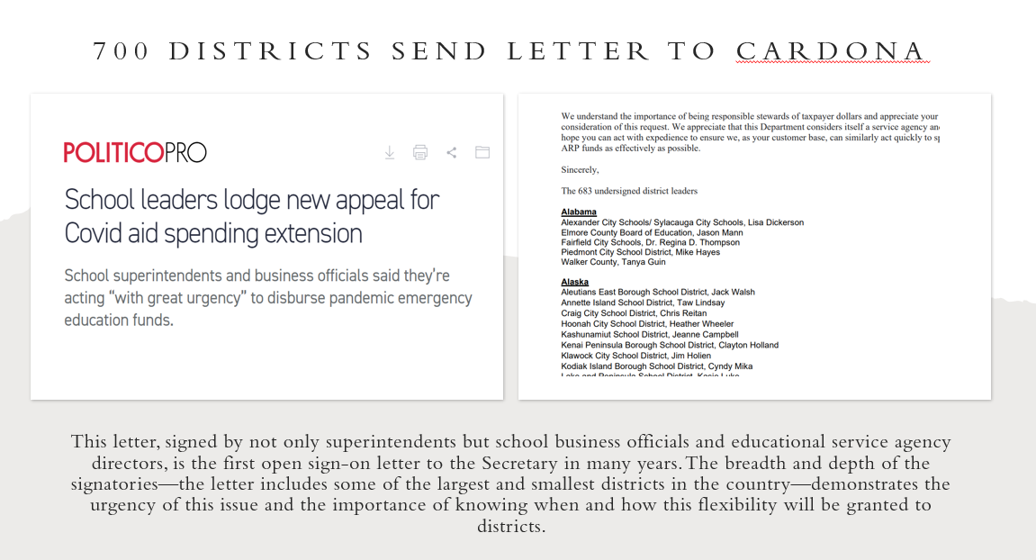

Slide 10
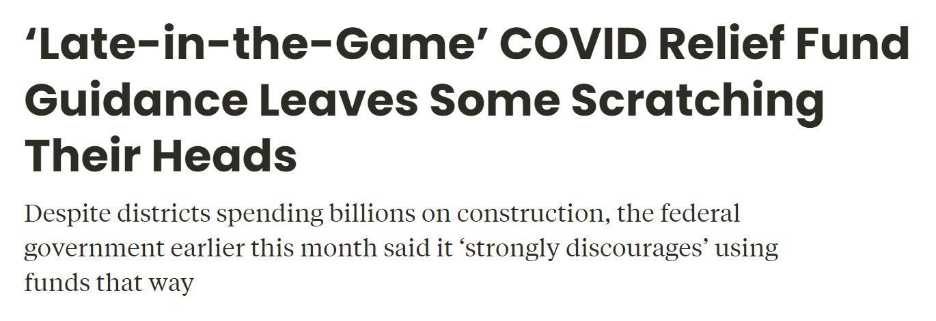
New ESSER FAQ document released on December 7

Slide 11
Unpacking new ESSER guidance
ED has worked on this document for over 8 months.
Lacks clarity and adds confusion to the field
Troubling tone around school construction/renovation projects
Mixed messages around late liquidation

Slide 12
Flip flopping in ESSER guidance
Can’t use funds for attendance incentives
Can’t use funds for increase in fuel
Backtracking on using funds for school athletic facilities unless related to preventing, preparing for and responding to the pandemic BUT addendum states that:
“These Federal emergency resources are available for a wide range of activities to address diverse needs arising from or exacerbated by the COVID-19 pandemic, or to emerge stronger post-pandemic, including responding to students’ social, emotional, mental health, and academic needs and continuing to provide educational services as States, LEAs, and schools respond to and recover from the pandemic.”

Slide 13
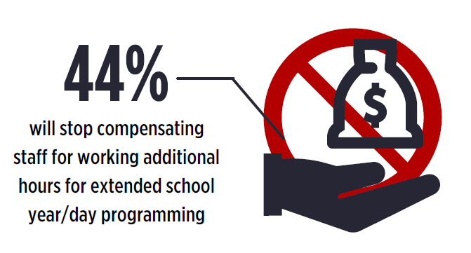
What will go away?

Slide 14
What else is ED working on? Asking of you?
Proposed regulations on 504
School discipline guidance
Title IX athletics proposal
New data collection on school finance data
ESSER data collection round 2
CRDC

Slide 15
Other agency work to keep an eye on
FCC is seeking public comment on using its E-rate program to pay for school and library cybersecurity improvements, such as advanced or next-generation firewalls. Feedback must be shared by Feb. 13
New CMS claiming guide for school-based Medicaid
Proposed EPA regulation on testing for lead/copper in schools – would not go into effect until October 2023
New sodium/whole grain regulatory targets from USDA

Slide 16
SCOTUS considers IDEA/ADA case
Perez v. Sturgis stems from Michigan
District won at the local and appellate level
Perez is a deaf student who never received a qualified sign language interpreter
Question before the court: whether and when IDEA requires him to fully pursue his claims against the school district via due process case even when doing so would be pointless as he would be able to receive the monetary damages for “emotional
Notes:
In Perez v. Sturgis Public Schools, the justices granted a petition for review filed by Miguel Perez, a deaf student who says that a Michigan school district failed for years to provide him with a qualified sign language interpreter, leaving him an “academic and social outcast.” Perez has asked the justices to decide whether and when federal education law required him to fully pursue his claims against the school district in administrative proceedings even when doing so would be pointless.
Perez, who is now 24, entered the Sturgis Public Schools when he was nine, after emigrating from Mexico. Perez never received a qualified sign language interpreter; instead, he was only assigned a classroom aide who lacked any training in working with deaf students. Just a few months before Perez – who consistently received grades that qualified him for the honor roll – expected to graduate in 2016, the school district told him for the first time that he would not receive a diploma.
Perez filed an administrative complaint against the school district. He alleged that the school district had violated both the Individuals with Disabilities Education Act, which requires school districts to provide students with disabilities with a free appropriate public education, and the Americans with Disabilities Act, which (among other things) bars discrimination against children with disabilities in public schools. A hearing officer dismissed the ADA claim, on the ground that he lacked the power to hear it, and the school board eventually settled Perez’s IDEA claim by agreeing that he could attend the Michigan School of the Deaf.
Perez then brought his ADA claim in federal court, but the district court dismissed it because he had not fully pursued it in the state administrative proceedings after settling his IDEA claims. After the U.S. Court of Appeals for the 6th Circuit upheld that ruling, Perez went to the Supreme Court, which in June asked the federal government to weigh in. In a brief filed on Aug. 24, U.S. Solicitor General Elizabeth Prelogar urged the justices to take up the case, which they did on Monday.

Slide 17
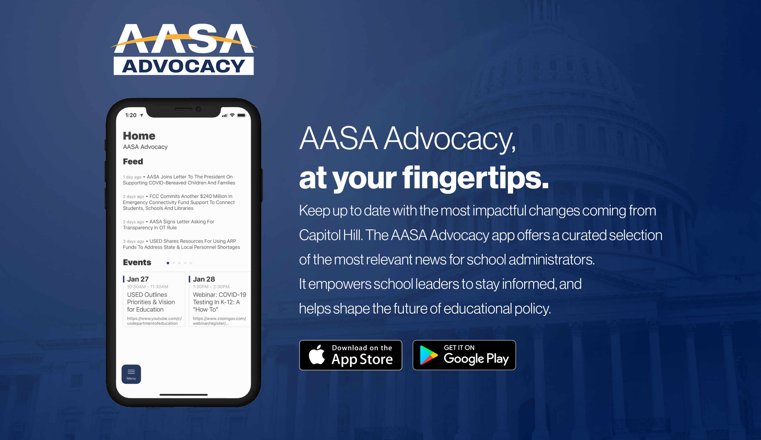
Notes:
Your greatest advocacy resource is the Advocacy Team. Noelle, Tara, Kat and I are here to assist you in any way we can. We are here to clear out that advocacy lane for you so you can make time for the more important aspects of your job.

Slide 18
AASA Advocacy & Governance
Noelle Ellerson Ng
Associate Executive Director
@Noellerson
nellerson@aasa.org
Sasha Pudelski
Director of Advocacy
@SPudelski
spudelski@aasa.org
Tara Thomas
Policy Analyst
@TaraEThomas1
tthomas@aasa.org
Kat Sturdevant
Advocacy & Governance Coordinator
@K_Sturdevant
ksturdevant@aasa.org
Notes:
Your greatest advocacy resource is the Advocacy Team. Noelle, Sasha, Kat and I are here to assist you in any way we can. We are here to clear out that advocacy lane for you so you can make time for the more important aspects of your job.

