Slide 1
Leading Questions
Keeping your finger on your pulse

Slide 2
Using an emoji, tell us how you are doing today.
ⓘ Start presenting to display the poll results on this slide.

Slide 3
“Crises take a toll on all of us. They are exhausting and can lead to burnout. Thus, one critical function of leadership during intense turbulence is to keep your finger on the pulse of your people’s energy and emotions and respond as needed. When tending to energy and emotion, you must begin with yourself.”
Nancy Koehn – “Forged in Crisis”

Slide 4
“Every day, leaders must wake up and lead themselves before they can lead anyone else.”
John Maxwell

Slide 5
Leading Questions
Keeping your finger on your pulse

Slide 6
What’s a Leading Question?

Slide 7
Leading Questions
Keeping your finger on your pulse in these challenging days
1.
4.
5.

Slide 8
Leading Questions
Keeping your finger on your pulse in these challenging days
1. How will I have fun today?
4.
5.

Slide 9
How will I have fun today?

Slide 10
How will I have fun today?
“People rarely succeed unless they have fun in what they are doing.”
Dale Carnegie

Slide 11
How do you insert fun into your day?
ⓘ Start presenting to display the poll results on this slide.

Slide 12
Leading Questions
Keeping your finger on your pulse in these challenging days
1. How will I have fun today?
Why am I a school business official?
4.
5.

Slide 13
Why am I a school business official?
“Those who have a 'why' to live, can bear
with almost any 'how’”.
Viktor Frankl – Austrian Neurologist, Psychiatrist, Holocaust survivor and author

Slide 14
Why am I a school business official?
“Who knows but that you have come to your royal position for such a time as this.”
Mordecai (Esther 4:14 NIV)

Slide 15
Why am I a school business official?
Why are you a school business official?

Slide 16
Leading Questions
Keeping your finger on your pulse in these challenging days
1. How will I have fun today?
Why am I a school business official?
What am I looking forward to?
4.
5.

Slide 17
What am I looking forward to?

Slide 18
What am I looking forward to?
“We become what we think about.”
Earl Nightingale

Slide 19
What is something you are looking forward to today or the near future?
ⓘ Start presenting to display the poll results on this slide.

Slide 20
Leading Questions
Keeping your finger on your pulse in these challenging days
1. How will I have fun today?
Why am I a school business official?
What am I looking forward to?
4. Who will I help today?
5.

Slide 21
Who will I help today?
“The best way to find yourself is to lose yourself in the service of others.”
Gandhi

Slide 22
Who will I help today?

Slide 23
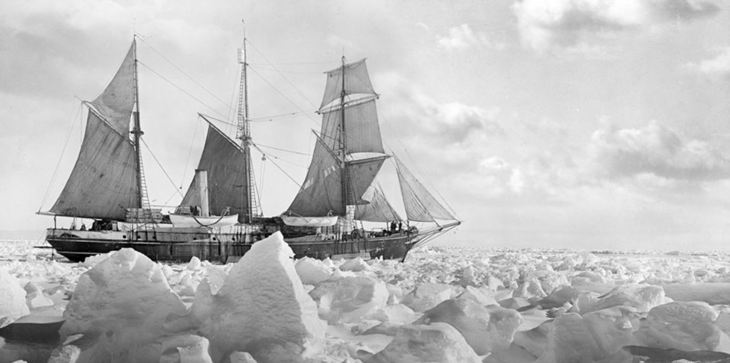
Who will I help today?

Slide 24
Who will I help today?
“Quite simply, he understood his men, their strengths and weaknesses and what motivated them. Perhaps his greatest quality was that he put the welfare of his men above everything else.”
ShakletonLondon.com

Slide 25
How have you helped others?
ⓘ Start presenting to display the poll results on this slide.

Slide 26
Leading Questions
Keeping your finger on your pulse in these challenging days
1. How will I have fun today?
Why am I a school business official?
What am I looking forward to?
4. Who will I help today?
5. What am I thankful for?

Slide 27
What am I thankful for?
Being joyful isn’t what makes you grateful.
Being grateful is what makes you joyful.
Ann Voskamp - Author

Slide 28
What am I thankful for?
One of the largest studies of happiness ever conducted
Happiness fuels success, not the other way around
Rewire your brain for positivity and optimism

Slide 29
What am I thankful for?
Write down three things you're grateful for that occurred over the last 24 hours.
Take one positive experience from the past 24 hours and spend two minutes writing down every detail about that experience.

Slide 30
What am I thankful for?
What are you thankful for?

Slide 31
Leading Questions
Keeping your finger on your pulse in these challenging days
1. How will I have fun today?
Why am I a school business official?
What am I looking forward to?
4. Who will I help today?
5. What am I thankful for?

Slide 32
Leading Questions
Keeping your finger on your pulse

