Slide 1
Optimizing School Meal Programs: Guidelines and Best Practices Virginia Association of School Business Officials May 19, 2022

Slide 2
AGENDA
TOP CONCERNS FOR SCHOOL NUTRITION PROFESSIONALS
TRANSITIONAL MEAL STANDARDS
COMMUNITY ELIGIBILITY PROVISION
SUMMER FOOD SERVICE PROGRAM
AFTERSCHOOL MEAL PROGRAM LEGISLATION

Slide 3
TOP CONCERNS FOR SCHOOL NUTRITION PROGRAM OPERATORS

Slide 4
TRANSITIONAL STANDARDS RULE
In February 2022, USDA published a rule that will serve as a bridge, giving schools the support they need to build back better from the pandemic
The rule establishes transitional standards for the school years 2022-2023 and 2023-2024 in three key areas:
Milk
Whole Grains
Sodium
Notes:
Laura – On February 7, 2022, the USDA published a rule that will serve as a bridge, giving schools the support they need to build back better from the pandemic.
The rule establishes transitional standards for the school years 2022-2023 and 2023-2024 in three key areas: milk, whole grains, and sodium.

Slide 5
SUMMARY OF TRANSITIONAL STANDARDS
Notes:
Laura- Quick review! These transitional standards allow schools and child care providers to offer flavored, low-fat milk in addition to unflavored low-fat milk and flavored or unflavored nonfat milk.
The weekly sodium limits for school lunch and breakfast will remain at the current Sodium Target 1 for school year 2022-2023. For lunch only, the limit will decrease by about 10 percent for school year 2023-2024.
At least 80 percent of grains served in school lunch and breakfast per week must be whole grain-rich.

Slide 6
ESTABLISHING ELIGIBILITY
Meal applications must be collected annually, beginning July 1
Eligibility status for the previous year carries over for the first 30 days of the new school year
VDOE-SNP is awaiting approval of a USDA waiver to allow SY 19-20 student eligibility to carryover for the first 30 days of SY 22-23
CEP schools do not collect meal applications
Notes:
Schools are required to distribute and collect school meal applications at the beginning of every school year. Applications may be distributed and collected for the current school year beginning July 1. However, households may apply for school meals any time during the school year by submitting an application directly to the school or division. Applications are reviewed by local school or district officials before granting free or reduced price benefits.
At the start of a new school year, school divisions can carry over a students’ eligibility for free or reduced-price school meals for up to 30 operating days or until a new eligibility determination is made, whichever comes first.
VDOE-SNP has submitted a waiver request to USDA that would allow SY 2019-2020 student eligibility statuses to roll over for the first 30 days of SY 2022-2023. VDOE-SNP will promptly alert SFAs when approval of this waiver has been granted.
Schools participating in the Community Eligibility Provision (CEP) are not permitted to distribute school meal applications. All students enrolled in CEP schools receive meals free of charge without needing to submit an application.

Slide 7
WHAT IS THE COMMUNITY ELIGIBILITY PROVISION?
Alternative to collecting meal applications
All enrolled students receive breakfast and lunch at no charge
Four-year cycle
Reimbursement: Number of identified students x 1.6 = % meals reimbursed at the free rate
Notes:
What is CEP? The Healthy, Hunger-Free Kids Act of 2010 amended the National School Lunch Act to provide an alternative that eliminates the need for household applications for free and reduced-price meals in high-poverty LEAs and schools. This alternative is the Community Eligibility Provision, usually referred to as (CEP). CEP provides access to school breakfast and school lunch for all students at no cost – similar to how you have been operating under pandemic waivers. In order to qualify, a school or division must have at least 40% of its enrolled students eligible for free meals by DIRECT CERTIFICATION ONLY. That’s not 40% free eligible, it’s 40% free by DC and any method without application. These are the identified students you reported for each of your schools as of April 1. The CEP school, group or division applies for CEP and is approved for a four year cycle. CEP meals are claimed as total meals served and the Identified Student Percentage (ISP) times the 1.6 multiplier is used to calculate the percentage of meals reimbursed at the free rate. The remainder are reimbursed at the paid rate.
For example, a CEP school has an ISP of 62.5%. That percentage multiplied by 1.6 means 100% of the meals served would be reimbursed at the free rate. A school with an ISP of 45% would have a claiming percentage of 72% free and 28% paid.

Slide 8
VIRGINIA CEP PARTICIPATION
Notes:
Virginia schools have eight years of experience and success with CEP. From small beginnings, CEP has expanded to almost 90% of all school divisions participating. More than half of all school divisions in Virginia participate in CEP divisionwide.
The pioneers who started CEP in SY 2014-2015 jumped off a cliff without knowing what was below. Since then we have learned from the many schools and divisions with ISPs from 40% to 60%+ that have implemented CEP – it works!

Slide 9
VIRGINIA CEP PARTICIPATION (1)
Notes:
More than half of all schools in Virginia are approved for CEP and more than a half million students can continue to receive meals at no cost through CEP after the pandemic waivers expire.
About 75% f these schools were participating in CEP before the pandemic. They were able to provide meals at no cost to all students. Whether it was for one or two schools or for all schools in the division, CEP has had a positive impact on the school nutrition program, student meal participation, and students learning readiness through increased access to healthy, delicious school meas at no cost.

Slide 10
CEP AS A TOOL FOR RETURNING TO NSLP/SBP
Continue meals at no cost for all students
Streamlines meal service
Simplifies counting and claiming
Provides support to students, families, and the community
Notes:
Schools have achieved significant increases in meal participation under the pandemic waivers during in-person school. One reason for that increased participation is access to meals at no cost for all students…Saying…rising tide lifts all boats… High meal participation is key to the financial health of your SNP…..Participation drives everything…It is critically important for the health of your school nutrition programs to sustain and build on the high participation you achieved with SSO and pandemic waivers. CEP continues meals at no cost to all students. Meal service outside of the cafeteria, like breakfast in the classroom and grab n go lunch, can be streamlined with CEP. Meal counting under CEP does not require counting by category, so CEP schools can continue to use a tick sheet, a handheld clicker, or their POS system with no ID required. CEP meal claims are submitted by total meals served only and SNPWeb applies the CEP claiming percentages.
CEP is an excellent tool to continue providing support to students, families and the community as challenging times continue.

Slide 11
ADVANTAGES OF CEP
Students
Parents
School nutrition staff and administrators
Notes:
Students: Removes barriers to receiving school meals, eliminates meal debt, all students are treated the same regardless of household income. There are more reasons than low income for students to benefit from CEP. Some students that are not low income need support of low time, low access to nutritious foods, or low family support. CEP helps all students with learning readiness through good, healthy food at school.
Parents: Eliminates meal application paperwork, provides goodwill and help to all families, regardless of income status.
School nutrition staff and administration: Streamlines meal service, simplifies counting and claiming, requires less staff time, and reduces administrative burden.
Schools can use simplified methods for counting meals as long as there is a way to prevent claiming more than one meal per student. Simplified methods may include your POS without students having to enter their PIN for lunch in the cafeteria and using paper rosters for breakfast in the classroom.
CEP elimates school meal debt. All meals are served at no cost to students. All students are treated equally and no debt collection is necessary. Staff interactions with students can be focused on good customer service and delicious food.
CEP can help the transition back to NSLP/SBP by maintaining the high meal participation so many of you have reported this year. The significant increases in participation and removal of stigma associated with eating a school meal often makes CEP a revenue generator for schools.

Slide 12
WHY CEP?
Eliminates meal applications and administrative burden
Makes it simpler to count meals - in the classroom, library, cafeteria, or grab-and-go
Eliminates school meal debt
Can help support the transition back to NSLP/SBP operation and financial stability
Notes:
Why CEP? Because it creates a positive, supportive environment for school meals and for all students. It simplifies the processes, eliminates paperwork, levels the playing field and treats all students the same – no student has to feel uncomfortable about being singled out for receiving a school lunch or breakfast OR feel embarrassed because they’re hungry but they don’t have the funds to pay the full-price for their meal… CEP creates a positive customer service driven relationship between your students and your SNP staff…
We understand that often you are not the final decision maker about CEP in your schools…administrators, leaders, and other decision makers might need your help to see the impact CEP can have on students, school environment, and the school nutrition program. Have these conversations with your school administrators. Use Virginia’s historical information. The CEP experience of 90% of all school divisions and nearly 1000 CEP schools with ISPs from 40-60+% and 90% reinforces the program’s success. Provide facts and data. When talking to administrators and leaders about school nutrition program, keep this thought a wise superintendent once shared… in any decision a school division makes, the first question should always be, is it in the best interest of our students…If the answer is yes, it’s our job to figure out how to make it happen.

Slide 13
CEP OPPORTUNITIES April 1 LEAs and Schools Eligible and Near Eligible to Participate in CEP
Expand to divisionwide CEP
13 school divisions
Add CEP schools
78 new eligible schools
36 nearly eligible schools
Notes:
Many LEAs and schools have the opportunity to adopt or expand CEP for SY 2022-2023 based on the April 1 ISP report – which is publicly posted to the VDOE website at this link.
How can you tell if your LEA can expand to divisionwide CEP (Ron can you click the link to the report?) Look at the first tab of the report, LEA level ISP. If there is an X under eligibility, that means the divisionwide ISP is 40%> and the LEA can apply for DW CEP.
For the school level data, click on the second tab. If the school has an X in Column F, Eligible to Participate, and no X in Column H, currently participating, the school can apply to participate in CEP for SY 2022-2023.
If you have questions or want more information, reach out to your assigned SNP specialist.

Slide 14
WHAT ABOUT REQUIRED CEP SCHOOLS?
CEP eligibility is an opportunity – if your schools are eligible, participate.
Communicate. Educate.
Terminating CEP participation
Notify VDOE by June 30 by attaching the required form to your SY 2022-2023 SFA Application Packet
Notes:
CEP eligibility is an opportunity – if your schools are eligible, participate. Get the word out, be positive, educate administrators and school officials and provide information and justification for why CEP is the right thing for your students and your program.
If an LEA determines it has no other option and must remove a school from CEP, federal regulations require LEAs to officially notify VDOE by June 30 of the school year prior to termination. The formal notification of CEP termination requires the reason to be documented and submitted to VDOE. Financial analysis of CEP should be part of the decision making process. The previously mentioned financial viability waiver related to the state CEP legislation will not be implemented at this time. We have created a form that will be available in SNPWeb download forms. The signed form must be submitted directly to Dr. Curwood for review and, after approval, VDOE will attach it to your SY 2022-2023 Application Packet. Instructions for that form will be included in the CEP Application Supt. Memo at the end of this month. VDOE-SNP is awaiting further guidance from the VDOE Policy Office and the OAG about HB 5113.

Slide 15
CEP TOOLS AND RESOURCES
USDA CEP Planning and Implementation Guidance Manual
VA Hunger Solutions CEP Toolkit
VDOE-SNP CEP Federal Reimbursement Calculator
VDOE-SNP Templates for CEP proposal and school board presentations
ICN Key Performance Indicators (KPIs) Cost Per MEQ
Notes:
Additional resources to drive CEP success.
Slide notes for presenter: Discuss and possibly show each of the resources by pulling up on screen and describing what they are, how they can be used, and where they can be found.
If you’re a member of the national School Nutrition Association (SNA) you can access an on demand recording of their April webinar – Make CEP Work for You! And other CEP resources from the Food Research Action Center (FRAC) and No Kid Hungry (NKH). And finally, some of the best resources are your neighbors and colleagues who have operated CEP under NSLP and SBP and the VDOE_SNP specialist assigned to your region.

Slide 16
What is the SFSP?
Ensures children have access to nutritious meals during the summer and unanticipated closures
Notes:
So let’s begin by talking about the purpose of the SFSP. The SFSP is part of the federally funded USDA Child Nutrition Programs. It’s intent is to ensure children have access to nutritious meals during summer months and also during emergency situations, such as snow days, hurricanes, and global pandemics.
But, when talking about SFSP in a traditional sense, we typically focus on the summer months. For children who rely on school meals as their main source of nutrition during the school year, the summer can be a time of anxiety, wondering where their next meal will come from. That is why the SFSP is so crucial. It plays a critical role in ensuring our children remain nourished during May through September, so they can focus on enjoying time off from school and not losing any learning gains accomplished during the school year.

Slide 17
SCHOOL YEAR 2022-2023 SSO WAIVERS
SSO waivers expire on June 30, 2022
Schools should choose between the SFSP or the SSO when summer begins and operate that program through the summer
Consider the unique situation of your division to drive your decision
Community sponsors will begin summer with “normal” SFSP operations
Notes:
USDA confirmed that for school divisions, the current SSO waivers are available through June 30, 2022. So for example, if your school division’s academic school year ends on May 16, you can continue operating the SSO with the waivers through June 30.
For community sponsors they are not eligible to operate the SSO. Once the academic school year ends in your area, you will switch to normal, pre-pandemic SFSP operations.

Slide 18
OPERATING SFSP IN 2021 VS. 2022
Waivers 2020-21: Non-Congregate Feeding, Parent/Guardian Meal Pickup, Area Eligibility, Meal Pattern Flexibility
Summer 2022: Schools and Community Sponsors will operate under normal operation
Notes:
Now, let’s take a look at what the SFSP program looked like last summer with the USDA nationwide waivers compared to what the SFSP program will look like this year. In 2020, the USDA has issued nationwide waivers for all of the school and child nutrition programs. Those waivers include:
Non-Congregate Feeding: With this waiver, participants can consume their meal offsite
Parent Guardian Pickup: This waiver to allowed parents and guardians to pick up meals for children. This waiver is coupled with the non-congregate waiver, and sometimes the meal times restriction waiver, to allow for grab and go and curbside operations.
Area Eligibility: This waiver suspends the area eligibility requirement to allow a feeding site to operate in any location, regardless of the free and reduced-price rate.
Meal Pattern Flexibility: Allowed sponsors to serve meals that do not meet the meal pattern for reasons related to the pandemic. This was approved by the State Agency on a case-by-case basis.
Schools and Community Sponsors utilized these waiver for their SFSP operation last year. These waivers are set to expire on June 30, 2022. In March 2022, the VDOE-SNP submitted waiver requests for these waivers, but is unsure if they will be approved by the USDA. Schools and community sponsors should plan for a normal summer operation that begins right when their SFSP operation begins. By “normal”, we mean what a summer operation looked like before the pandemic.

Slide 19
Who is eligible?
Different from the NSLP - sites qualify, not the individuals
Children through the age of 18
Notes:
SFSP meals are for children through the age of 18. Proof of identity or age is not required and should not be asked in order for a child to receive a meal.
I want to take this opportunity to discuss feeding infants in the SFSP. As per the USDA, an infant is a child aged 0 through 11 months. If a sponsor wishes to feed infants at an SFSP site, the CACFP infant meal pattern must be used. Since the CACFP infant meal pattern is complex, prior approval must be granted by our office. For example, following the CACFP infant meal pattern would entail having formula on hand or working with the parent or guardian to provide breastmilk. Around 6 months, infants are introduced to solids, which requires close coordination with the parent or guardian to determine developmental appropriateness.
Serving infants is not required in the SFSP and sponsors without the operational capacity to follow the CACFP infant meal pattern should not elect to serve infants. Feeding sites can deny meals to children under 1, but if a child age 1 and older visits a feeding site requesting an SFSP meal, the meal must be provided.

Slide 20
Site Eligibility
Area Eligibility (school or Census data)
Income Eligibility (income applications)
Open
Open restricted
Closed enrolled in needy area
Closed enrolled in non-needy area
Camps
COVID-19Waiver
COVID-19 Waiver
Migrant sites can operate anywhere but must submit certification letter
Notes:
Open sites are located in areas where 50% or more of the children residing in the area are eligible for free or reduced-price school meals. Meals are available to all children in the community on a first-come, first-served basis. In the SFSP, sponsors can use school and attendance data or Census data to establish area eligibility. Once established, sites are eligible to operate for 5 years.
Open restricted and closed enrolled sites in a needy area qualify the same way as open sites, however meal service is limited to a restricted population or only to children enrolled in the program being offered.
Enrolled programs that are located in areas that are not eligible can potentially still operate as well. These types of sites are referred to as closed enrolled in non-needy areas. The site will collect income forms from all enrolled children. As long as 50% of the children qualify for free or reduced-priced meals the site is eligible to operate, and all children eat for free.
Camps do still need to collect income forms. Any campers that qualify for free or reduced-priced meals using the USDA income guidelines can be claimed for reimbursement.
And lastly, migrant sites can be established anywhere, but only with a letter from the migrant organization certifying that the site will serve only or mostly migrant children.

Slide 21
Meal Service Requirements
Sites may claim 2 meals per day
Lunch and supper cannot be claimed on the same day
Meals must be consumed in a congregate setting
Meal must be consumed during designated meal times
SFAs may use the NSLP meal pattern
Any sponsor may use the CACFP meal pattern
COVID-19 Waiver

Slide 22
AFTERSCHOOL MEAL LEGISLATION
House Bill 2135
2021 General Assembly session
Legislation amended § 22.1-207.4:2 of the Code of Virginia
Eligible schools must operate the CACFP At-Risk
Effective school year 2022-2023 (July 1, 2023)

Slide 23
SCHOOL MEALS PROMOTE COMMUNITY
School staff, parents/guardians, and students need consistency and support
Divisions should seek opportunities to build community and rebuild school culture
School nutrition provides many opportunities to invest in school culture and a sense of community
School nutrition professionals are facing significant challenges. They need your help!
Notes:
Main point 1: At the current state in the pandemic, school staff, parents/guardians, and students - need consistency and support
It is important to acknowledge the reality that students have faced over the past two years. All systems supporting them have been pushed to their limits, and students have felt the impacts first hand.
Main point 2: As we work to recover from the pandemic, divisions should seek opportunities to build community and rebuild school culture.
Today, many students are experiencing trauma and may be facing developmental challenges brought on or exacerbated by the COVID-19 pandemic – to combat this, students need time for connection, social interaction, and the opportunity to build positive relationships with other children and adults.
Main point 3: School nutrition provides many opportunities to invest in school culture and a sense of community.
School meals are most recognized as a critical source of nutrition for students, but school meals also offer students vital social support.
These meals help students build social relationships and trust, develop social and self-awareness, and promote responsible decision-making behaviors.
A 2021 survey to parents and students found that 77% of parents saw school meals as a time to help their children build community and friendship with other students
Source: https://bestpractices.nokidhungry.org/resource/how-school-meals-can-support-social-emotional-school-climates
Main point 4: School nutrition professionals are facing significant challenges with the expiration of nationwide waivers. They need your help.
At this time, more than ever, it’s crucial to work with your school nutrition departments and support these programs.
This will ensure that students are not only fed, but supported as they lead our schools in rebuilding a positive and healing school culture.

Slide 24
WAIVER RESPONSE
Waivers for SFSP/NSLP back to school:
Require school/site to be closed in response to COVID-19 to use the waivers

Slide 25
VIRGINIA FOOD FOR VIRGINIA KIDS
The overarching goal of the Virginia foods for Virginia Kids initiative is to ensure that every Virginia child has equitable access to good, healthy, Virginia foods in school and community meals programs.
This project supports nutrition, health, agricultural and cultural competence, and environmental education, and connects the cafeteria with the classroom and school gardens as well as the agricultural and business communities.
This project will focus on getting Virginia agricultural products into the school meal programs, with a focus on scratch cooking.
STUDENTS TASTING LOCALLY GROWN LEMON CUCUMBERS IN TAZEWELL, VA.

Slide 26
VIRGINIA FOOD FOR VIRGINIA KIDS
The Virginia Food for Virginia Kids Steering Committee combines diverse partners and stakeholders from across the Commonwealth and beyond to develop programs and resources that support increasing fresh, local food in school nutrition programs.

Slide 27
WORKFORCE DEVELOPMENT
The Workforce Development Subcommittee is gathering key organizations to both evolve the professional nature of the school nutrition workforce and align Virginia programs to effectively train and prepare future school nutrition staff.
The Department of Aging and Rehabilitation Services (DARS) has a unique role in identifying career pathways for individuals with disabilities and are developing an apprenticeship program for school nutrition job training.
Additionally, the Virginia Department of Education’s Office of Career, Technical, and Adult Education (VDOE CTE) will utilize existing statewide agriculture programs to increase work-based learning.

Slide 28
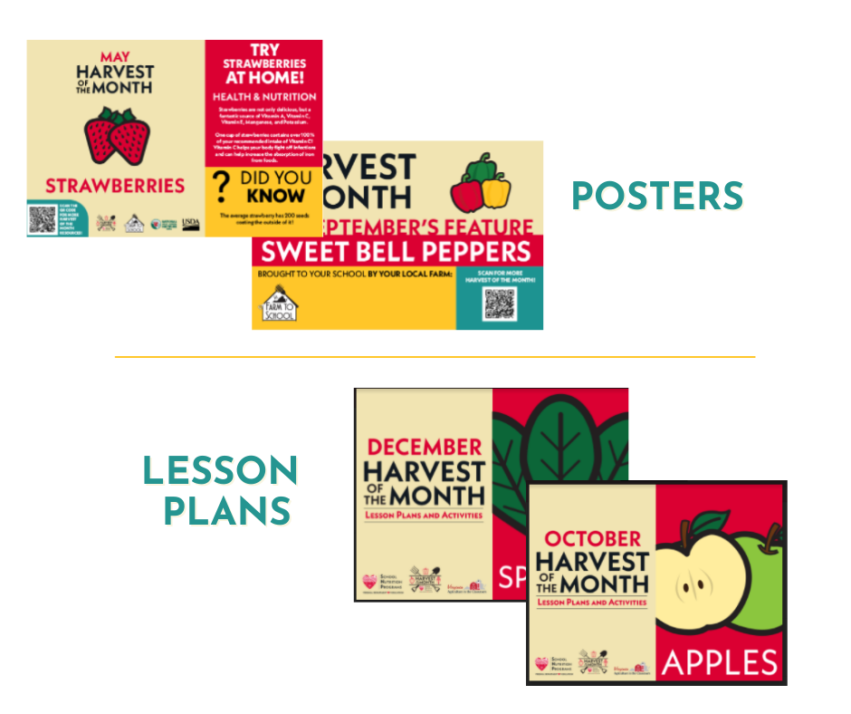
TNTG TRAINING AND RESOURCES

Slide 29
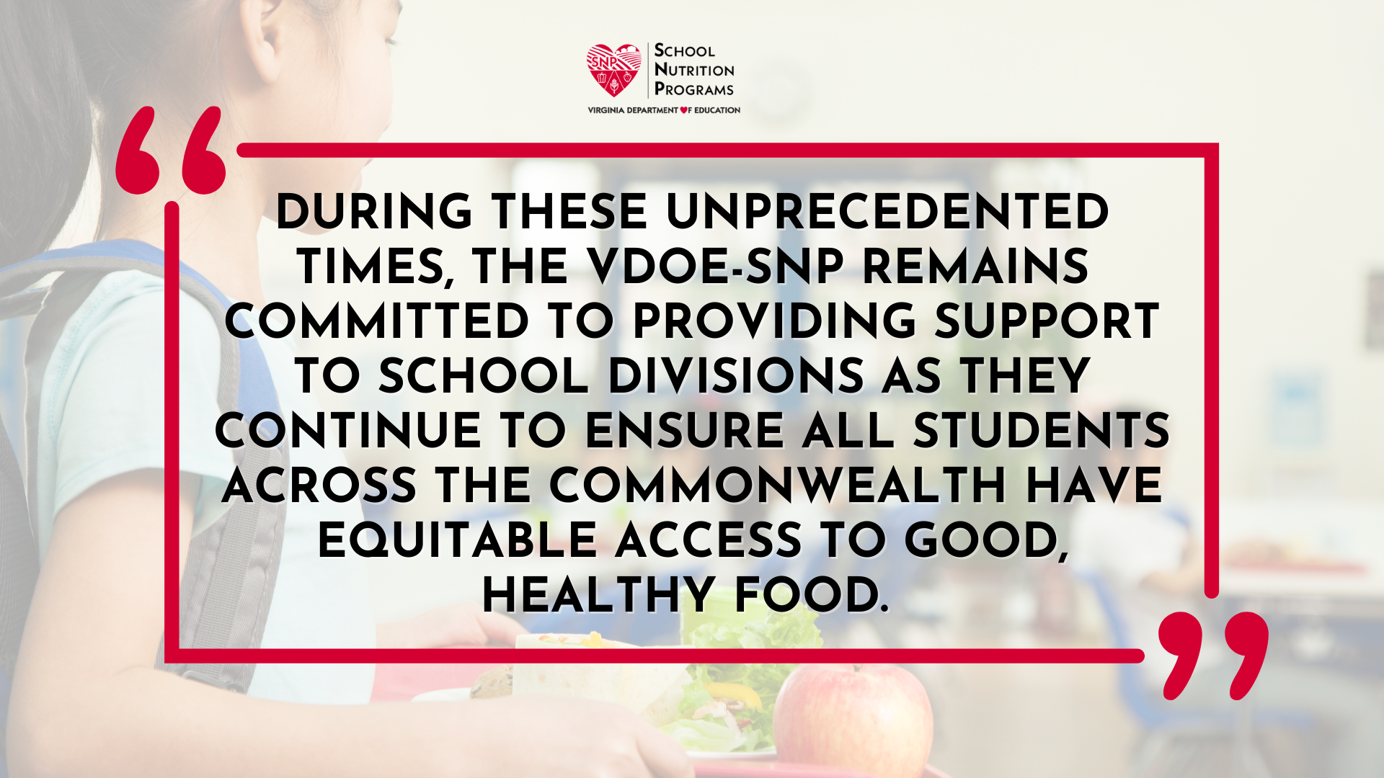
Notes:
The VDOE-SNP is extremely appreciative and thankful for our Virginia school nutrition professionals as they navigate the ever changing landscape in school cafeterias daily with innovation and determination.

Slide 30
QUESTIONS?
Dr. Sandy Curwood, RDN
Director, Office of School Nutrition Programs
Sandra.Curwood@doe.virginia.gov

Slide 31
CONNECT WITH US!
FACEBOOK
INSTAGRAM
TWITTER
FOLLOW US FOR THE LATEST UPDATES, FUN FACTS, EVENTS, AND RESOURCES FOR SCHOOL NUTRITION PROFESSIONALS!
@VDOESNP
Notes:
Laura – Before we go, remember to follow the Virginia Department of Education, Office of School Nutrition Programs on social media using the tag @VDOESNP for the latest updates, fun facts, events, and resources for school nutrition professionals. Together we are changing the perspective and promoting good, healthy meals from school nutrition programs across the Commonwealth.
Than you and have a wonderful day.

