Slide 1
2022 VASBO Spring Conference
May 19, 2022

Slide 2
School Division Relationships with PTA/PTO and Booster Organizations

Slide 3
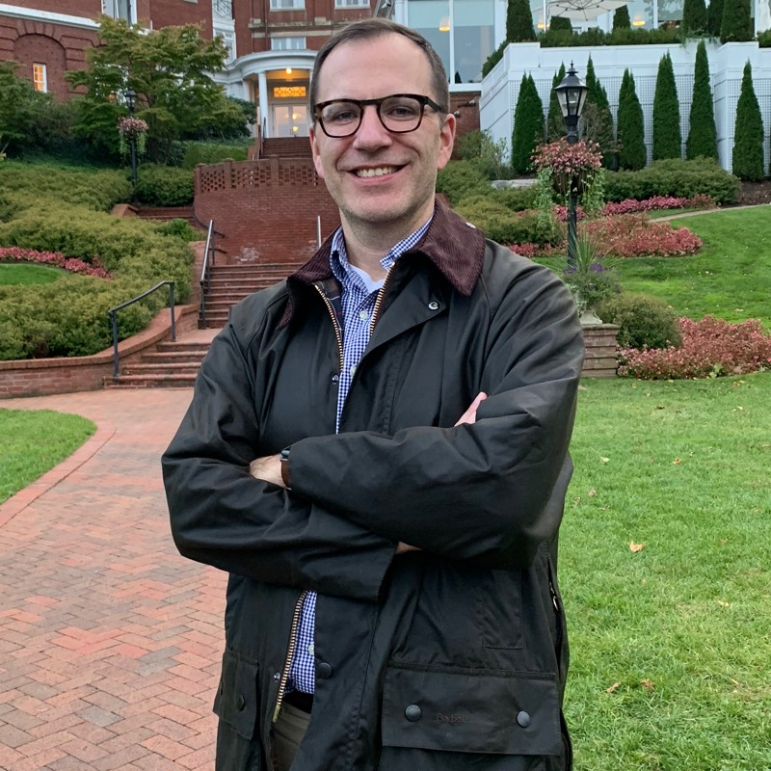
Your Speaker
John S. Aldridge, CPA
Partner

Slide 4
Company History
Brown Edwards is a full-service regional accounting firm with offices in Virginia, West Virginia, and Tennessee, and is included in Inside Public Accounting’s list as one of the top 100 firms in the United States and included on the 2021 Inc. 5000 list of Fastest-Growing Companies. We are proud to support a wide-range of industries throughout the Mid-Atlantic, including automobile dealerships, construction, credit unions, education, employee benefits, energy, financial institutions, healthcare, manufacturing and distribution, state and local government, real estate and not- for-profit organizations.

Slide 5
Agenda
TOPICS TO COVER
Getting to know the different entities
How you can help
Risks
GASB 84 impact

Slide 6
Let’s get to know these groups
PTA
The National PTA is a formal membership organization headquartered in Chicago with a 125-year history of working for children.
Local groups that choose to belong to the PTA must pay dues to the state and national organizations and abide by state and national group rules.
In return, they get member benefits, and they get a voice in the operations of the larger organization. The National PTA maintains a Washington, D.C., lobbying office, and most state PTAs advocate at their respective state capitals, as well.

Slide 7
Let’s get to know these groups (cont.)
PTO
Generally represents the thousands of groups that choose to remain independent of the PTA.
The acronym PTO is the most popular name, but other common monikers include PCC, PTG, and HSA. These are most often single-school groups that operate under their own bylaws and by and large concern themselves with the goings-on at their building or in their town only.

Slide 8
Let’s get to know these groups (cont.)
Booster Clubs
Booster Club often only focuses on raising funds in support of one specific school program rather than trying to fulfill school wide needs.
Clubs could be for band, athletics, academics, etc.
A school can have numerous Booster clubs but only one PTO or PTA

Slide 9
PTA Summary
Very structured organization, with set bylaws, fund-raising rules, etc.
Mission statement already established for you. “to make every child’s potential a reality by engaging and empowering families and communities to advocate for all children.”
Provide not only a local voice but a national one as well. It’s more than just your specific school
Openly an advocacy organization for PTA-approved positions.
In Virginia a PTA member pays $2.25 for national dues, $1.50 state, and in some cases a local due as well.
Had a hand in child labor laws, universal kindergarten, National School Lunch Program, and Juvenile Justice System.

Slide 10
PTA Statistics
16.5M - Students served in the U.S., District of Columbia, U.S. Virgin Islands, Puerto Rico and Department of Defense Schools in Europe
55% - of PTAs serve Title I schools
59% - of students served are students of color
71% - of PTAs serve elementary schools
$400K+ in grants awarded to PTAs/schools for program efforts
69% - of dues spent on programs for PTAs and families
Source: pta.org

Slide 11
Where Are PTAs Located?

Slide 12
PTO Summary
The PTO are independent and can be set up for a specific school or district.
The PTO has more freedom to choose their role in the parental involvement building aspect, however, their resources may be more limited.
Previously, PTO organizations had very few resources but now have ample through www.PTOtoday.com.
Given lack of guidance there is a greater risk that fraud may occur.

Slide 13
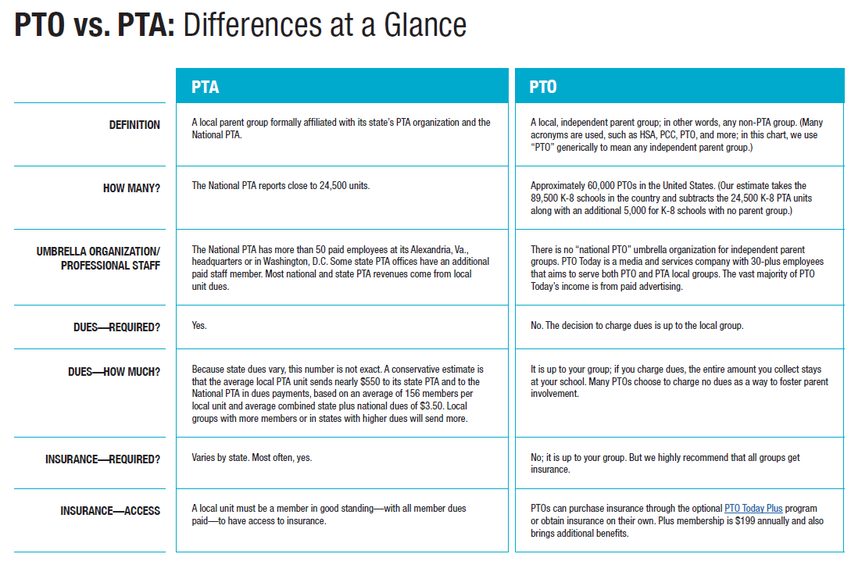

Slide 14
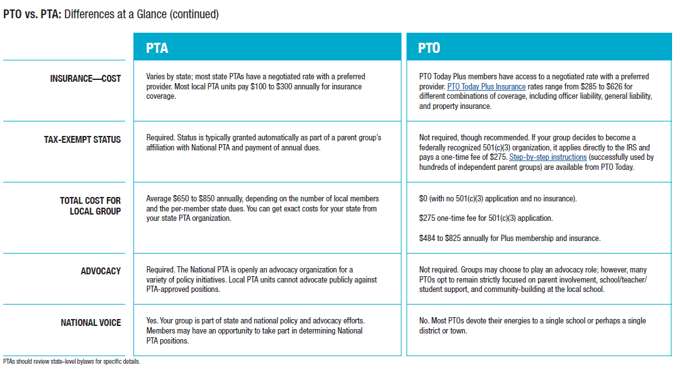

Slide 15
Resources
www.pta.org (National PTA)
www.vapta.org (Virginia PTA Group)
www.ptotoday.com (PTO resources)

Slide 16
PTOs and other Similar Organizations
Although, there are some websites and groups out there providing assistance such as www.ptotoday.com there are others forming these groups with little or no guidance.

Slide 17
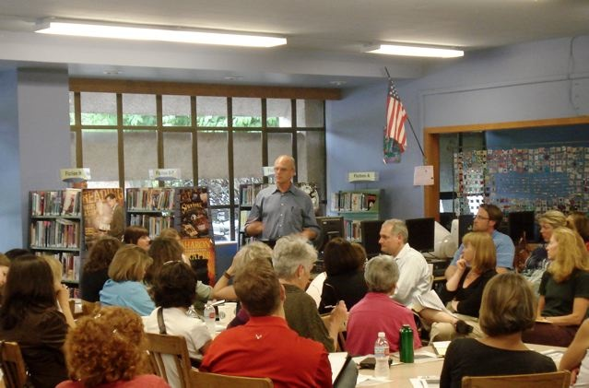
How Can You Help?
By providing assistance throughout the process:
Initial Information Gathering and Planning
Setting up the Organization
Encourage Participation
Maturing Organization

Slide 18
Initial Information Gathering and Planning
Gather a small group of like-minded parents
Share ideas as to why you want to start the group
Develop a purpose or mission statement for your PTO
Broad description of what you see as the core reason you’re forming a group.

Slide 19
Initial Information Gathering and Planning (cont.)
Brainstorm a list of benefits and a preliminary list of activities
Be sure to emphasize building parent involvement over fundraising
Brainstorm fundraising ideas
Always consider the return on investment
Adopt a fundraising policy
Having a reputation as a fundraising group will hurt your chances to grow. Possibly limit to 2 a year

Slide 20
Initial Information Gathering and Planning (cont.)
WRITE IT ALL DOWN!
Document the details of your plan
Meet with the principal
Present your plans and your desire to work together
You are not creating the principal’s personal fundraising team
Remember you are forming a “partnership” with the school

Slide 21
Setting up the Organization
Draft a set of basic bylaws
These are the core rules that will govern your organization
Officer elections, Frequency of meetings, make-up of the executive board
Be sure to include procedures to amend the bylaws later
Get an employer identification number
Fill out IRS form SS-4, which can be obtained from IRS website

Slide 22
Setting up the Organization (cont.)
Open a checking account
Adopt a set of financial controls
There are five wise financial controls that any PTO or related organization should put in place

Slide 23
Five Wise Financial Controls
Require Two Signature
You should have at least three authorized check signers
NEVER sign blank checks in advance
Maintain a Paper Trail
Utilize reimbursement request forms
Check request forms
Cash receipt form

Slide 24
Five Wise Financial Controls (cont.)
Report Monthly
Treasurer should prepare a report of financial activity for the executive board and members
Keep it simple (Beginning cash, plus receipts, less disbursements, ending balance)
It should be signed by the Treasurer

Slide 25
Five Wise Financial Controls (cont.)
Reconcile Monthly
Checking account
Preparer and Reviewer should sign the reconciliation
In a perfect world, someone with no access to cash or ability to write checks would receive the bank statement unopened and also perform the reconciliation

Slide 26
Five Wise Financial Controls (cont.)
Conduct an Annual Audit
This isn’t an audit by a CPA firm, but simply a few volunteers going through the year’s activity
You could set up standard procedures as part of the audit such as:
Look at all checks over $500 written
Make sure reconciliations were done and reviewed each month
Make sure all reimbursements included appropriate supporting documentation

Slide 27
Fraud is a Real Risk
In March 2019, a woman in East Fallowfield, Pa., who served as treasurer of two school-based volunteer organizations in the Coatesville Area School District admitted to taking more than $40,000 from a variety of fundraising events, telling authorities she was “drowning in debt.”
March 2019, the president of the Pine Beach Elementary PTO in Beachwood, N.J., was accused of stealing more than $14,000 from the parent group. Investigators found withdrawals from the PTO’s bank account that matched deposits the president made to her checking account.
In August 2019, a former treasurer from the Newton (Mass.) Parent Teacher Organization Council was arrested for transferring some $14,600 of PTO funds into her own accounts over a period of several years.
From May through November 2018, the treasurer at Benjamin Franklin Elementary West Campus PTO in Mesa, Ariz., took more than $18,000, withdrawing large amounts of cash and using the parent group debit card for personal transactions.
The former treasurer of the Berkeley Glenn Elementary PTO in Waynesboro, Va., drained about $12,000 from the PTO bank account from August 2017 to May 2018, using the money at bars, restaurants, and clothing stores.
The former president of the H.G. Hill Middle School PTO in Nashville, Tenn., was alleged to have stolen up to $31,490 from August 2014 to August 2017, using schemes that included making cash withdrawals from the PTO account, keeping money from fundraisers, and making multiple personal purchases with the PTO debit card.

Slide 28
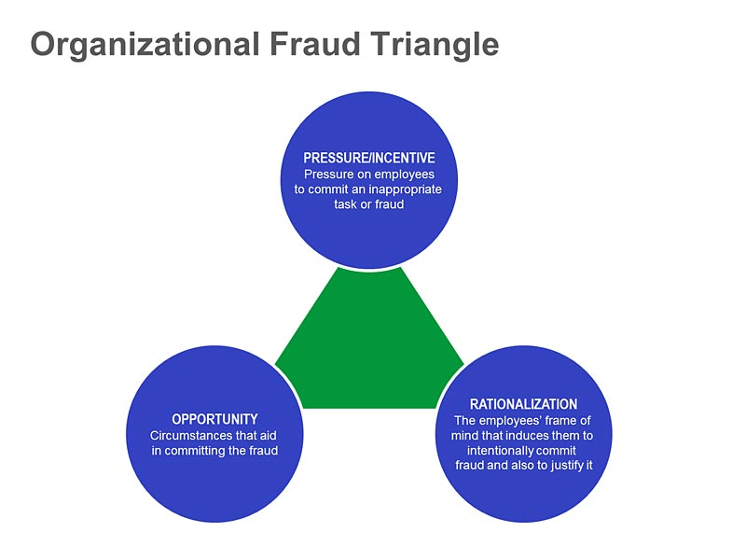
Fraud Overview

Slide 29
Facts About Fraud
Per the 2020 Report to the Nation (ACFE):
Estimated that the typical organization loses 5% of its annual revenue to fraud which when applied to the estimated 2019 Gross World Product translates to a potential total fraud loss of more than $4.5 trillion
The median loss was $125,000
The frauds lasted a median of 14 months before being detected
Small organizations are disproportionately victimized
Organizations with <100 employees account for more than 26% of the fraud reported.

Slide 30
Encourage Participation
Prepare to announce your PTO or Booster Club
Write an introductory letter for your teachers and parents
People want to be part of a well-organized group that will not waste their time
Have a well-planned first meeting
Limit to one hour
Have an agenda printed, and “stick to it”

Slide 31
Maturing Organization
Continue to Build involvement
Be truly welcoming and not cliquish
Avoid the reputation for focusing only on fundraising
There’s more power in 400 people donating 2 hours of their time than 4 people donating 200 hours of their time

Slide 32
Maturing Organization (cont.)
Get your ducks in order
Becoming incorporated – done through the state
Becoming tax-exempt – done through the IRS
Fill out a fairly detailed form that asks for information ranging from mission to fundraising gross revenue
Once approved you will receive a 501(c)(3) letter
Consider purchasing insurance
In most cases parent groups are not covered by the school’s policy

Slide 33
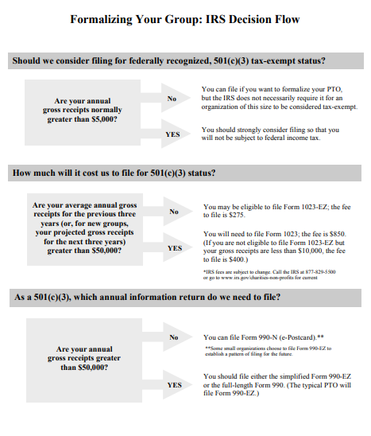
Other Items to Consider

Slide 34
Record-Retention Rules
3 years:
Monthly treasurer reports
7 years:
Bank statements
Canceled checks
Check registers
IRS Form 990, 990-EZ, 990-N
Permanently:
Incorporation paperwork
IRS Form 1023 and documentation
IRS determination letter for 501(c)(3) tax-exempt status
Meeting minutes and agendas
Year-end treasurer reports
Annual reports from auditor (financial review)

Slide 35
GASB 84 Impact
Under GASB 84, a "fiduciary activity" for a school district is identified based on various criteria which generally focus on the source of and the control over the activity's assets. GASB 84 provides the following criteria applicable to school districts for determining whether an activity is a fiduciary activity:
The activity's assets must be controlled by the school district (e.g. school district's bank account or ability to direct use of funds);
The activity's assets cannot be derived from the school district's source revenues (e.g. State Aid, property taxes, grants, fees, service revenues, sale of property, etc.);
The activity's assets must be for the benefit of individuals and the school district and the school district does not have administrative involvement with the assets or the activity's assets must be for the benefit of organizations or other governments that are not part of the school district.
Of particular concern to school districts is the criterion which indicates an activity that benefits individuals will not be deemed a fiduciary activity if a school district has administrative involvement with an activity's assets. The GASB has developed examples and other literature to assist in applying the concept of "administrative involvement." Key examples of administrative involvement with the assets provided under GASB 84 include the following:
"a government has administrative involvement with the assets if, for example, it (a) monitors compliance with the requirements of the activity that are established by the government or by a resource provider that does not receive the direct benefits of the activity, (b) determines eligible expenditures that are established by the government or by a resource provider that does not receive the direct benefits of the activity, or (c) has the ability to exercise discretion over how assets are allocated."
Outside organizations such as Booster Clubs, Parent Teacher Organizations (PTOs) and Parent Teacher Associations (PTAs) are separate entities that have their own tax identification (ID) number and are not allowed to use the School’s tax ID number. GASB 84 does not affect the financial relationship between the School and the outside organizations because they are not part of the School

Slide 36
O F F I C E A D D R E S S
319 McClanahan Street, S.W., Roanoke, Virginia 24014
E M A I L A D D R E S S
jaldridge@becpas.com
P H O N E N U M B E R
(540) 345-0936

Slide 37
Any Questions?

