Slide 1



GASB 96: Subscription-Based Information Technology Arrangements
Implementation Tips and Frequently Asked Questions

Slide 2
About Me: Andrea Nichols, CPA
Ms. Nichols joined PBMares in 2005 and is a manager in the firm’s audit department. Ms. Nichols has extensive experience planning and performing audits subject to the provisions of Government Auditing Standards and the Uniform Guidance. She has worked on audit teams in various capacities for various public sector audit engagements including authorities, counties, cities, towns, boards, and commissions.
Ms. Nichols is a member of the American Institute of Certified Public Accountants (AICPA), the Virginia Society of Certified Public Accountants, and the Virginia Government Finance Officers’ Association. She carries the AICPA Advanced Single Audit Certification that proves heightened competencies surrounding single audit engagements as outlined in the AICPA Competency Framework: Governmental Auditing. She has a Master of Accountancy in Governmental Accounting from Rutgers University.
anichols@pbmares.com
540-434-5975
Harrisonburg, VA
www.PBMares.com

Slide 3
About PBMares
Ranked on INSIDE Public Accounting’s IPA 100 list, PBMares is a full-service accounting and consulting firm, providing audit, tax, and advisory services. Founded in 1963, the firm is headquartered in Virginia and maintains a strong presence in the Mid-Atlantic region, with offices in Baltimore and Rockville, Maryland; Fairfax, Fredericksburg, Harrisonburg, Newport News, Norfolk, Richmond, Warrenton, and Williamsburg, Virginia; as well as Morehead City, Wilmington, and New Bern, North Carolina.
PBMares’ State & Local Government Team is comprised of more than 25 professionals focused on the unique compliance and regulatory needs of clients in the public sector. The public sector is one of the main focus industries within our firm. Members of the State & Local Government Team have extensive experience in providing audit and consulting services to many authorities, boards, commissions, counties, cities, and towns. The team is co-led by Betsy Hedrick and Mike Garber who are based in the firm's Harrisonburg office.
Members of the team actively pursue information on the most up-to-date government developments and devote significant time researching and studying the economics, operational issues and trends affecting governmental entities to ensure we are on the leading edge of issues affecting clients. Team members serve as volunteer instructors at seminars conducted by the Virginia Government Finance Officers Association and the Virginia Society of Certified Public Accountants, as well as serve as seminar sponsors held by these associations. This deep industry involvement translates to a well-trained, specialized engagement team, setting us apart from many CPA firms.
www.PBMares.com

Slide 4
Learning Objectives
Become familiar with the GASB 96 implementation process through:
GASB 96 overview
Implementation Tips
Frequently Asked Questions
Journal Entry Examples
www.PBMares.com

Slide 5
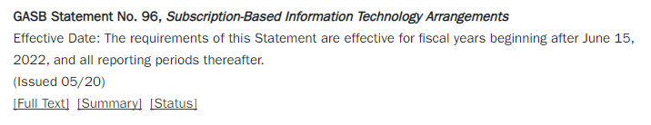

Where to Find Guidance
www.gasb.org
www.PBMares.com

Slide 6

Timing
GASB 96 takes effect for fiscal years starting after June 30, 2022 (for most of us that is FY2023)
GASB 96 is retroactive only if the restatement of the prior year financial statements is practicable. The total impact of the changes can be shown as an adjustment to the starting net position/fund balance of the first year GASB 96 is adopted.
www.PBMares.com

Slide 7
Acronyms
GASB:
Governmental Accounting Standards Board
SBITA:
Subscription-Based Information Technology Arrangements
www.PBMares.com

Slide 8
Definitions
SBITA: “A SBITA is defined as a contract that conveys control of the right to use another party’s (a SBITA vendor’s) information technology (IT) software, alone or in combination with tangible capital assets (the underlying IT assets), as specified in the contract for a period of time in an exchange or exchange-like
transaction.”
www.PBMares.com

Slide 9
FAQ: Does It Convey Control of the Right of Use?
The right to obtain the present service capacity from the use of the underlying IT assets as specified in the contract.
The right to determine the nature and manner of use of the underlying IT assets as specified in the contract.
Conveys Control
www.PBMares.com
Notes:
Must have both

Slide 10
Definitions
Subscription Term: “The subscription term includes the period during which a government has a noncancellable right to use the underlying IT assets. The subscription term also
includes periods covered by an option to extend (if it is reasonably certain that the government or SBITA vendor will exercise that option) or to terminate (if it is reasonably certain that the government or SBITA vendor will not exercise that
option).”
www.PBMares.com

Slide 11
FAQ: What factors impact “reasonably certain?”
Significant economic incentives or disincentives
Potential change in technological development
Potential change in demand for the IT assets
History of exercising options to extend or terminate
Extent to which the underlying IT assets in the SBITA are essential to the provision of government services
www.PBMares.com

Slide 12
Definitions
Right-to-Use Subscription Asset: An intangible asset resulting from a SBITA
Subscription Liability: Liability which corresponds to the Right-to-Use Subscription Asset
www.PBMares.com

Slide 13
Examples of SBITA
Rental of IT Software with a defined rental period and rental amount
www.PBMares.com
Notes:
Kasey to give update.

Slide 14
Examples of items that are NOT included in GASB 96
Rental of IT Software for an indefinite period of time
Rentals for $1 a year that do not meet exchange transaction definition
Contracts solely for IT support services
    Items with a period of 12 months or less
www.PBMares.com
Notes:
Kasey to give update.

Slide 15
Combination of Software and Tangible Assets
Which component is most significant?
    “Smart” copiers
    Computers with operating software
If the software component is insignificant, it’s possible this may fall under GASB 87 instead
www.PBMares.com
Notes:
Kasey to give update.

Slide 16
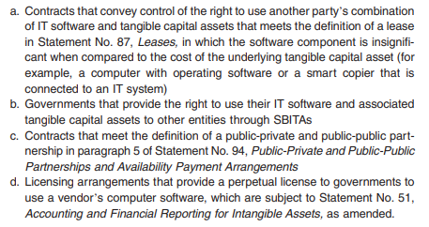
Excluded from This Standard
www.PBMares.com
Notes:
Kasey to give update.

Slide 17
Subscription Liability Calculation
Measured at Present Value
Include (if applicable):
Fixed payments
Variable payments that depend on an index or a rate, measured using the index or rate as of the commencement of the subscription term
Variable payments that are fixed in substance
Payments for penalties for terminating the SBITA if the subscription term reflects the government exercising that option
Subscription contract incentives
Any other payments to the SBITA vendor associated with the SBITA contract that are reasonably certain of being required
www.PBMares.com
Notes:
Kasey to give update.

Slide 18
FAQ: How is the Present Value Rate Determined?
Subscription Liability must be recorded at present value. This discount rate can be:
The rate charged by the vendor (if applicable)
If there is no explicitly stated rate, the government’s estimated incremental borrowing rate can be used.
If the government does not have a readily determinable estimated incremental borrowing rate, the rate of a similar entity can be used instead.

Slide 19
Subscription Asset Calculation
Amount of the initial Subscription Liability
Plus: Payments associated with the SBITA contract made to the SBITA vendor at the commencement of the subscription term
Plus: Capitalizable initial implementation costs
Less: Vendor incentives received from the SBITA vendor at the commencement of the subscription term
www.PBMares.com
Notes:
Kasey to give update.

Slide 20
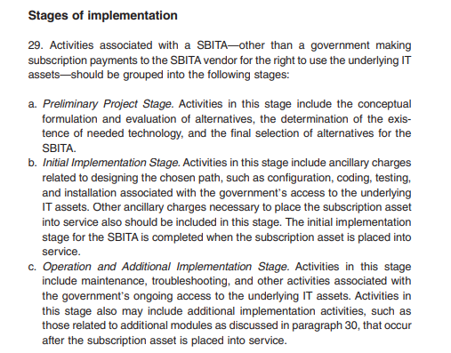

Expenses Other than Subscription Payments
Notes:
Generally Not capitalizable: A, C
Generally Capitalizable: B

Slide 21
Amortization Calculation
Systematic and rational manner over the shorter of:
Subscription term
Useful life of underlying IT assets
www.PBMares.com
Notes:
Kasey to give update.

Slide 22
Remeasurements
Modification to terms or payments
Reduction in right-to-use assets
Shortening of the asset term
If any of these scenarios result in a partial termination: Asset and Liability are reduced, and a gain or loss is recognized for the difference between the two.

Slide 23
We know what GASB 96 is. Now what?
Communicate with departments and take an inventory potential agreements
Determine scope of impact on your entity
Consider whether you will use implementation software
Document implementation strategy
Discuss with your auditors early
Notes:
Poll the audience: Who is using DebtBook? Lease Crunch? Another software? Or just an excel spreadsheet?

Slide 24
Example Journal Entries
To record an initial SBITA:
Debit: Right-to use subscription asset
Credit: Subscription liability
Note: Preliminary implementation and operational costs are typically expensed as normal.

Slide 25
Example Journal Entries
To record a subscription payment:
Debit: Subscription liability
Credit: Cash

Slide 26
Example Journal Entries
To record amortization of a SBITA:
Debit: Amortization expense
Credit: Accumulated amortization

Slide 27
Disclosures
Very similar to GASB 87, Leases requirements, including (but not limited to):
Description of SBITAs
Total amount of subscription assets and amortization
Principal and interest requirements to maturity for the subscription liability for five subsequent fiscal years and in five-year increments thereafter
Any additional pertinent items such as impairment loss, other payments not included in the measurement of the subscription liability, variable payments, etc.

Slide 28
FAQ: Materiality
Per GASB, the provisions of this Statement need not be applied to immaterial items. Significance must be evaluated for both:
Individual Assets
Classes of Assets
Caution: Do not exclude a class of assets that would be material as a whole simply because an individual asset within that class is not material. Determination of what is considered material needs to be discussed with auditors.

Slide 29
Final Thoughts
Start early! As we saw last year with GASB 87, the inventory phase can be a substantial time commitment.
Inform your departments, management, and Board about the new requirements.
Communicate frequently with your auditors.

Slide 30

Questions
www.PBMares.com

Slide 31
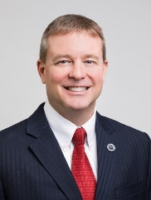
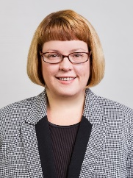
Contact Us: Government Niche Team
Mike Garber, CPA, MBA, Partner
mgarber@pbmares.com
540-434-5975
Betsy Hedrick, CPA, Partner
bhedrick@pbmares.com
540-434-5975
www.PBMares.com
Notes:
You can replace the image above by right-clicking and selecting ‘change picture’

Slide 32

www.pbmares.com
MARYLAND - Baltimore • Rockville
NORTH CAROLINA - Morehead City • New Bern • Wilmington
VIRGINIA - Fairfax • Fredericksburg • Harrisonburg • Newport News • Norfolk • Richmond • Warrenton • Williamsburg

