Slide 1
Records Management: Covering the Basics

Slide 2
What is records management?
1
Notes:
Let’s start with the basics - what is records management anyways?

Slide 3
Records lifecycle
Permanent preservation
CREATION
RETENTION
Destruction
DISPOSITION
USE
Notes:
Records management is the systematic control of records throughout their entire “lifespan” – beginning with creation; then a period of active use; then once those records aren’t being referenced on a regular basis, they are retained as inactive records for a defined time period; and then finally comes disposition. Disposition sounds like it means destruction, but really it’s the final destination of the records or the final action taken upon them, whether that be destruction or transfer to an archives for permanent preservation.

Slide 4
Why should I practice records management?
2
Notes:
You’ve got a brief definition of what records management is. Why should you practice records management?

Slide 5
The records you create when conducting government business are public records.
1
Notes:
First of all, it’s the law! As a public official whose salary is paid by public funds, the records you create are public records. Anything a public official produces in the course of their duties is a public record - because that’s work paid for with public money.

Slide 6
Virginia Public Records Act
Designate
a records officer
Establish and maintain
a records management program
Destroy records and report to LVA
COV § 42.1-76 et seq.
Notes:
The Virginia Public Records Act establishes the LVA’s authority over records management. These are the three basic duties of every public agency under the VPRA.
Each agency must designate at least one records officer to serve as a liaison to the LVA on matters of records management
Each agency must establish and maintain an active, economical, and efficient records management program which ensures that the agency’s public records are preserved and remain accessible throughout their lifecycle
Agencies may not destroy or dispose of a public record unless (i) the record appears on an approved records retention schedule, the record's retention period has been fulfilled, and (ii) a certificate of records destruction has been completed and approved by the agency's designated records officer

Slide 7
Records management facilitates access and efficiency.
2
Notes:
Another reason to practice records management is that it makes your life easier and increases efficiency for your agency. I know it sounds weird to hear the folks at the archives say this, but we want you to get rid of stuff as it becomes eligible. When you’re looking for a needle in a haystack, you want the haystack to be as small as possible to reduce the burdens of time and cost.
If there’s an open records request, audit, lawsuit, etc. and the haystack is so big and disorganized that you are unable to produce the records required, not only is that a bad look, but it is a disservice to the public that we serve as public officials.

Slide 8
Institutional knowledge is lost when that knowledge is not documented, organized, and accessible.
3
Notes:
Additionally, those who come after you will thank you. I don’t know if it’s just me, but everywhere I’ve worked there has been one person or a handful of people who have been there forever and who have a wealth of institutional knowledge floating in their brain. If those people move on without creating records that document that knowledge, or just leave their records in disarray, that institutional knowledge is lost.

Slide 9
Physical storage is expensive!
18”
36”
4
24”
$290/ month
Storing a single filing cabinet can cost over $200/month.
16”
Notes:
Storage space costs money, whether that’s for paper records or electronic. Every bit of space counts - If you have an average-sized filing cabinet -
Must leave 2 feet of passable space per fire code, so you can’t fill the whole room up
That requires 14.5 square feet of storage
That storage, times office rental costs of $20/square foot, means storing one filing cabinet in office costs $290.00/month
This slide shouldn’t be taken to mean, “Get rid of all the file cabinets.” It’s meant to illustrate that the amount of records you keep has a cost associated with it.

Slide 10
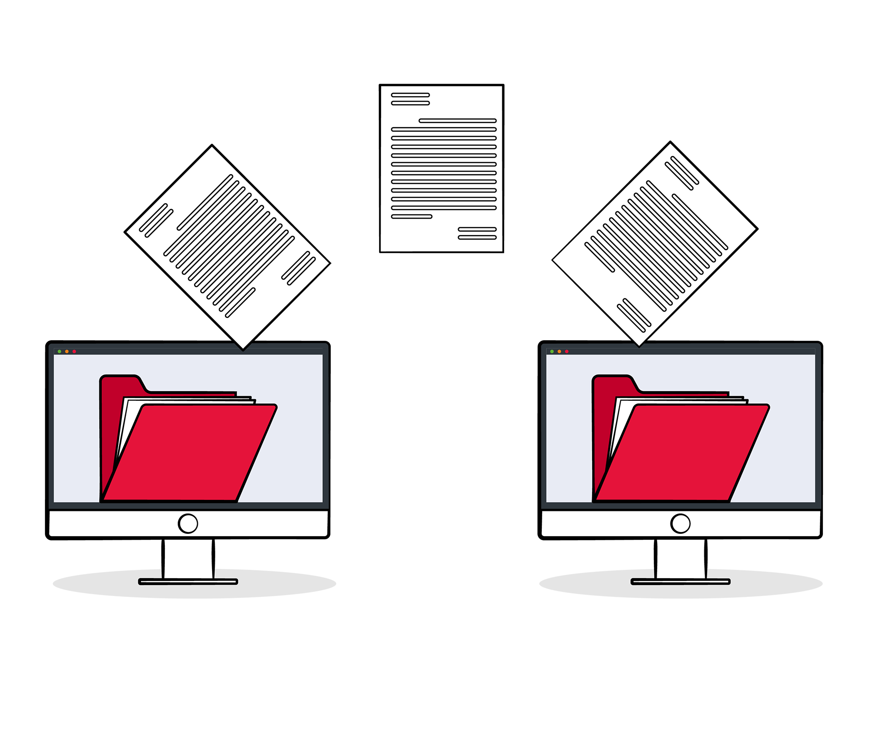
Digital storage is also expensive!
5
Data migration can cost tens of thousands of dollars –
especially in systems bloated with obsolete records.
Notes:
You may think, let’s just digitize everything to save on space! But there are hidden costs to digital storage as well. There’s this idea, even among IT staff, that electronic space is infinite, but the fact of the matter is that you have to pay for that infinite space, whether that’s cloud storage or server space or anything else. IT will tell you that storage space has minimal cost, and that’s true - but where it gets expensive is when it comes to data migration.
Migration is something every agency will undergo, as vendors change and technology updates over time. Migration is not optional – it will and must happen so that records remain accessible. These costs can run into the tens of thousands of dollars, easily - and a major culprit is the mentality that “oh, well, we can just keep everything, since they’re computer files.” By the time migration is imminent, it’s often too late to go back and weed. By that point, you’ve got years and years of files, often not named in a way where you can easily tell if they’re eligible for destruction.
Be proactive now about deleting stuff you no longer need, the same way you’d destroy paper files that are obsolete. It will save you very real money in the long run.

Slide 11
6
The cost of discovery &
e-discovery
In a lawsuit, records can be subpoenaed regardless of age
“Spoliation of evidence”
Practice defensible disposition
Notes:
The last financial motivation to practice management is the cost of discovery and e-discovery in the event of a lawsuit. In a lawsuit, records can be subpoenaed regardless of age. Legally, agencies cannot destroy pertinent records once litigation, investigation, audit, or open records request is imminent - it’s called “spoliation of evidence”. So even if you have records that should have been destroyed ten years ago, it’s too late. This includes electronic records – If electronic records build up over the years without being disposed of, the costs of e-discovery can run into the six figures.
It is a much better idea to keep up with destruction on a regular schedule as records become eligible. This is a practice called defensible disposition.
The idea is that, if you’re asked why a certain record no longer exists, you can produce documentation to show that your records were disposed of legally, at the proper time, and as part of a routine action instead of a scramble.
ADD MORE INFO ABOUT FOIA

Slide 12
What is a public record?
3
Notes:
The number 1 reason to practice management is that the records you create when conducting government business are public records.
What is a public record?

Slide 13
A public record…
. . . documents a transaction or activity . . .
Regardless of physical form or characteristic . . .
. . . is produced, collected, received or retained in pursuance of law or in connection with the transaction of public business.”
Va. Code§ 42.1-77
Notes:
The Virginia Public Records Act defines a public record as “recorded information that documents a transaction or activity by or with any public officer, agency, or employee of any agency. Regardless of physical form or characteristic, the recorded information is a public record if it is produced, collected, received, or retained in pursuance of law or in connection with the transaction of public business.”

Slide 14
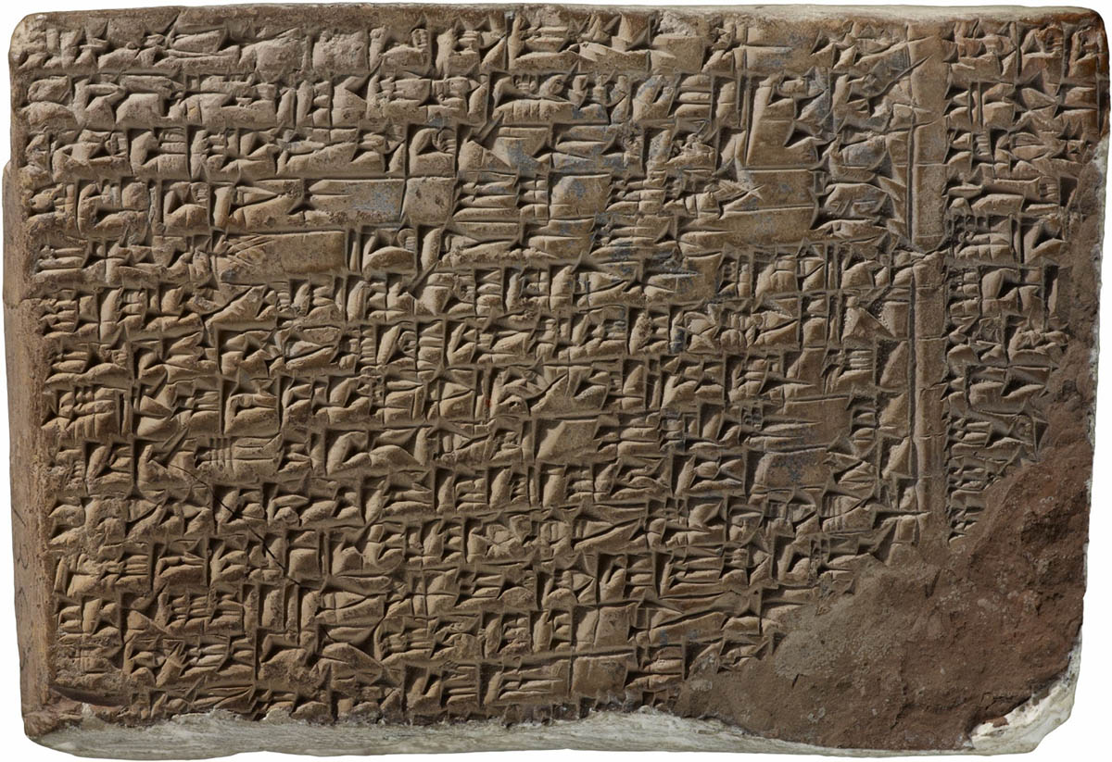
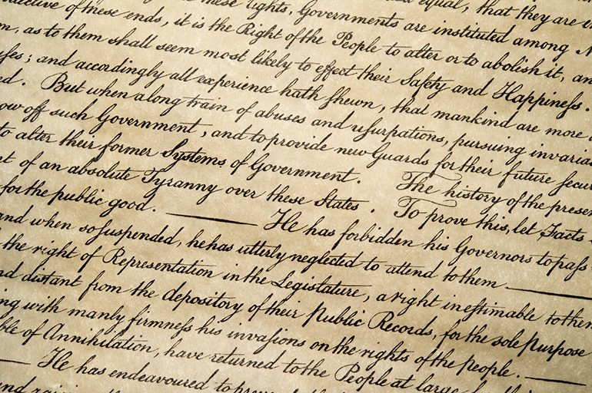
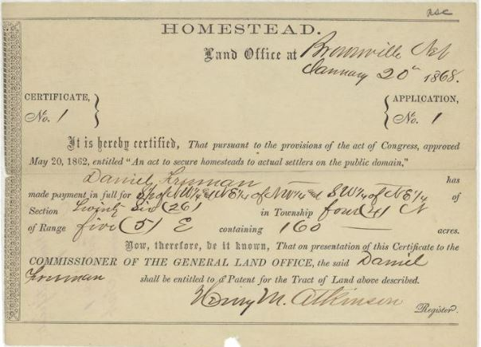
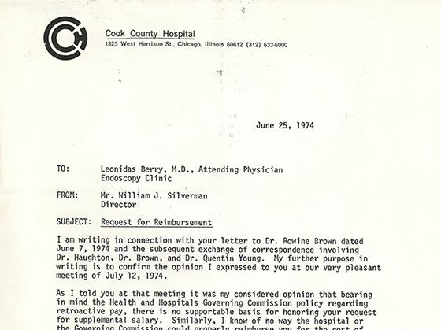
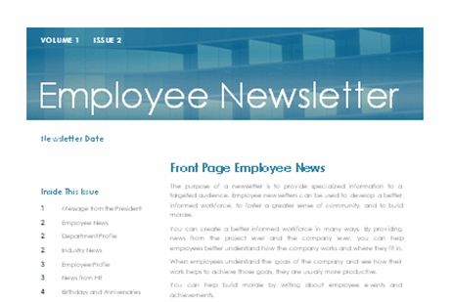
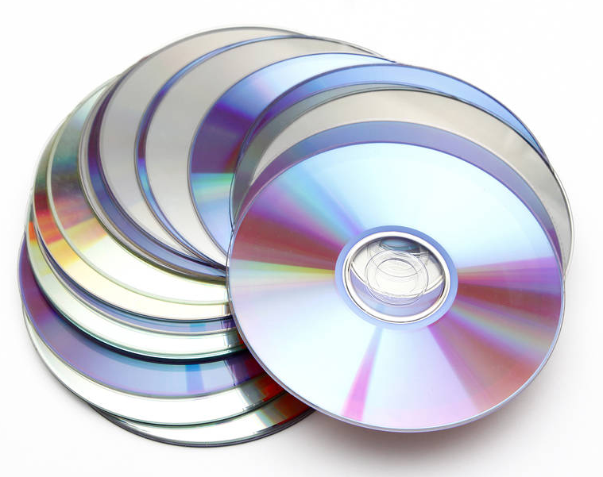
Notes:
The Code stated “Regardless of physical form or characteristic”
What does that mean?
Public records can come in all kinds of formats. What is a record is determined not by the format or medium of the record, but by the content of the record.
Practically anything can be a record. If you chose to write on clay tablets like the top left, hey that doesn’t seem super efficient, but more power to you. That would be a public record.
The same applies to handwritten, printed information, electronic media, and so on. All of these technologies are just the containers for information.
Consider agency newsletters. In the past, those were typically printed and mailed out to subscribers. Now, most agencies are creating and distributing those via email. The fact that this record is in electronic form doesn’t change what it is. It just means that when you’re ready to transfer it to the archives, it’ll be transferred on a flash drive or via email or Dropbox instead of handed over in a box full of paper records.

Slide 15
Can my email be a public record?
Email is a format and can contain many kinds of records.
Keep personal and work email separate.
Notes:
One of the most common questions we get about public records is “what about government email”? Where is email on the retention schedule?
You will not find email in the retention schedules because email is a format of record, not a record itself. Email can fall into various categories or “record series” depending on the content of the message.
Some emails, like the emails you get about donuts in the break room, don’t need to be kept for any length of time.
Other emails may fall into a temporary record series. Some emails might even be permanent.
Because email is a public record, you want to keep personal and business email separate. You don’t want to be planning your daughter’s wedding or corresponding with your doctor in your work email, because you may have to spend hours separating those personal emails out in the event of a FOIA request.
Also, consider how your emails would read to someone outside the agency. Don’t put something in an e-mail that you wouldn’t want to see on the front page of tomorrow’s newspaper!

Slide 16
What is not a public record?
reference materials,
trade journals,
listserv messages, spam, informal notices, out of office messages
Notes:
Also in the category of transitory records are things like professional catalogs or journals you receive in the mail, reference materials like a user manual for technology you’re using, that page you printed from Wikipedia, listserv messages, or spam messages.
These records are not created by you, and they don’t document the work you do.

Slide 17
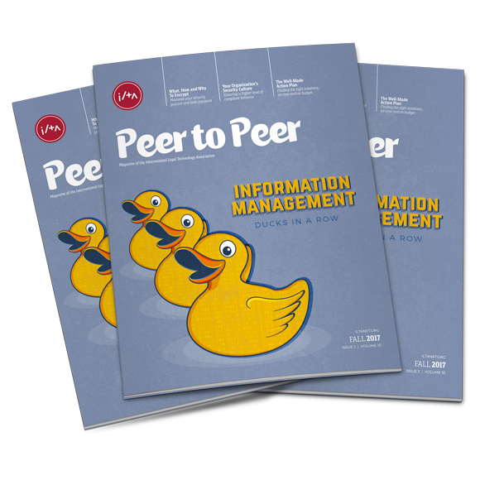
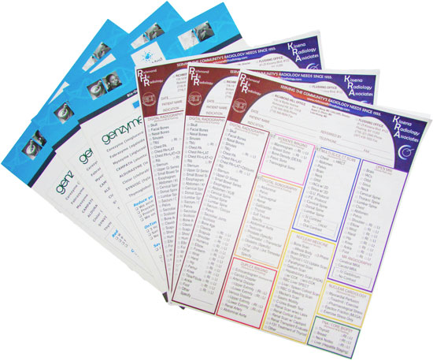
What is not a public record?
COPIES
duplicates
(extra copies kept for convenience;
stocks of publications)
Notes:
Another non-record is the convenience copy. Whenever you attend a meeting of a committee or commission, usually everyone gets a copy of the meeting agenda and packet, whether that be a digital copy or a paper copy. Every single committee member does not need to keep their meeting packet. Only one “copy of record” needs to be maintained.

Slide 18
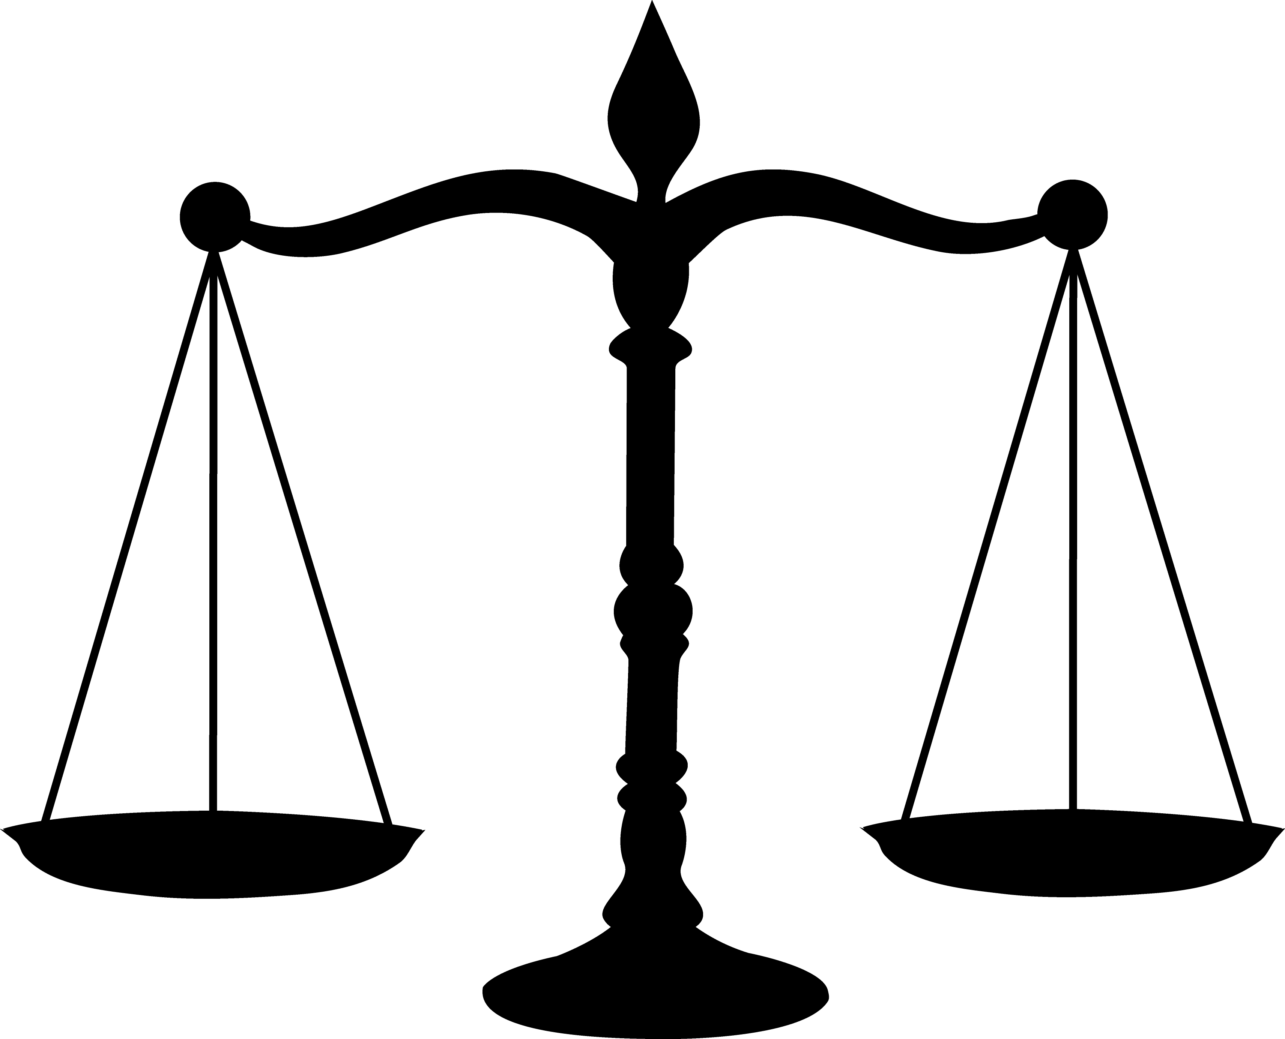
public records ≠ open records
Public records can be open or closed.
Examples of closed records:
attorney-client privileged records
attorney work product
minutes of closed meetings
vendor proprietary information software
records protected by HIPAA, FERPA
Notes:
I know the phrase “public records” can freak a lot of people out, because it can sound like all public records are open to the public, but that is not the case. Public records can be open or closed, and statute protects a wide variety of information in public records from disclosure.
Records containing confidential or sensitive personal information, like social work case files or medical records or certain kinds of court records, are still going to be closed to the public.
Public records don’t depend on the terminal either - they’re not necessarily made just on your work computer or at your workstation. A really timely example is the recent work from home situation as a result of the pandemic. I am still creating public records, even if I’m doing it at home on my personal laptop.

Slide 19
How do I manage public records?
4
Notes:
Okay, you have your foundation. You know about what is a public record, what is not a public record, the retention schedules, a record series, retention periods, and disposition. How can you use this knowledge to better take care of records on a day-to-day basis?

Slide 20
File related records together within a shared recordkeeping system.
Organize your electronic records like a grocery store. If you have a new person start tomorrow, they should be able to find records.
Use descriptive file and folder names.
Name files so that they are easily organized and sorted by date and/or subject.
Notes:
There’s a great analogy out there that I think works well for both paper and electronic records.
That is, to organize records like a grocery store. I know that sounds a little weird, but think of it like this: I could drop you in a Piggly Wiggly grocery store in Alabama tomorrow, tell you to find me a bag of chocolate chips, and you’d be able to do that in two minutes or less because of the way a grocery store is labelled and organized. You’d go look for the sign that says “baking”, and they’d be right there, along with the flour and sugar and everything else you’d need to make cookies. You want to think in the same way about your records storage. If we have a new person start tomorrow, I should be able to say “hey, can you go find the memo about last year’s annual conference on the drive?” and they should be able to find it easily, because the place where we keep memos is clearly labeled. People have a tendency to either store everything on the “name drive”, the “My Documents” folder of their computer – where no one else has access to it, including possible successors – or, if they use the shared drive, it ends up cluttered with individual files named things like “Katie’s Docs”. You can’t tell what’s in a folder with a name like that! We really urge folks to move away from that – you want all your division members to be able to access the same files so you don’t have 20 versions of the same thing, and you want them organized in a way that’s immediately obvious and navigable.

Slide 21
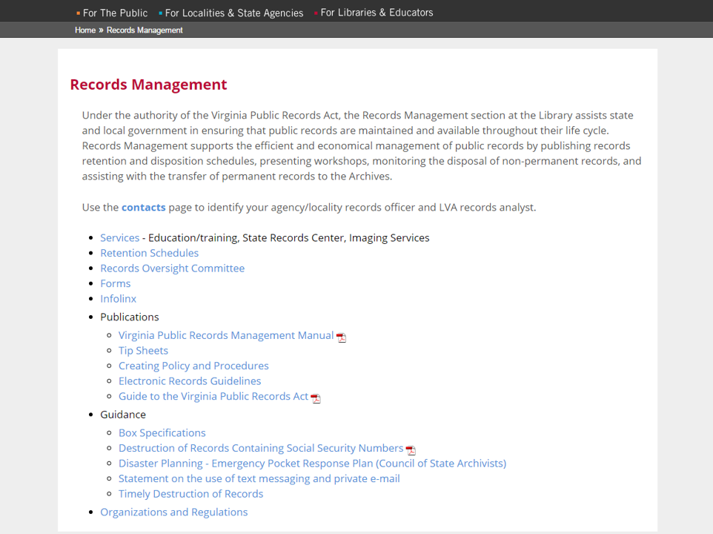
Notes:
This is the landing page for records management on the LVA web site.
I’d like to call attention to Contacts, Retention Schedules, Forms, Tip Sheets, and the Guide to the VPRA.

Slide 22
Closing Thoughts
7
Notes:
And to close out today, a few points to take away.

Slide 23
Almost no one destroys records too soon.
Notes:
I said at the very beginning, that we want you to destroy records as they become eligible. The vast majority of people hold onto records for too long, because it’s like a security blanket. Maybe you’ll need those records down the road? But you are just creating a problem for your future self or for those who come after you.
Almost nobody destroys records too soon.

Slide 24
Who are we trying to help?
Evil Records Scofflaw
Evil Records Scofflaw
Valiant Records Manager
Valiant Records Managerr
Notes:
We don’t do this to catch bad guys, or to be the Records Police and catch people who are nefariously destroying records to cover a crime.
We are trying to help the person who followed the schedule, destroyed the records after their retention period was over, and then their boss or someone else asks them “why don’t we have this?” If you follow the schedule as put forth by the LVA, and there is a problem, then it’s our problem, not yours.
If you don’t follow the schedule… that’s when you get into trouble. So we are here to help!

Slide 25
The persistence of memory
TV series Black Mirror, Series 1, Episode 3: “The Entire History of You”

Slide 26
Contact
Chad Owen
Records Management Coordinator
Library of Virginia
chad.owen@lva.virginia.gov
All forms and schedules, as well as additional resources, available at:
www.lva.virginia.gov/agencies/records
Notes:
I’ll leave you with my contact information…all forms and schedules, as well as additional resources, are available on the LVA website.
Questions?

