Slide 1
Ensuring Students Stay Engaged and On Track – The Critical Role of Data
January 11, 2021
©2020 Forecast5 Analytics. All Rights Reserved.

Slide 2
Ensuring Students Stay Engaged and On Track
The Critical Role of Data
Three Big Challenges for the 20/21 School Year
Finance – What does our financial future look like...and how will enrollment changes, revenue pressure, and federal dollars impact our available resources?
Access – In our division, who has access to the internet and who doesn't? Are the access speeds sufficient for learning?
Learning – What do we need to do to keep them on grade-level? What do we need to do to improve our eLearning performance as an organization on a go-forward basis?

Slide 3
Our Co-Presenter
Dr. Adam Cibulka
Senior Manager – 5Lab

Slide 5
WHAT WE PROVIDE
SUITE OF DATA ANALYTICS
TOOLS
Develop budgets, create projections, model scenarios, make decisions.
Analyze data to quickly generate new perspectives on organizational performance.
Connect data sets for insight, reports and custom dashboards.
Instantly access educational resources in one location.
Evaluate boundaries and demographics through mapping.

Slide 6
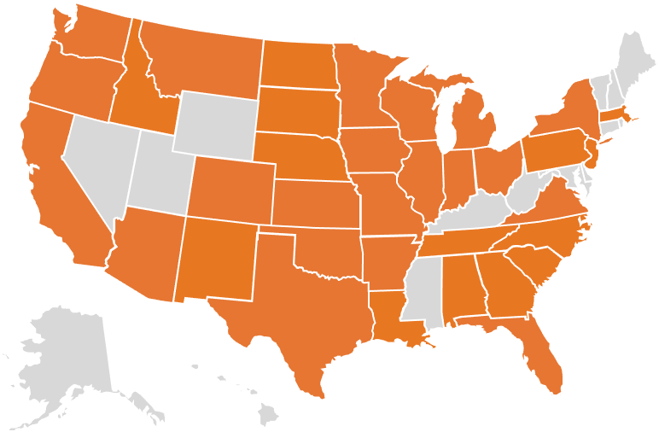
WHO WE WORK WITH
NATIONWIDE
Forecast5 Analytics has successfully developed and launched five separate applications to provide insights and drive decisions. More than 2,000 public sector organizations across the country are using Forecast5 tools to maximize their data insights.

Slide 7
WHO WE WORK WITH
VIRGINIA
38 School Divisions in Virginia are using one or more applications from Forecast5 to inform and support their decision making

Slide 8
Potential Issues of Equity and Access in Remote Learning Environments
Potential Issues of Equity and Access
Do we have a plan that addresses the disadvantages some students are experiencing with the “Digital Divide”?
eLearning Issues that schools need to track:
Do we have students who are not logging in daily?
Do we have students who are not engaging in and completing their virtual work?
Are any of our students falling behind grade level?
Virgina Ed Equity

Slide 9
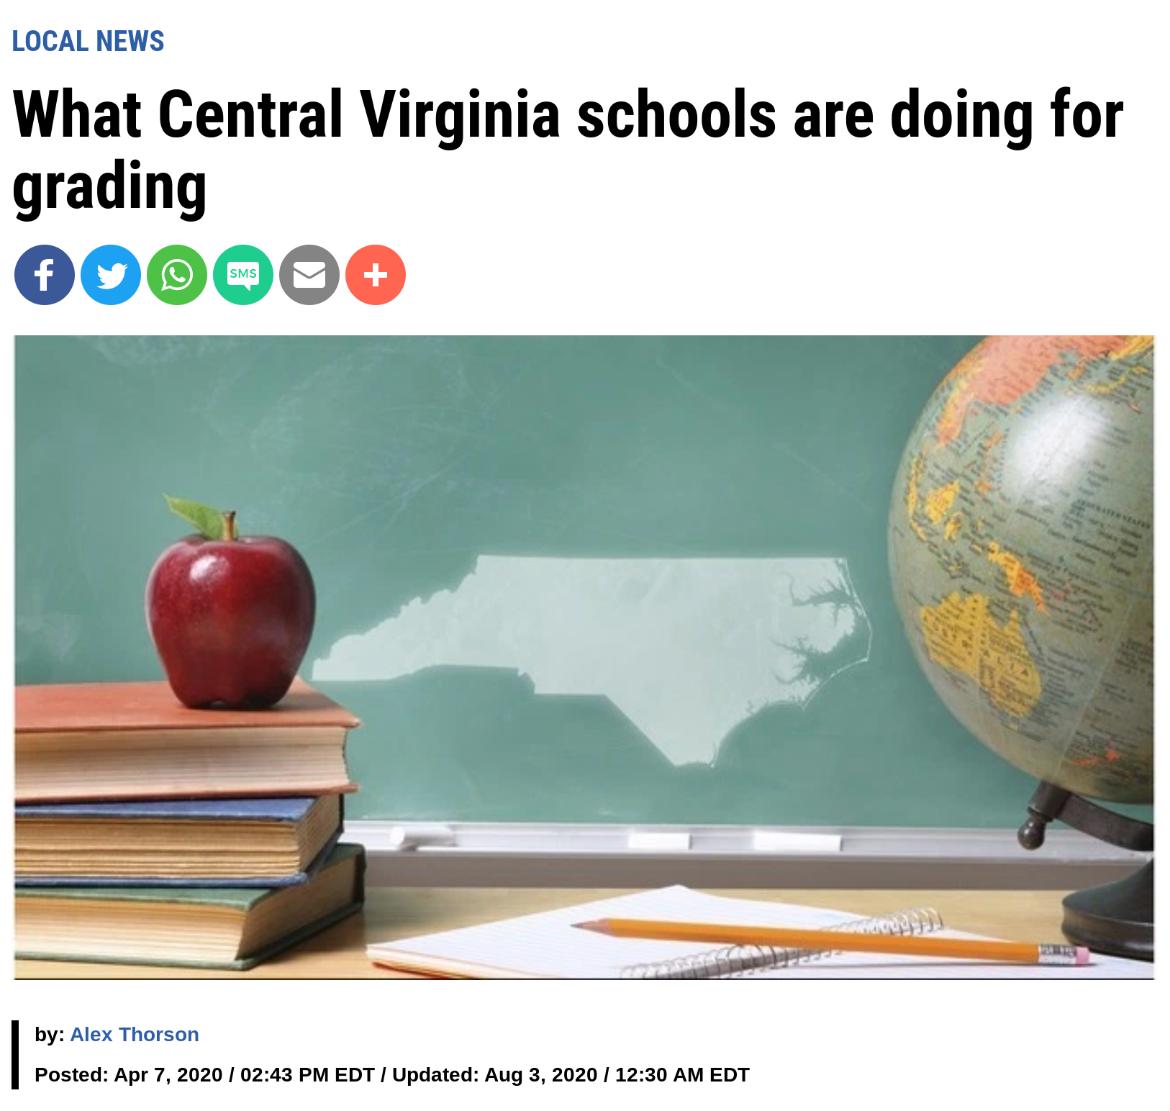
Critical Information Needed for the 2nd Semester
With a growing level of media coverage... prepared school leaders will have this data to take control of the narrative in 2021:
Level of engagement by school, grade, and demographic group
By name, which students are still struggling to engage in your eLearning...and a plan for intervention
Detailed information on failing grades with a plan for remediation and credit recovery
Grade level readiness and growth analytics
Virginia Schools and Grading

Slide 10
Potential Issues of Equity and Access in the Various Learning Environments
Which students have access to adequate broadband?
Which students and student groups are engaging in the district’s eLearning platform (Canvas, Google Classroom or Schoology, etc.)?
What support do I need to provide my staff to ensure students receive a rigorous learning environment, in both a remote learning or hybrid situation?
Which students are completing the necessary coursework to stay on-track?

Slide 11
Need for Analytics in Multiple Learning Environments
Analytics remain critical in navigating various learning environments, so that leaders can:
Ensure students receive high quality instruction and continue to meet learning goals.
Ensure staff are able deliver a rigorous experience for students in an in-person, hybrid or remote environment.
Ensure families and school board members are informed on ensuring all students have the resources necessary to learn, are engaging in the district’s learning environment and are staying on-track in meeting learning goals.

Slide 12
Finance

Slide 13
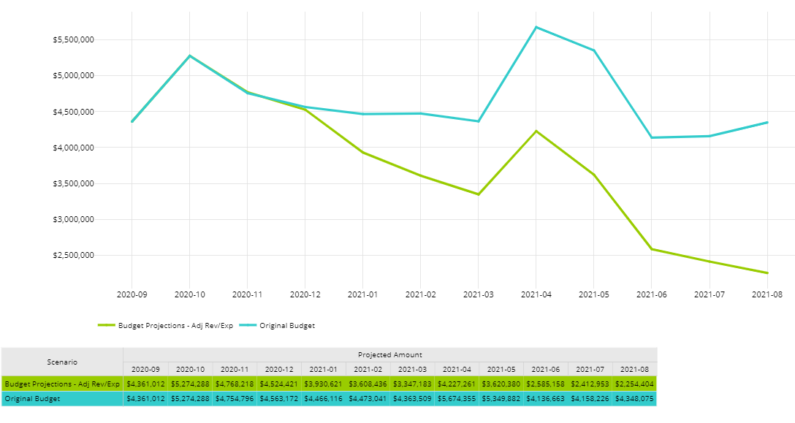
20-21 Monthly Cashflow – Ending Fund Balance
Data through October are actuals
November to August are projected
Original cashflow
Revised cashflow based on new revenue projections

Slide 14
SCENARIOS – ENDING FUND BALANCE
All scenarios have 20-21 revised budget based on:
Revenues based on November average enrollment
Expenditures based on known increases or decreases
Scenario 1: - Worst case
50% of students that didn’t enroll in 20-21 return in 21-22
Remaining of 50% of lost enrollment returns in 22-23
Scenario 2:
21-22 enrollment returns to 20-21 budgeted levels
Scenario 3:
50% of students that didn’t enroll in 20-21 return in 21-22
Remaining of 50% of lost enrollment returns in 22-23
Scenario 4: - Best case
21-22 enrollment returns to 20-21 budgeted levels

Slide 15
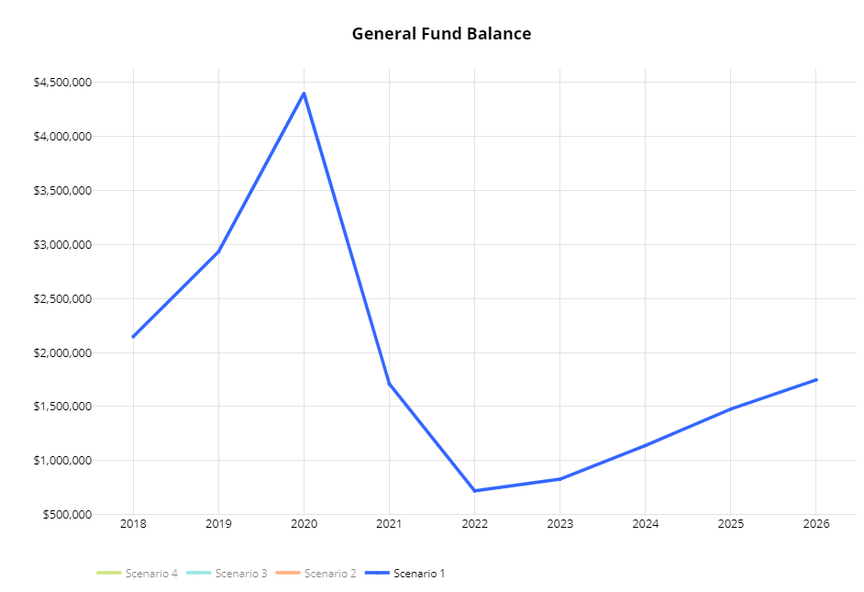
Worst case scenario

Slide 16
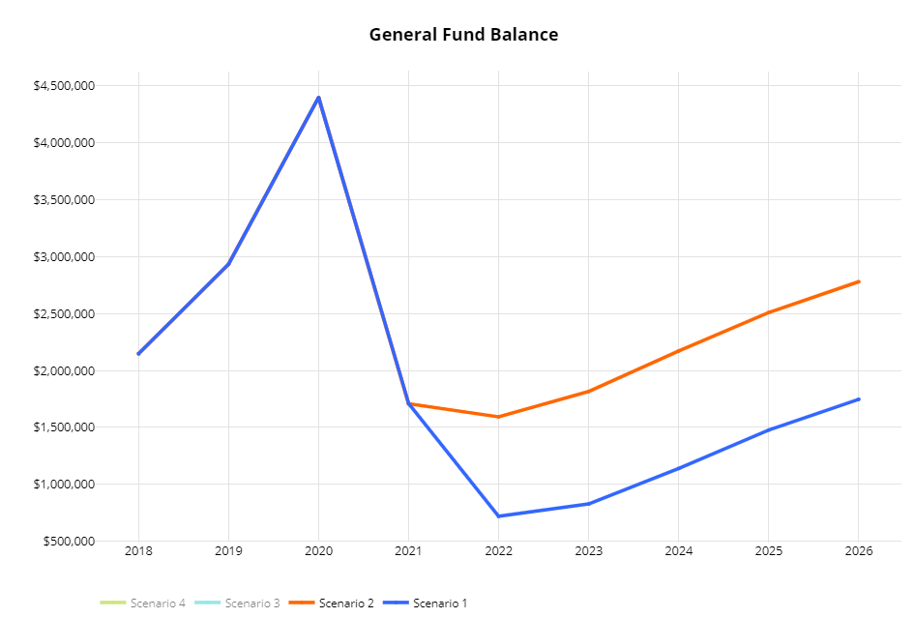

Slide 17
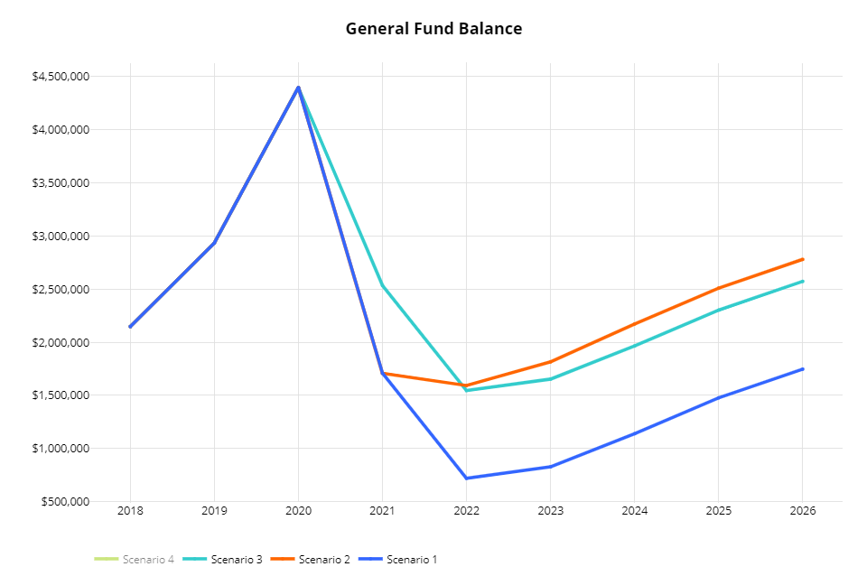

Slide 18
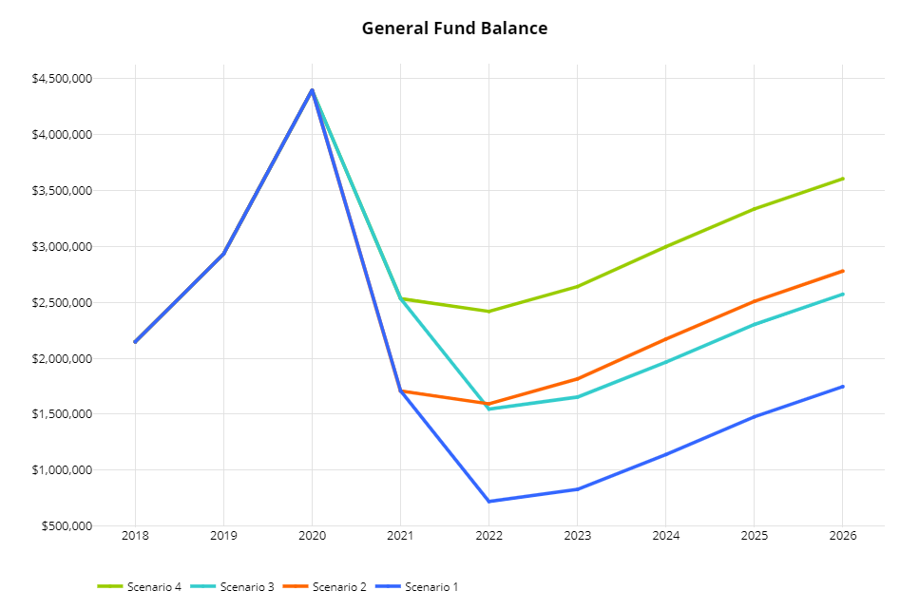
Best case scenario

Slide 19
Access

Slide 20
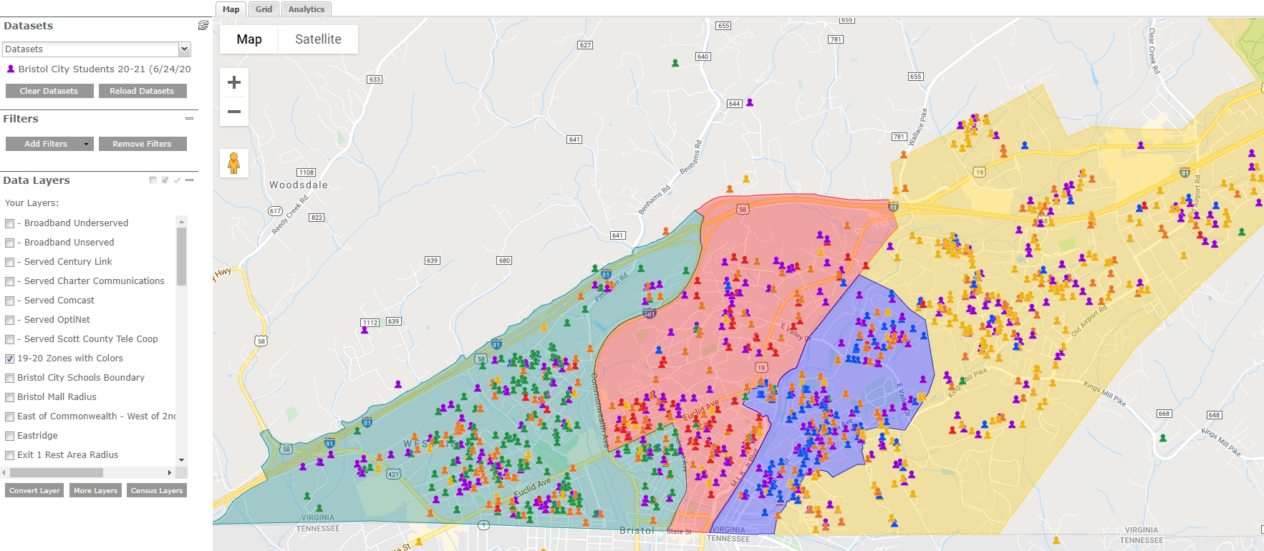
Access – Served, Underserved, Unserved
* Student pins are colored based on their school of attendance, matching their boundary​

Slide 21
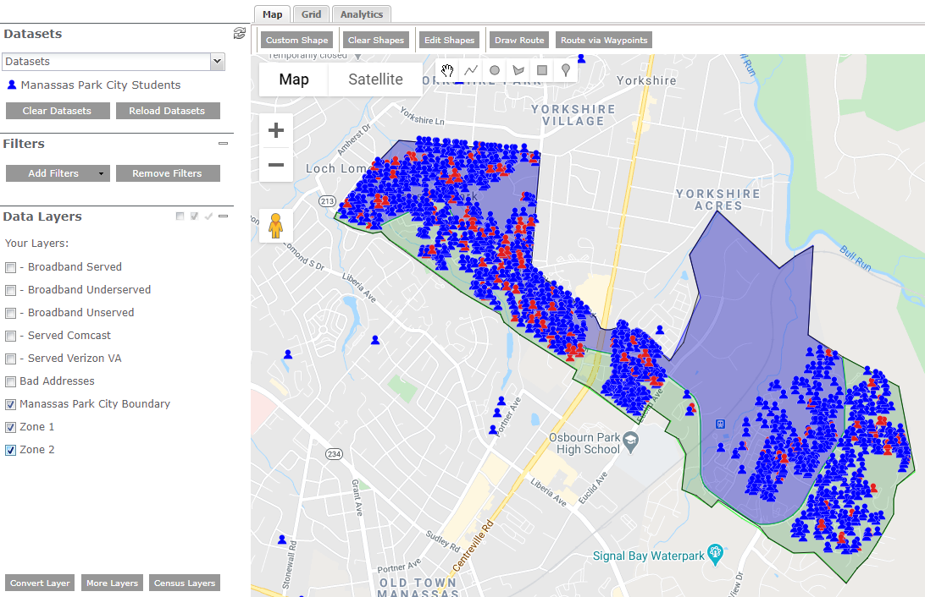
Disegragate by Data Attributes
Student Information System Data - Location based Data

Slide 22
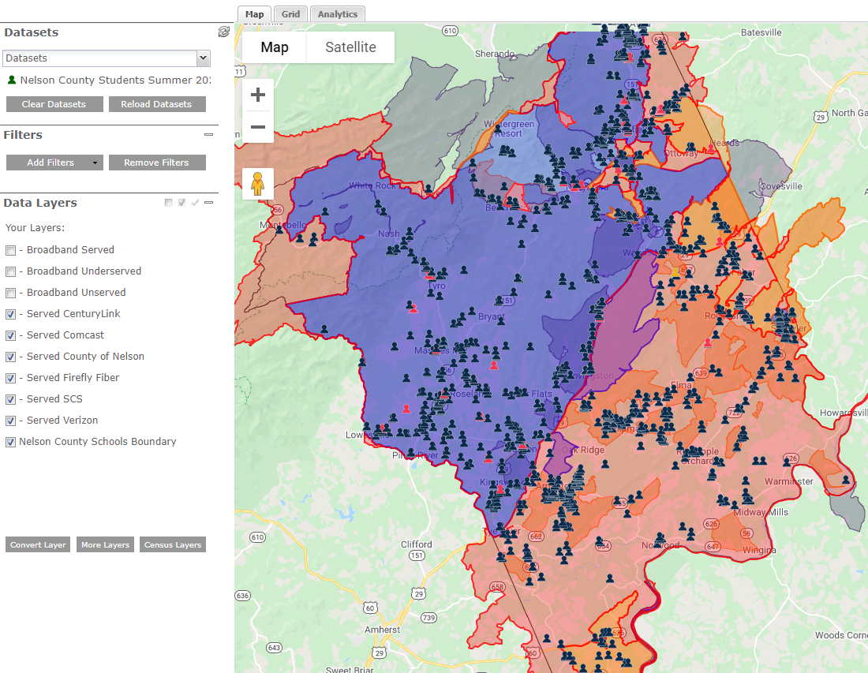
Broadband Access and Provider Maps
Student Data – FCC Data – Provider Data

Slide 23
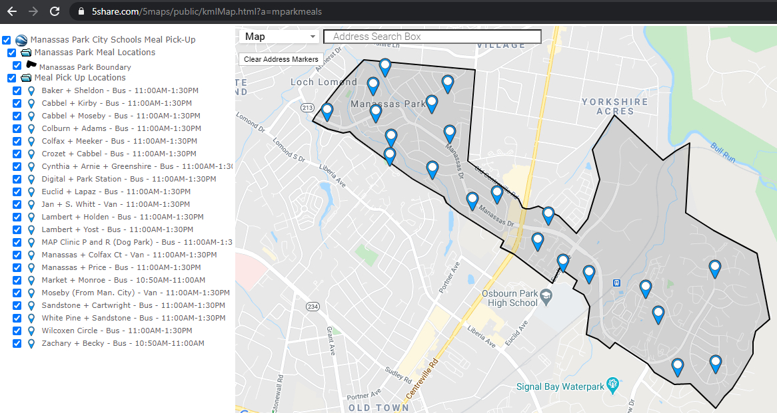
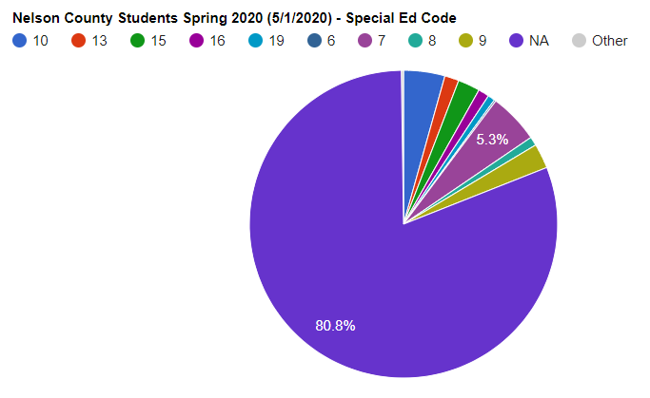
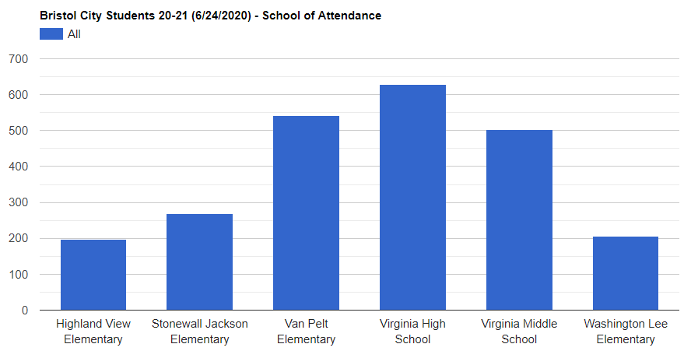
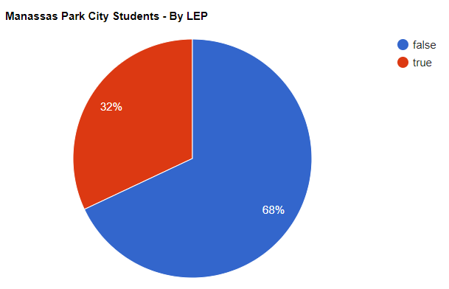
Support Decision-Making Process With Data

Slide 24
Learning

Slide 25
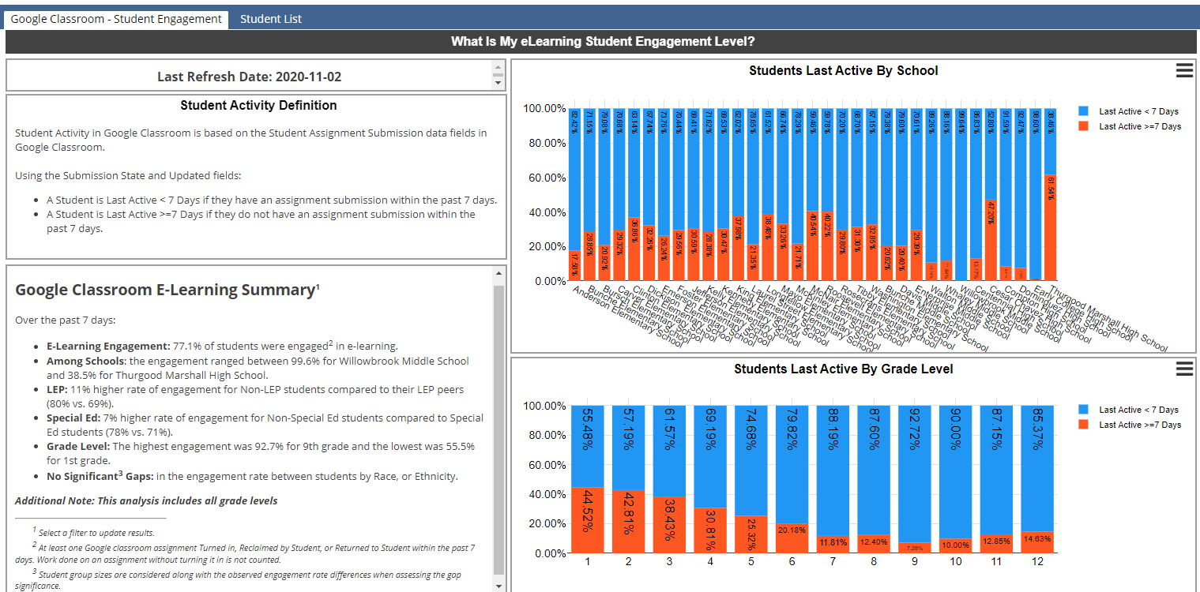
Which Students Are Engaging in My District’s eLearning Platform?
©2020 Forecast5 Analytics. All Rights Reserved.

Slide 26
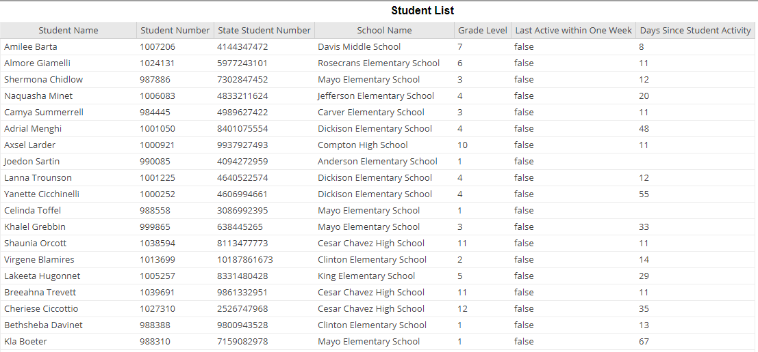
Who Are the Students Not Engaging in My District’s eLearning Platform?
©2020 Forecast5 Analytics. All Rights Reserved.

Slide 27
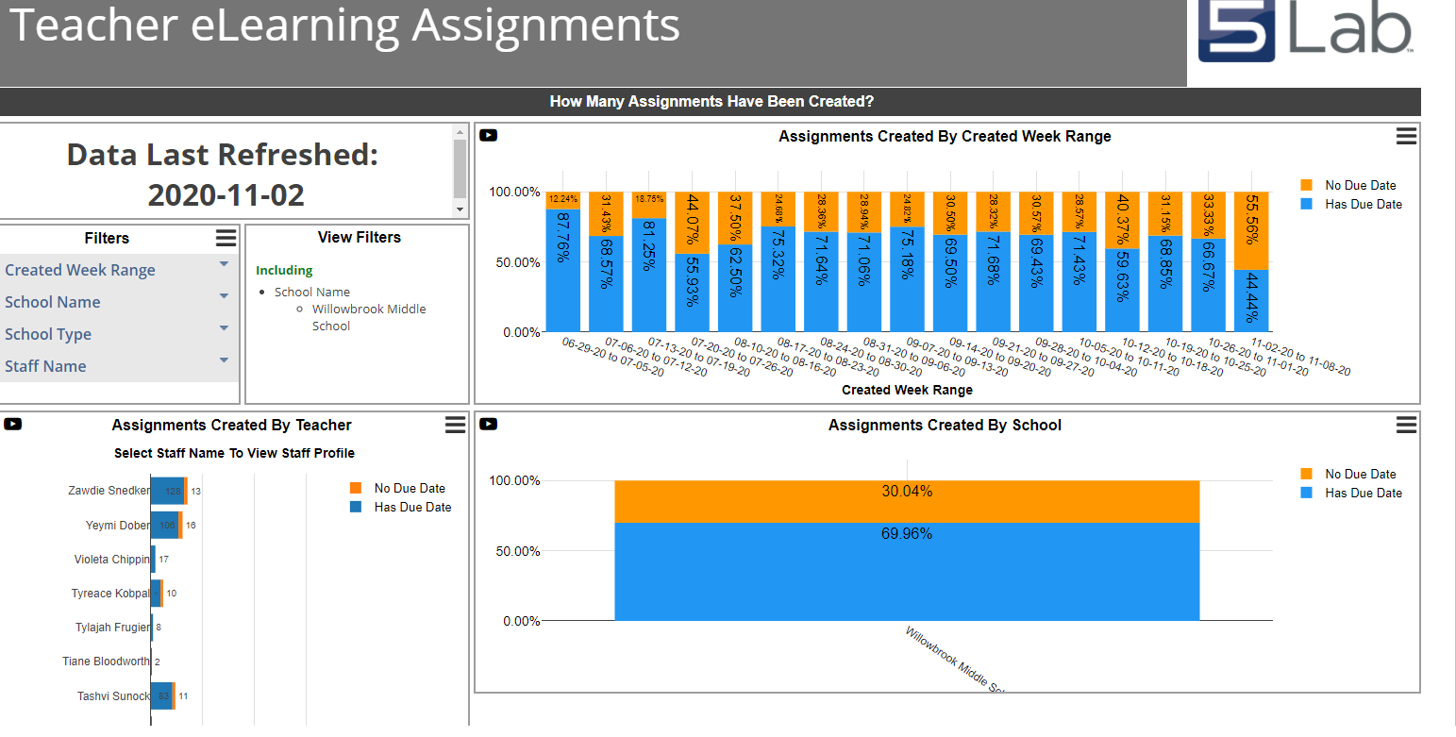
Which Staff Do We Need to Support?
©2020 Forecast5 Analytics. All Rights Reserved.

Slide 28
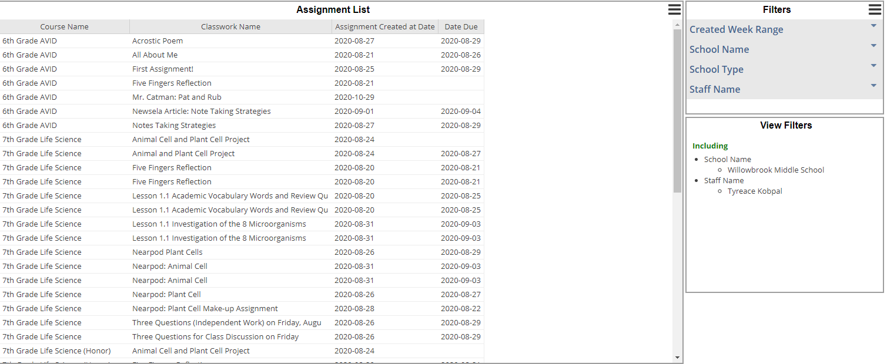
Instant Insight Into a Classroom…
©2020 Forecast5 Analytics. All Rights Reserved.

Slide 29
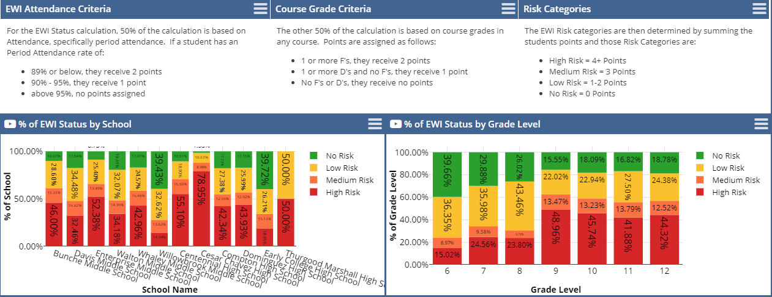
How Do We Keep Students On-Track?
Use of Early Warning Indicators
©2020 Forecast5 Analytics. All Rights Reserved.

Slide 30
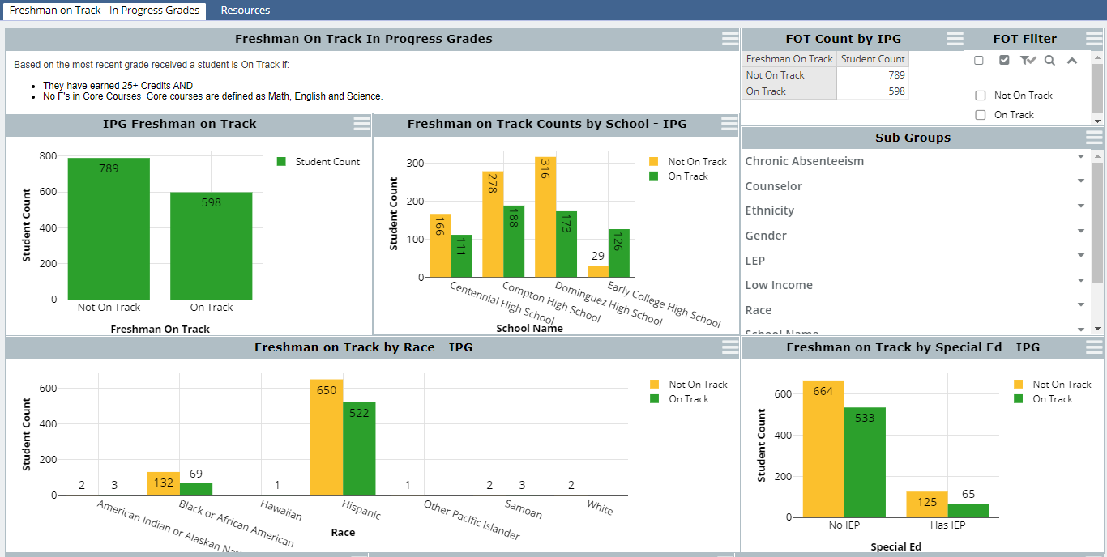
Keeping Freshman Students On-Track
©2020 Forecast5 Analytics. All Rights Reserved.

Slide 31
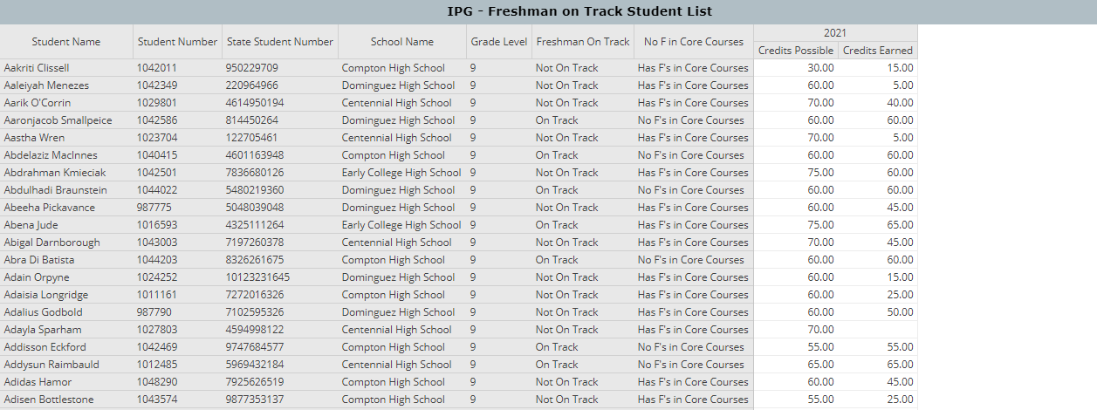
Student Lists to Target Support
©2020 Forecast5 Analytics. All Rights Reserved.

Slide 32
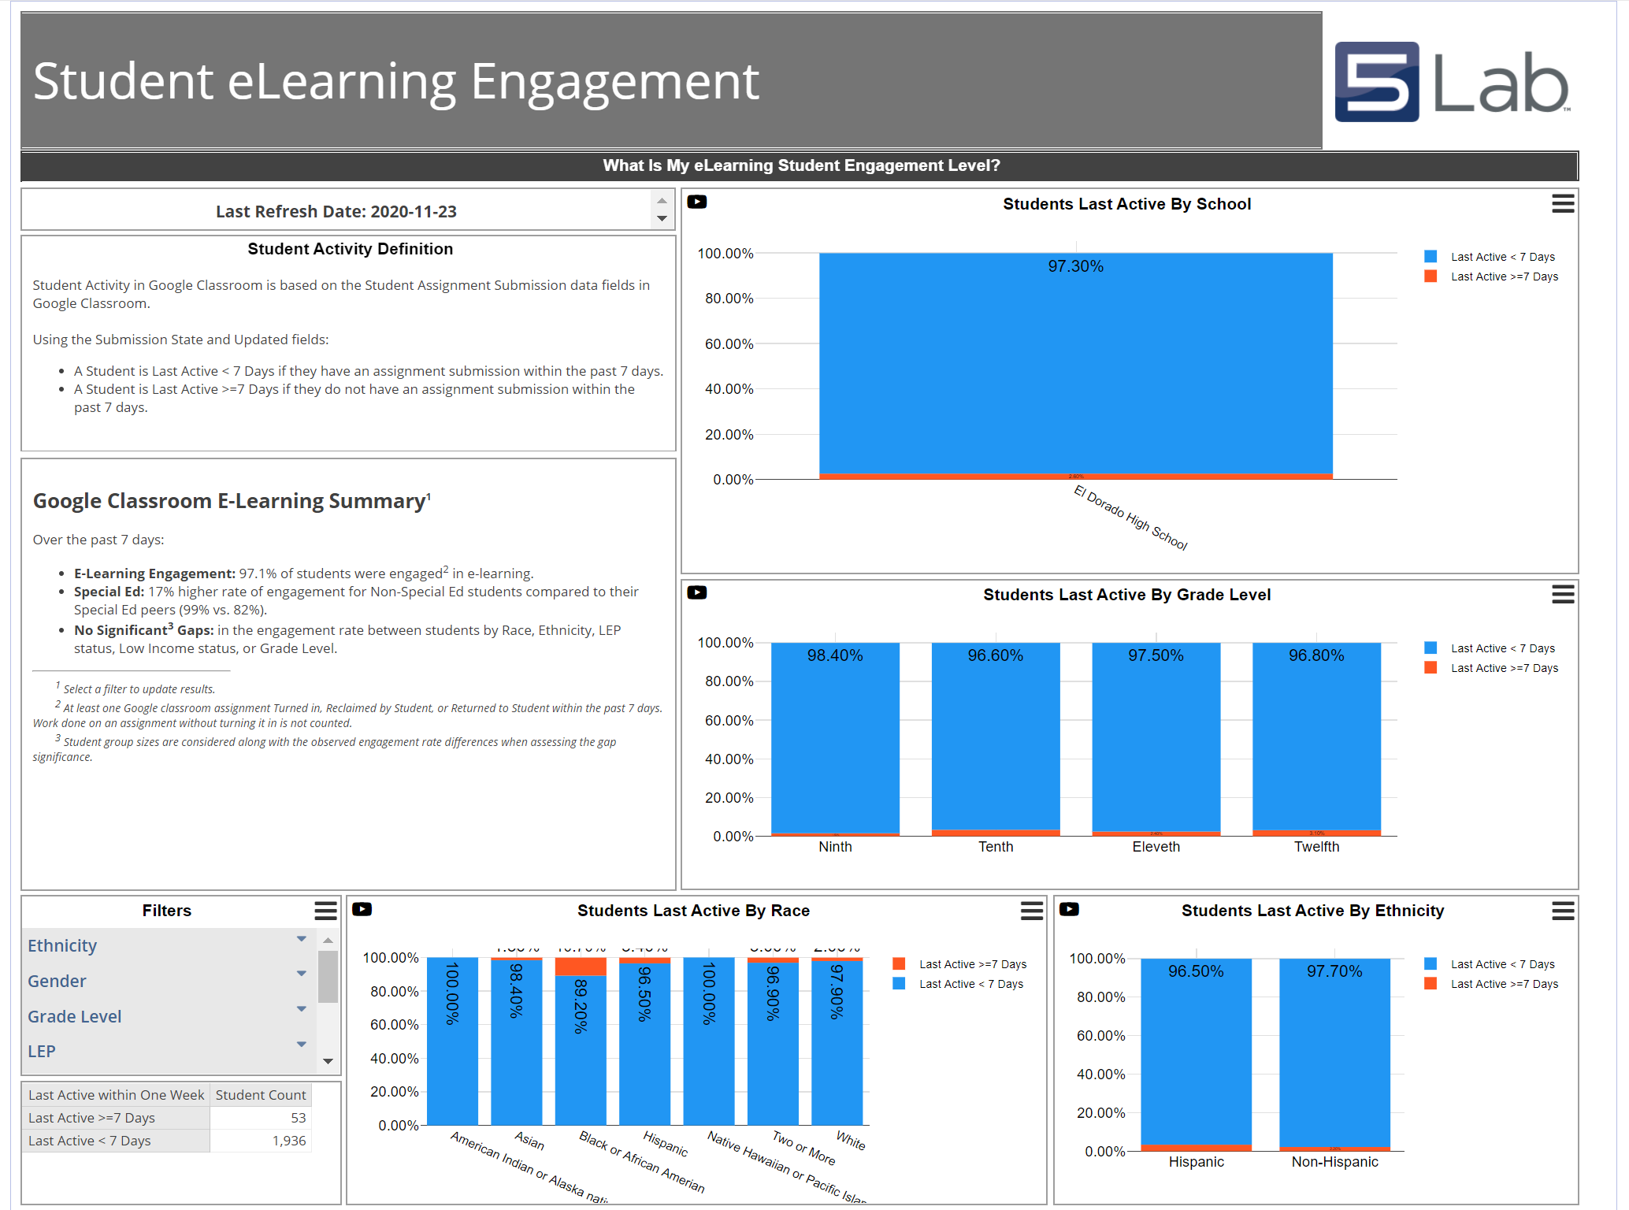
Learning – Who is engaged?
©2020 Forecast5 Analytics. All Rights Reserved.

Slide 33
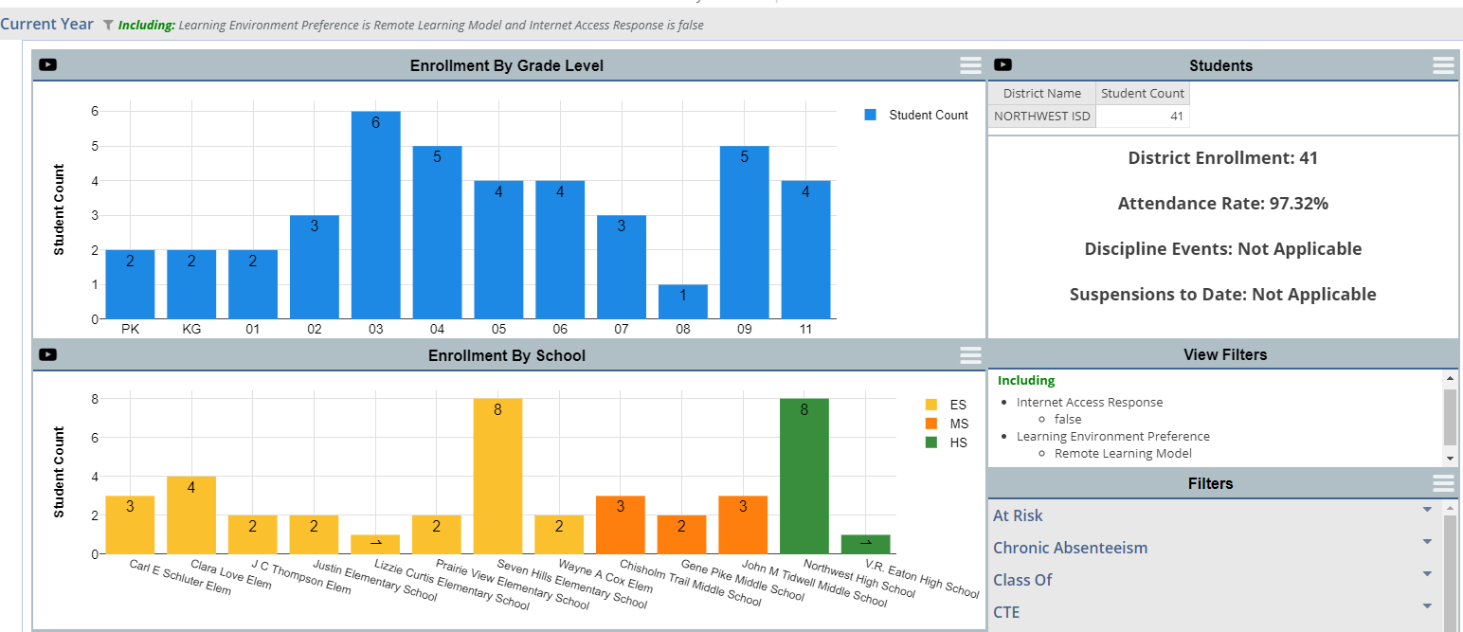
Who are our learners?

Slide 34
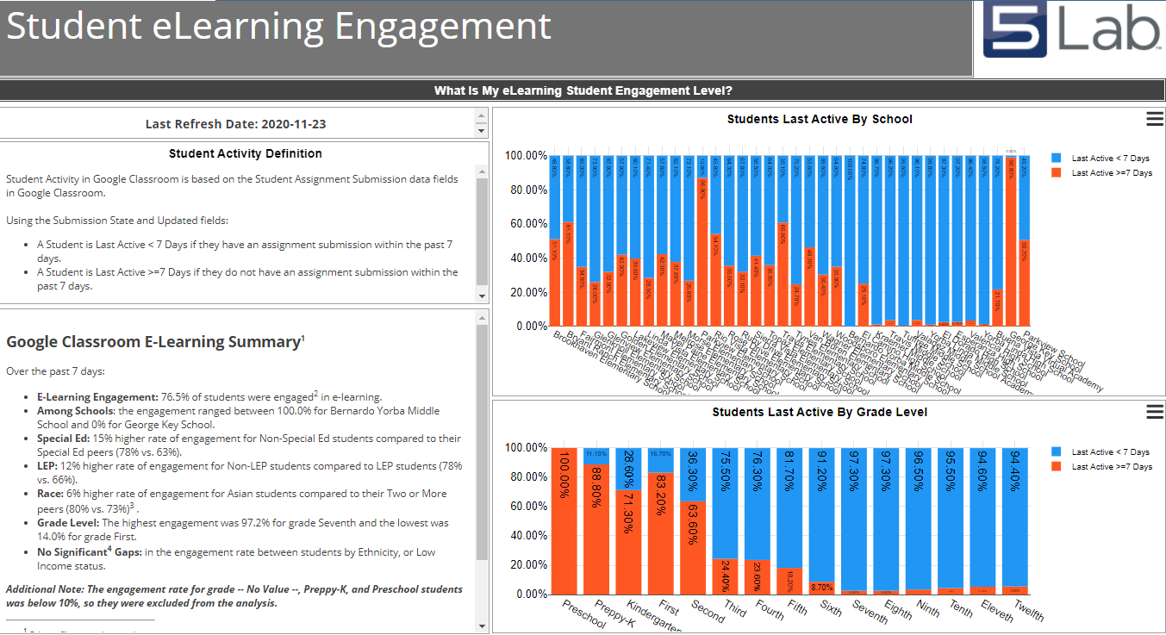
What is the engagement level of our students?

Slide 35
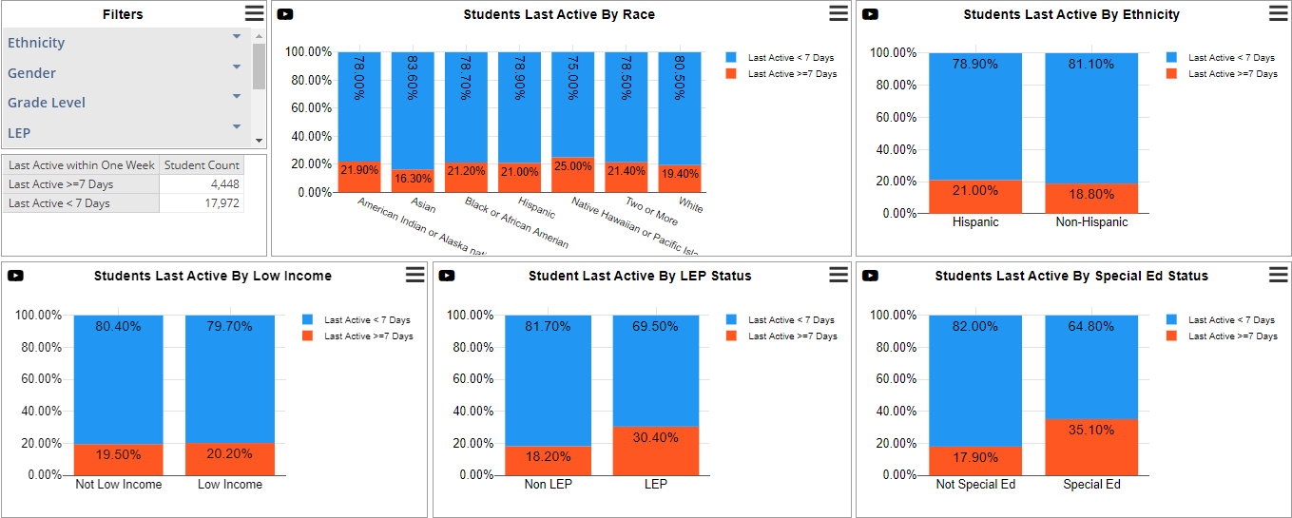
Is there equitable access for all students?

Slide 36
Know which students are not engaged

Slide 37
Was our staff prepared for Semester 1?

Slide 38
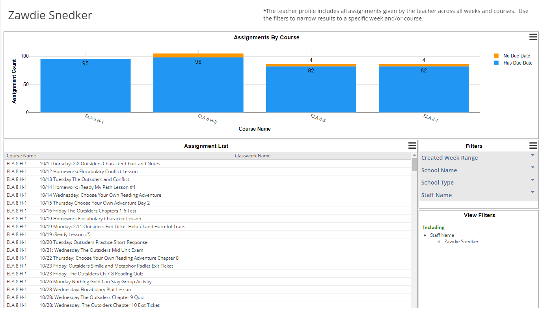
Instant Insight into Virtual Environments

Slide 39
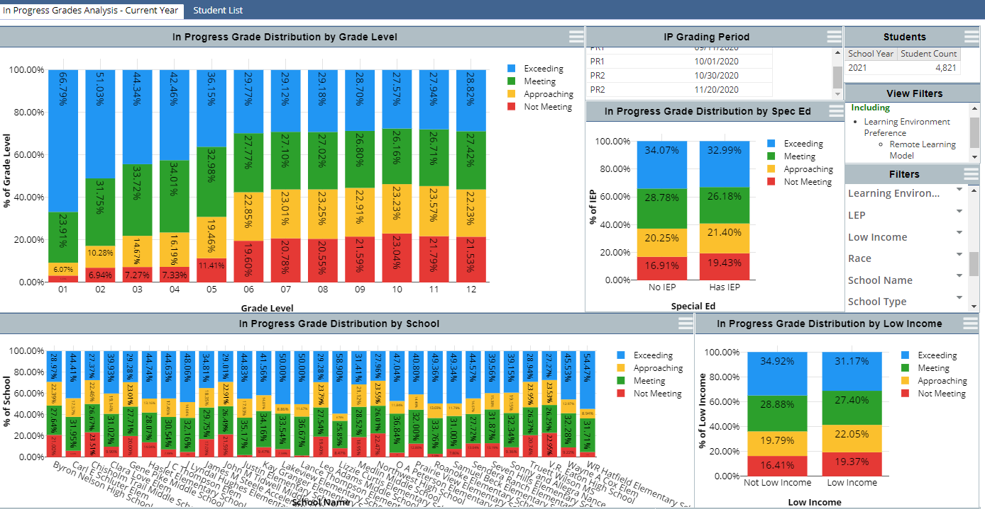
How did our students do in Semester 1?

Slide 40
Did Students Stay On-Track?
Use of Early Warning Indicators
©2020 Forecast5 Analytics. All Rights Reserved.

Slide 41
Are Students Staying On-Track for Graduation?
©2020 Forecast5 Analytics. All Rights Reserved.

Slide 42
Student Lists to Target Support
©2020 Forecast5 Analytics. All Rights Reserved.

Slide 43
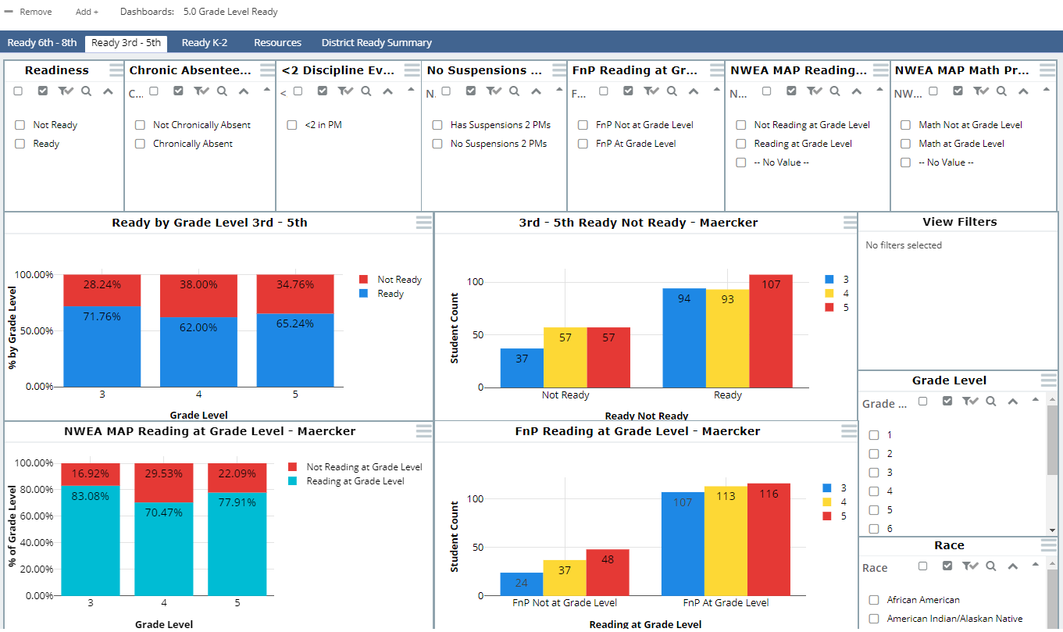
Tracking Next Grade Level Ready
©2020 Forecast5 Analytics. All Rights Reserved.

Slide 44
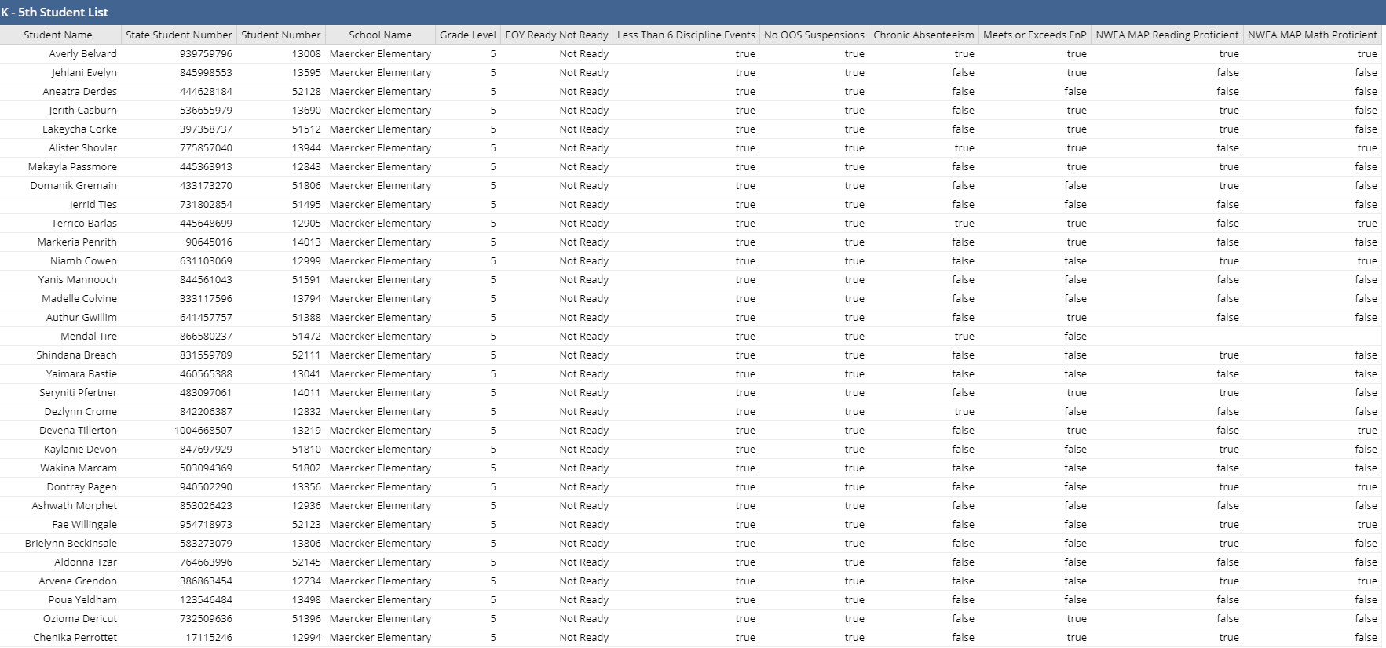
Tracking Next Grade Level Ready
ABILITY TO VIEW STUDENT BY STUDENT, NEXT GRADE LEVEL READINESS
©2020 Forecast5 Analytics. All Rights Reserved.

Slide 45
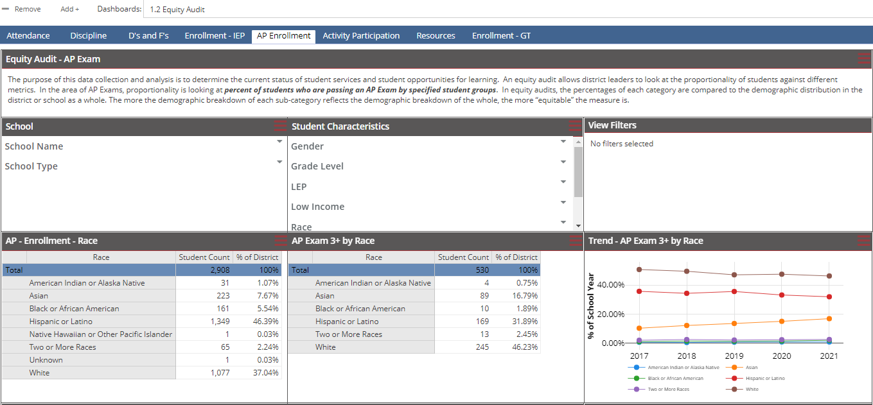
Maintaining a Focus on Equity
©2020 Forecast5 Analytics. All Rights Reserved.

Slide 46
Next Steps in Using Data to Drive Decisions
Further development of dashboards around college/ career readiness
Tracking of state assessment performance
Continued development of student profiles to track course performance and assessment history
©2020 Forecast5 Analytics. All Rights Reserved.

Slide 47
Any Questions?
Q&A

Slide 48
For More Information…
Visit our website: www.forecast5analytics.com
Learn more about The Critical Role of Data:
Contact Jeff Carew at jcarew@forecast5analytics.com

